Slide 1
SCLA Report
Minnesota District Convention
June 19, 2024
Brian Shult, Executive Director
Nate Kallies, Principal

Slide 2
SCLA Mission Statement:
Educating the total student
- spiritually, intellectually, physically -
in a caring, Christian family community.

Slide 3
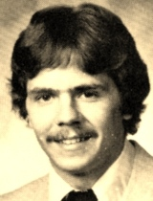
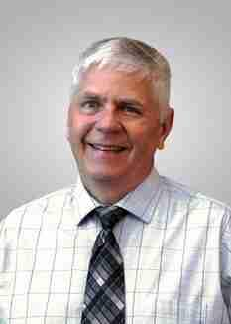
Thank you for your service!
Mr. Paul Weihing
Applied Tech/Rel 9
40 years of service
21 of them at SCLA

Slide 4
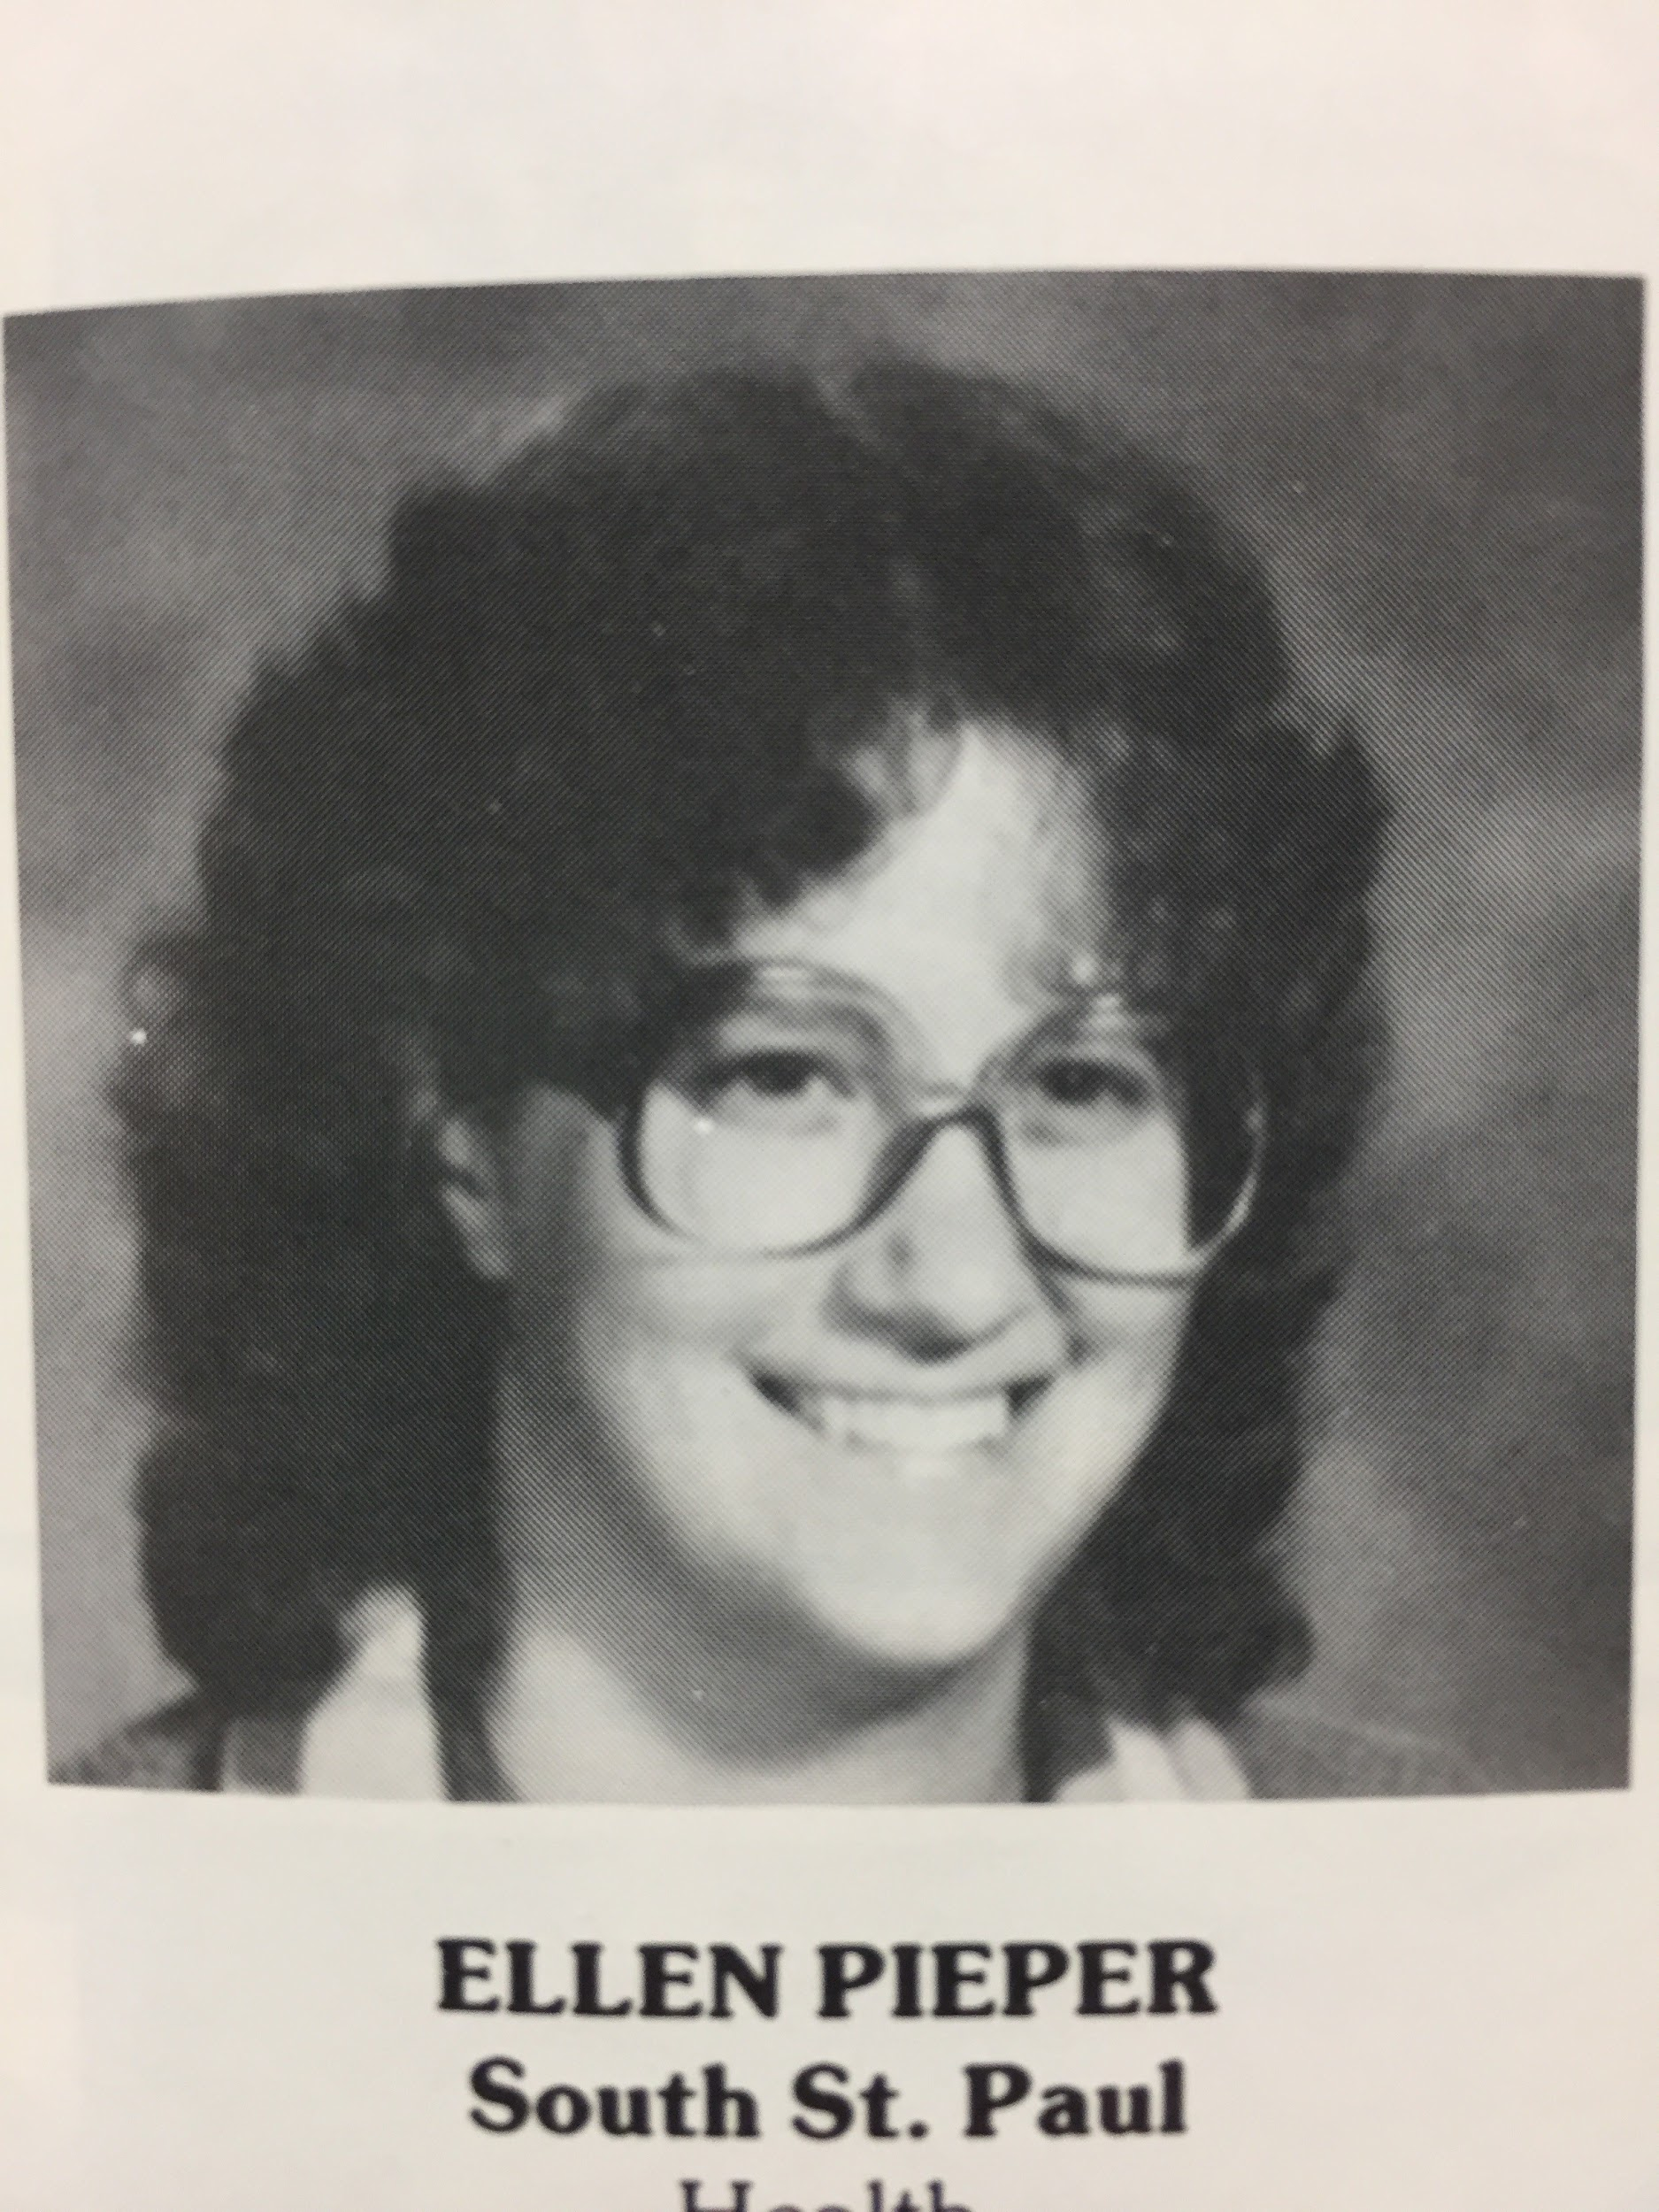
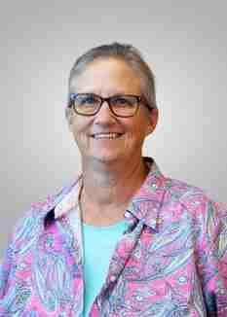
Thank you for your service!
Ms. Ellen Pieper
Social Studies/PE
45 years of service
All of them at SCLA

Slide 5
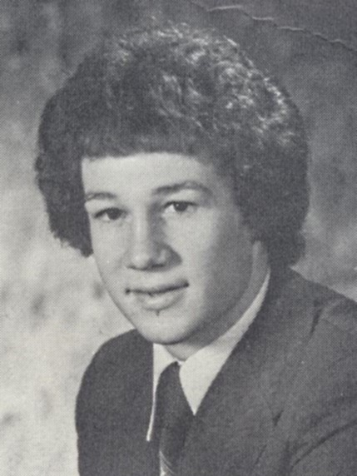
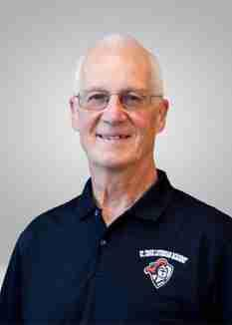
Thank you for your service!
Pastor Dave Huebner
Guidance/Anything we asked him to do
41 years of service
36 years at SCLA

Slide 6
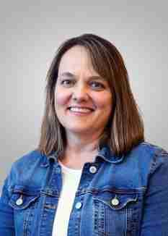
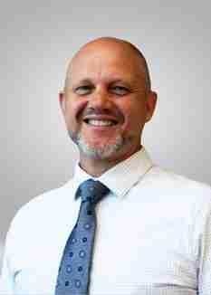
Thank you for your service!
Lorna Kapanke
Dave Mielke

Slide 7
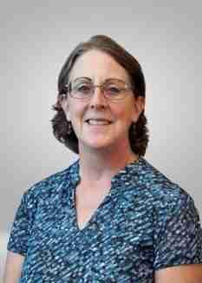
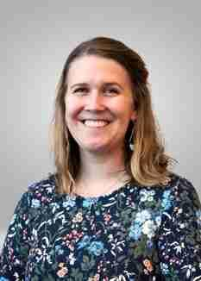
Thank you for your service!
Leanne Stob
Sarah Rieke

Slide 8
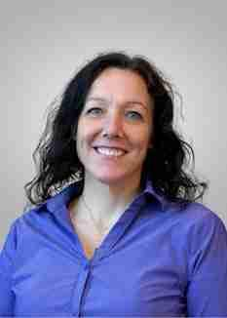
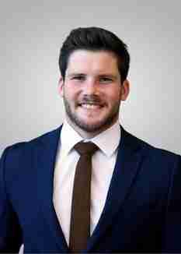
Thank you for your service!
Maria Reese
Kostia Skorenkyi

Slide 9
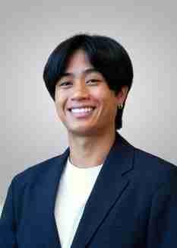
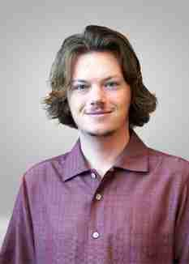
Thank you for your service!
Isaac McClosky
Greg Brisolara

Slide 10
New Teaching Staff
James Brohn, SS
Kincaid Diersen, Science
Andrew Grady, Dorm/SS
Riley Hillstrom, Dorm/Math
Jill Kock, ASL
Dave Liebhard, Science
Emily Mantz, English
Samantha Schoch, Dorm/PE

Slide 11
New Teaching Staff
Rev. Brad Snyder, Pastor/Counseling
Isaac Stellick, Dorm
Phil Sundblad, Applied Tech/STEM
Lori Unke, Dorm/Athletics
Summer Xu, Dorm/Mandarin
Abby Zuberbier, Learning Resource Center

Slide 12
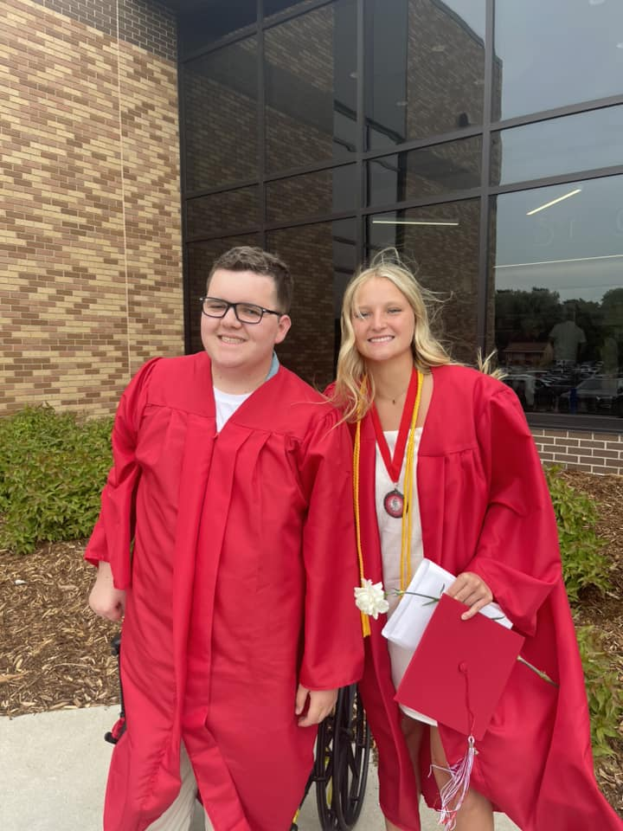
2023-24 Enrollment
Finished at 498
8th Grade: 43
Seniors: 102
98 International Students
22 Countries

Slide 13
Academic Update
PD Focus: Professional Learning Communities
PD Focus: Response to Intervention
Block Scheduling
American Sign Language
Cybersecurity
MS Woodshop
Dual Credit with Bethany (Applied Algebra/Stats and Computer Science)

Slide 14
The Social Institute
Proactive program used to fuel students’ health, happiness, and future success
Focused on social media use
Interactive lessons used in all 6-12 grade religion courses
Provides admin with snapshots of students’ mental state
Avenues available for staff and parent education

Slide 15
Under Construction
Classroom conversion to theater backstage
Soccer/Football Scoreboard
New track
HVAC
Tech Upgrades
Carpet
Teacher Workspace
Storage
Website Refresh

Slide 16
A look to the future…
Lord willing…
New spaces for applied tech/STEM (old boys’ dorm footprint)
Athletic space/gym/weight room (old girls’ dorm footprint)

Slide 19
