Slide 2
UPDATE ON WELS SPECIAL MINISTRIES
Rev. Patrick Feldhus

Slide 3
Notes:
Here are the 8 areas where WELS Special Ministries provides support and resources for those who are not served in the normal course of a congregation’s ministry

Slide 4
MINISTRY TO THE MILITARY
Notes:
WELS Ministry to the Military works to make God’s Word and Sacrament available to our actively serving military members and their families around the world

Slide 5
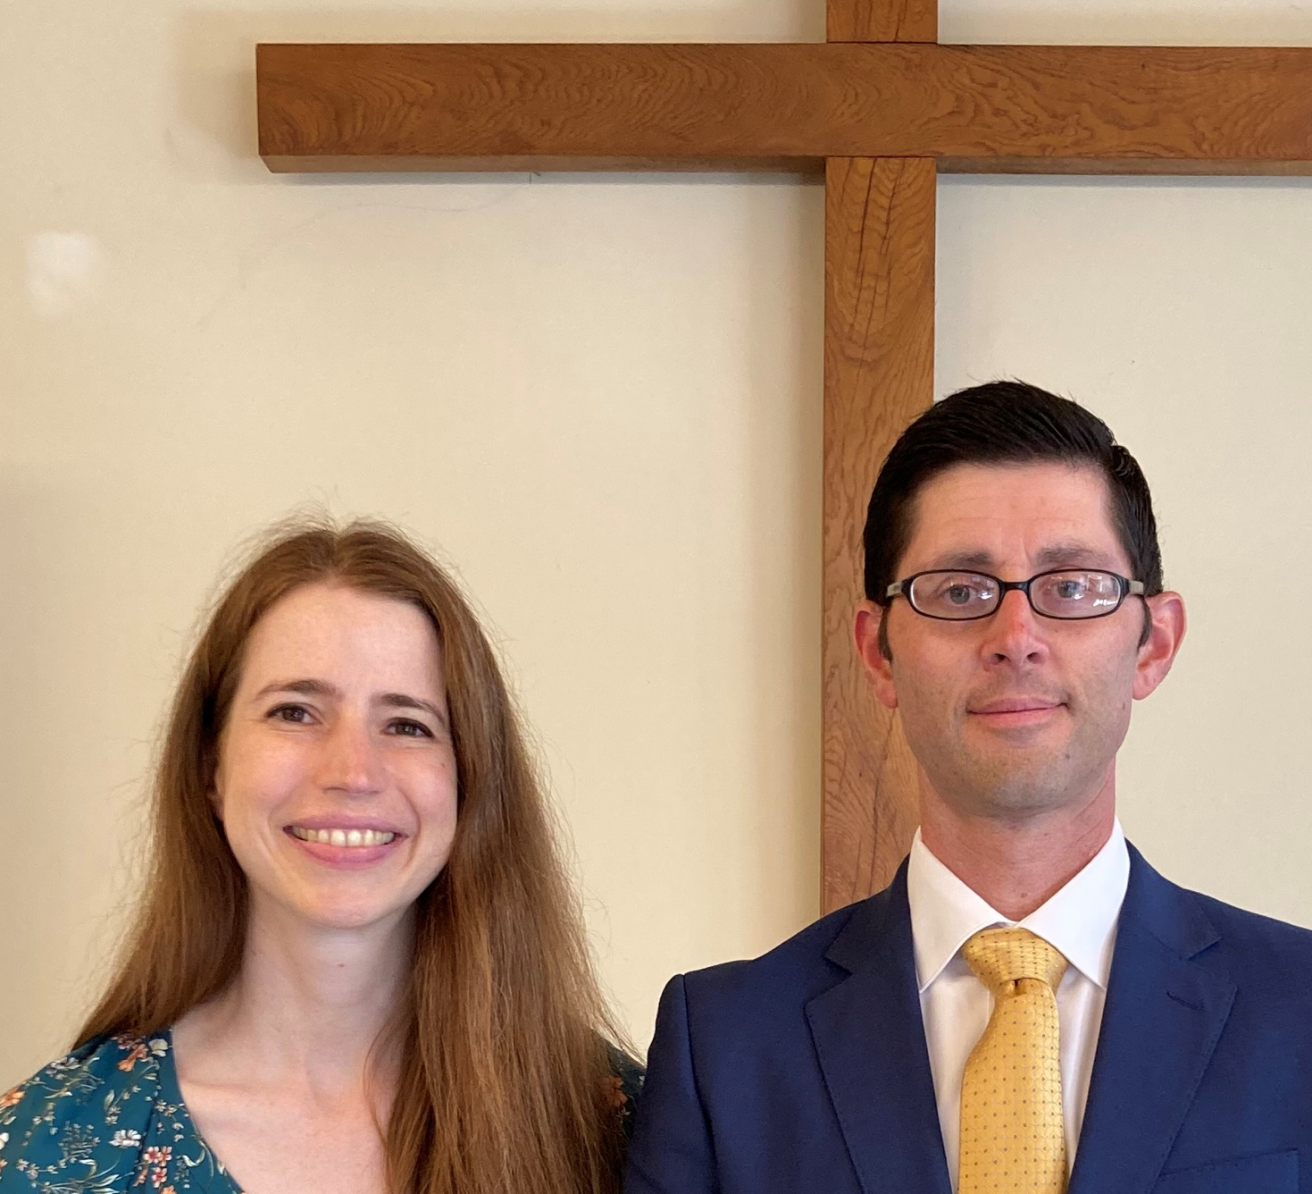
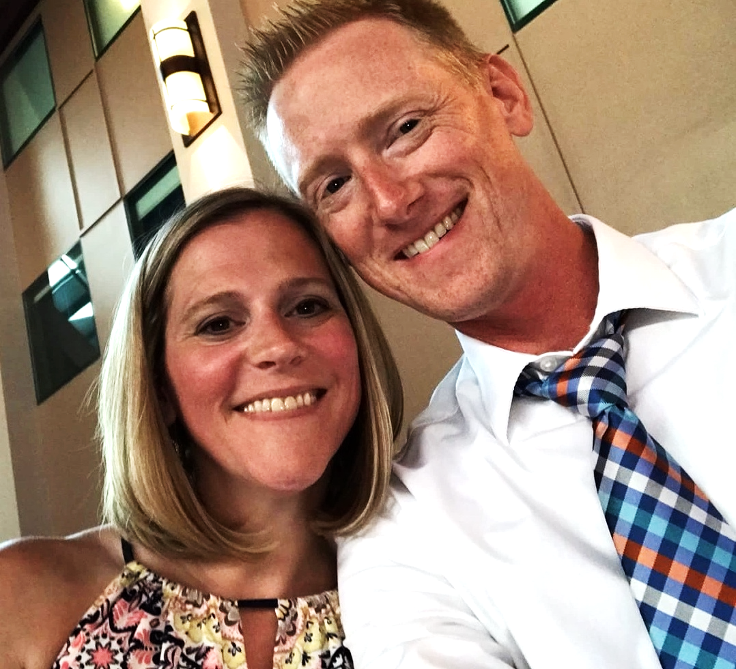
Ministering to our WELS military members
European Chaplain Rob Weiss and his wife, Rachel
National Chaplain Paul Horn and his wife, Becky
Notes:
We are blessed to have 2 full-time chaplains who lead the work of WELS Ministry to the Military. Chaplain Rob Weiss and his wife, Rachel live in Germany where Chaplain Weiss serves military members and other in Germany, Spain, Italy and Switzerland. National Chaplain Paul Horn and his family live in San Diego which gives Chaplain Horn contact with all the branches of the military.

Slide 6
wels.net/military
Spiritual Deployment kits
120+ Military Contact pastors
Weekly military devotions & others
Partnership with LMSG
Notes:
Please refer any active-duty military and National Guard members in your congregation by using the referral form at wels.net/military. Every referral receives a spiritual deployment kit. There are also 120 + military contact pastors around the country whose congregations are near to a military base. Could we please have all the military contact pastors in our district stand? Our national chaplain makes a military themed devotion available every Friday. We are also grateful for our partnership with and the support of The Lutheran Military Support Group.

Slide 7
PRISON MINISTRY
Notes:
WELS Prison Ministry seeks to get the Gospel to those who are incarcerated and their families.

Slide 8
Has been printed Bible study books
Transitioning to tablets in many institutions
Need for test correctors – prisonministry@wels.net
Notes:
While the work of prison ministry has historically been done via sharing printed Bible study books, much of that work is transitioning to tablets which the institutions make available. With this transition, we have seen an increase in tests returned and have a need for more test correctors. Please have those who are interested in being test correctors contact the Prison Ministry office at prisonministry@wels.net

Slide 9
MISSION FOR
THE DEAF
AND HARD
OF HEARING
Notes:
The Mission for the Deaf and Hard of Hearing makes Gospel centered resources available to those who are deaf or hard of hearing.

Slide 10
NEW!! Gospelhands.net – online dictionary
Weekly streamed signed services
Notes:
The newest resource from MDHH is Gospelhands.net – the first ever online dictionary of Christian religious signs. Also available on that page are weekly streamed signed services and sermons.

Slide 11
MINISTRY TO THE VISUALLY IMPAIRED
Notes:
The Mission for the Visually Impaired offers Gospel centered resources for those who are blind in a variety of formats

Slide 12
Limited Braille resources
Large print Forward in Christ
Listen.WELS.net
Notes:
Braille resources are rather limited. There is a large print version of Forward in Christ available. Since many people who are blind are looking to audio resources, MVI offers audio recordings of Meditations. Forward in Christ, about half of The Peoples Bible commentaries and other resources at listen.wels.net

Slide 13
INTELLECTUAL
AND
DEVELOPMENTAL
DISABILITY
MINISTRY
Notes:
The Intellectual and Developmental Disability Ministry committee seeks to serve those with special needs in our congregations by providing congregational encouragement and resources.

Slide 14
Coming soon - S.M.I.L.E.S
Resources for confirmation of individuals with special needs
Notes:
Very soon they will be releasing a number of resources to help a congregation do a SMILES service which is another version of a sensory friendly worship service for those with special needs. A reminder that IDDM also has resources available for confirmation instruction for those with special needs.

Slide 15
MENTAL HEALTH NEEDS COMMITTEE
Notes:
You are likely aware of the growing mental health crisis in our country. The Mental Health Needs Committee makes available many resources to help those who deal with these challenges in a number of areas

Slide 16
Christiantherapistnetwork.com
Conquerors through Christ
Freedom for the Captives
Resilient Recovery
Notes:
The Christian Therapist network seeks to make Christian counselors available all across our country. Conquerors Through Christ provides positive Gospel-centered support for those who struggle with addiction to pornography. This group also has available a Christian sex education curriculum for parents and Lutheran Elementary Schools. Freedom for the Captives provides training to prevent child abuse in our churches and schools and also support for those who have been abused. Resilient Recovery offers online support for those who seeking to recovery from alcohol and other addictions. MAP program in connection to CFS.

Slide 17
CARE COMMITTEE FOR
CALLED WORKERS
Notes:
The Care Committee for Called Workers encourages every congregation to have their own Care Committee for Called workers.

Slide 18
Every congregation is encouraged to have one
Recently updated CCCW manual for congregations
download at:
https://wels.net/serving-you/christian-life/special-ministries/care-for-called-workers/
Notes:
Several months ago CCCW released an updated CCCW manual for congregations which you can download from their page on the WELS website.

Slide 19
CHRISTIAN
CARE
COMMITTEE

Slide 20
Chaplain Certification
Notes:
The Christian Care committee encourages called workers and members in our congregations to consider chaplain certification to serve those in senior living facilities, our first responders, those in the military and others

Slide 21
For more information on any of the areas of Special Ministries,
Please contact:
Rev. Patrick Feldhus
920-918-9949 pfeldhus@hotmail.com
or
Pastor Joel Gaertner – Director of WELS Special Ministries
Cell: (920) 517-0381 joel.gaertner@wels.net
Notes:
I am privileged to serve as your District special ministries coordinator – please contact me if you would like more information on any of the areas mentioned. Also on the screen is the contact for our synod Director of Special Ministries if you would like to contact him about any of these areas. Thank you for your time and attention!

