Slide 1
Mission partners in 46 countries
47 missionaries (and counting!)
Prospective mission fields in 19 new countries…
Give thanks to the Lord!
WELS WORLD MISSIONS
Notes:
WELS World Missions conducts gospel outreach in 45 countries and is exploring outreach opportunities in 19 prospective new mission fields. World Missions brings the light of God’s Word to the world through evangelism efforts, church planting, training national workers for ministry, and providing religious materials in foreign languages through Multi-Language Productions (MLP).
World Mission supports mission work:
on Native American reservations, where the gospel is being shared on the Apache reservations in Arizona and exploratory mission work is beginning on other reservations throughout North America;
in Africa, where missionaries are partnering with national church bodies in seven countries and are exploring outreach in at least six more countries throughout the continent;
in Asia, where 16 missionaries have joined together to equip, encourage, and empower others to bring the good news of Jesus Christ to 1.8 billion unreached souls;
in Latin America, where hundreds of thousands of people are being reached through Academia Cristo online courses and more than 25 individuals are actively leading a group in worship and study;
in Europe, where missionaries partner with national churches to train the next generation of church leaders and bring the true gospel to countries without a strong Lutheran presence;
and through Multi-Language Productions, which has produced materials in more than 56 languages and reaches tens of thousands of English-speakers in more than 30 different countries through the TELL online training platform.

Slide 2
Notes:
https://vimeo.com/757979242

Slide 3
Worldwide network of Mission Partners
Notes:
The Board for World Missions (BWM) has four main functions:
Reach out to those who have not heard about Jesus yet.
Reach out to church bodies who contact us asking for help.
Mentor and train pastors and leaders to be confessional Lutherans.
Support this work in many languages through the production of materials such as videos, literature, publications, websites, advertising, and gospel tools through Multi-Language Productions.

Slide 4
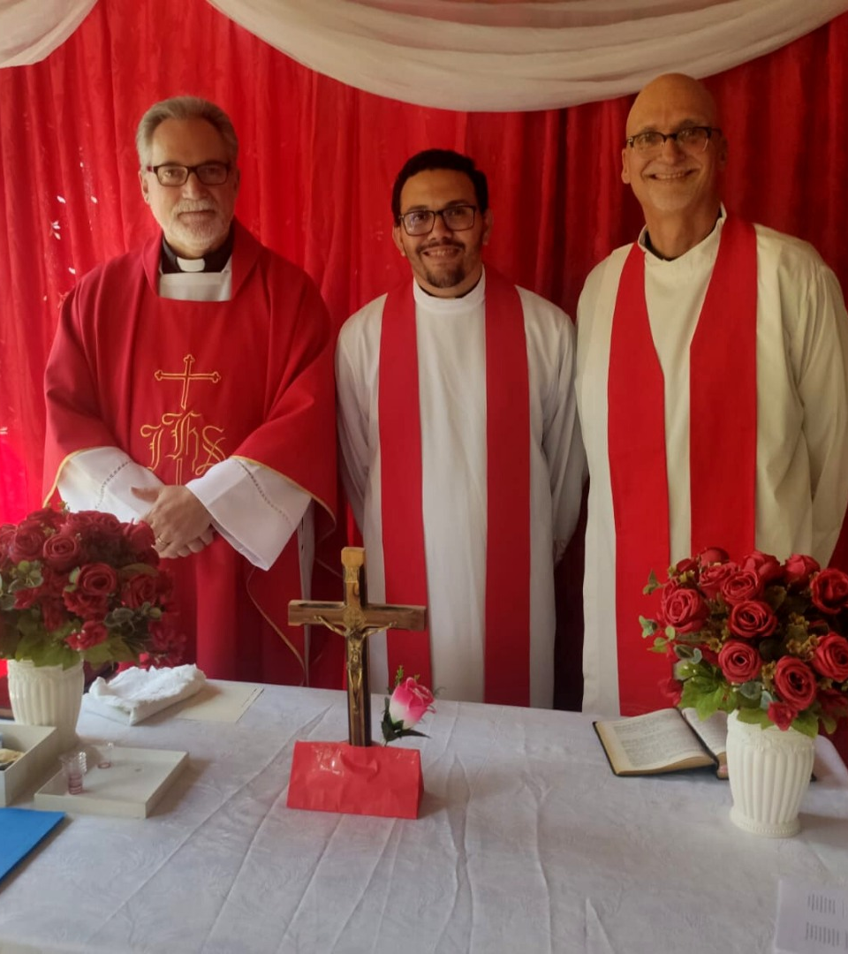
Sister synod in Portugal commissions missionary in Brazil
Notes:
WELS is working with sister synods around the globe as they embark on their own mission efforts. One example is the Lutheran Church of Portugal. Rev. Denicio Godoy connected online with Rev. Artur Villares, President of the Lutheran Church of Portugal, and took classes with him to be colloquized as a Confessional Lutheran pastor.
Rev. Denicio Godoy was ordained and commissioned as a missionary in Brazil on April 3, 2022. The celebration took place in Dom Cavati and was officiated by Rev. Villares and Rev. Kenneth Cherney, Old Testament professor at Wisconsin Lutheran Seminary and WELS pastor. Rev. Godoy is conducting outreach in Brazil as a mission arm of the Lutheran Church of Portugal, with support from the WELS Europe team and continued encouragement from Rev. Cherney.

Slide 5
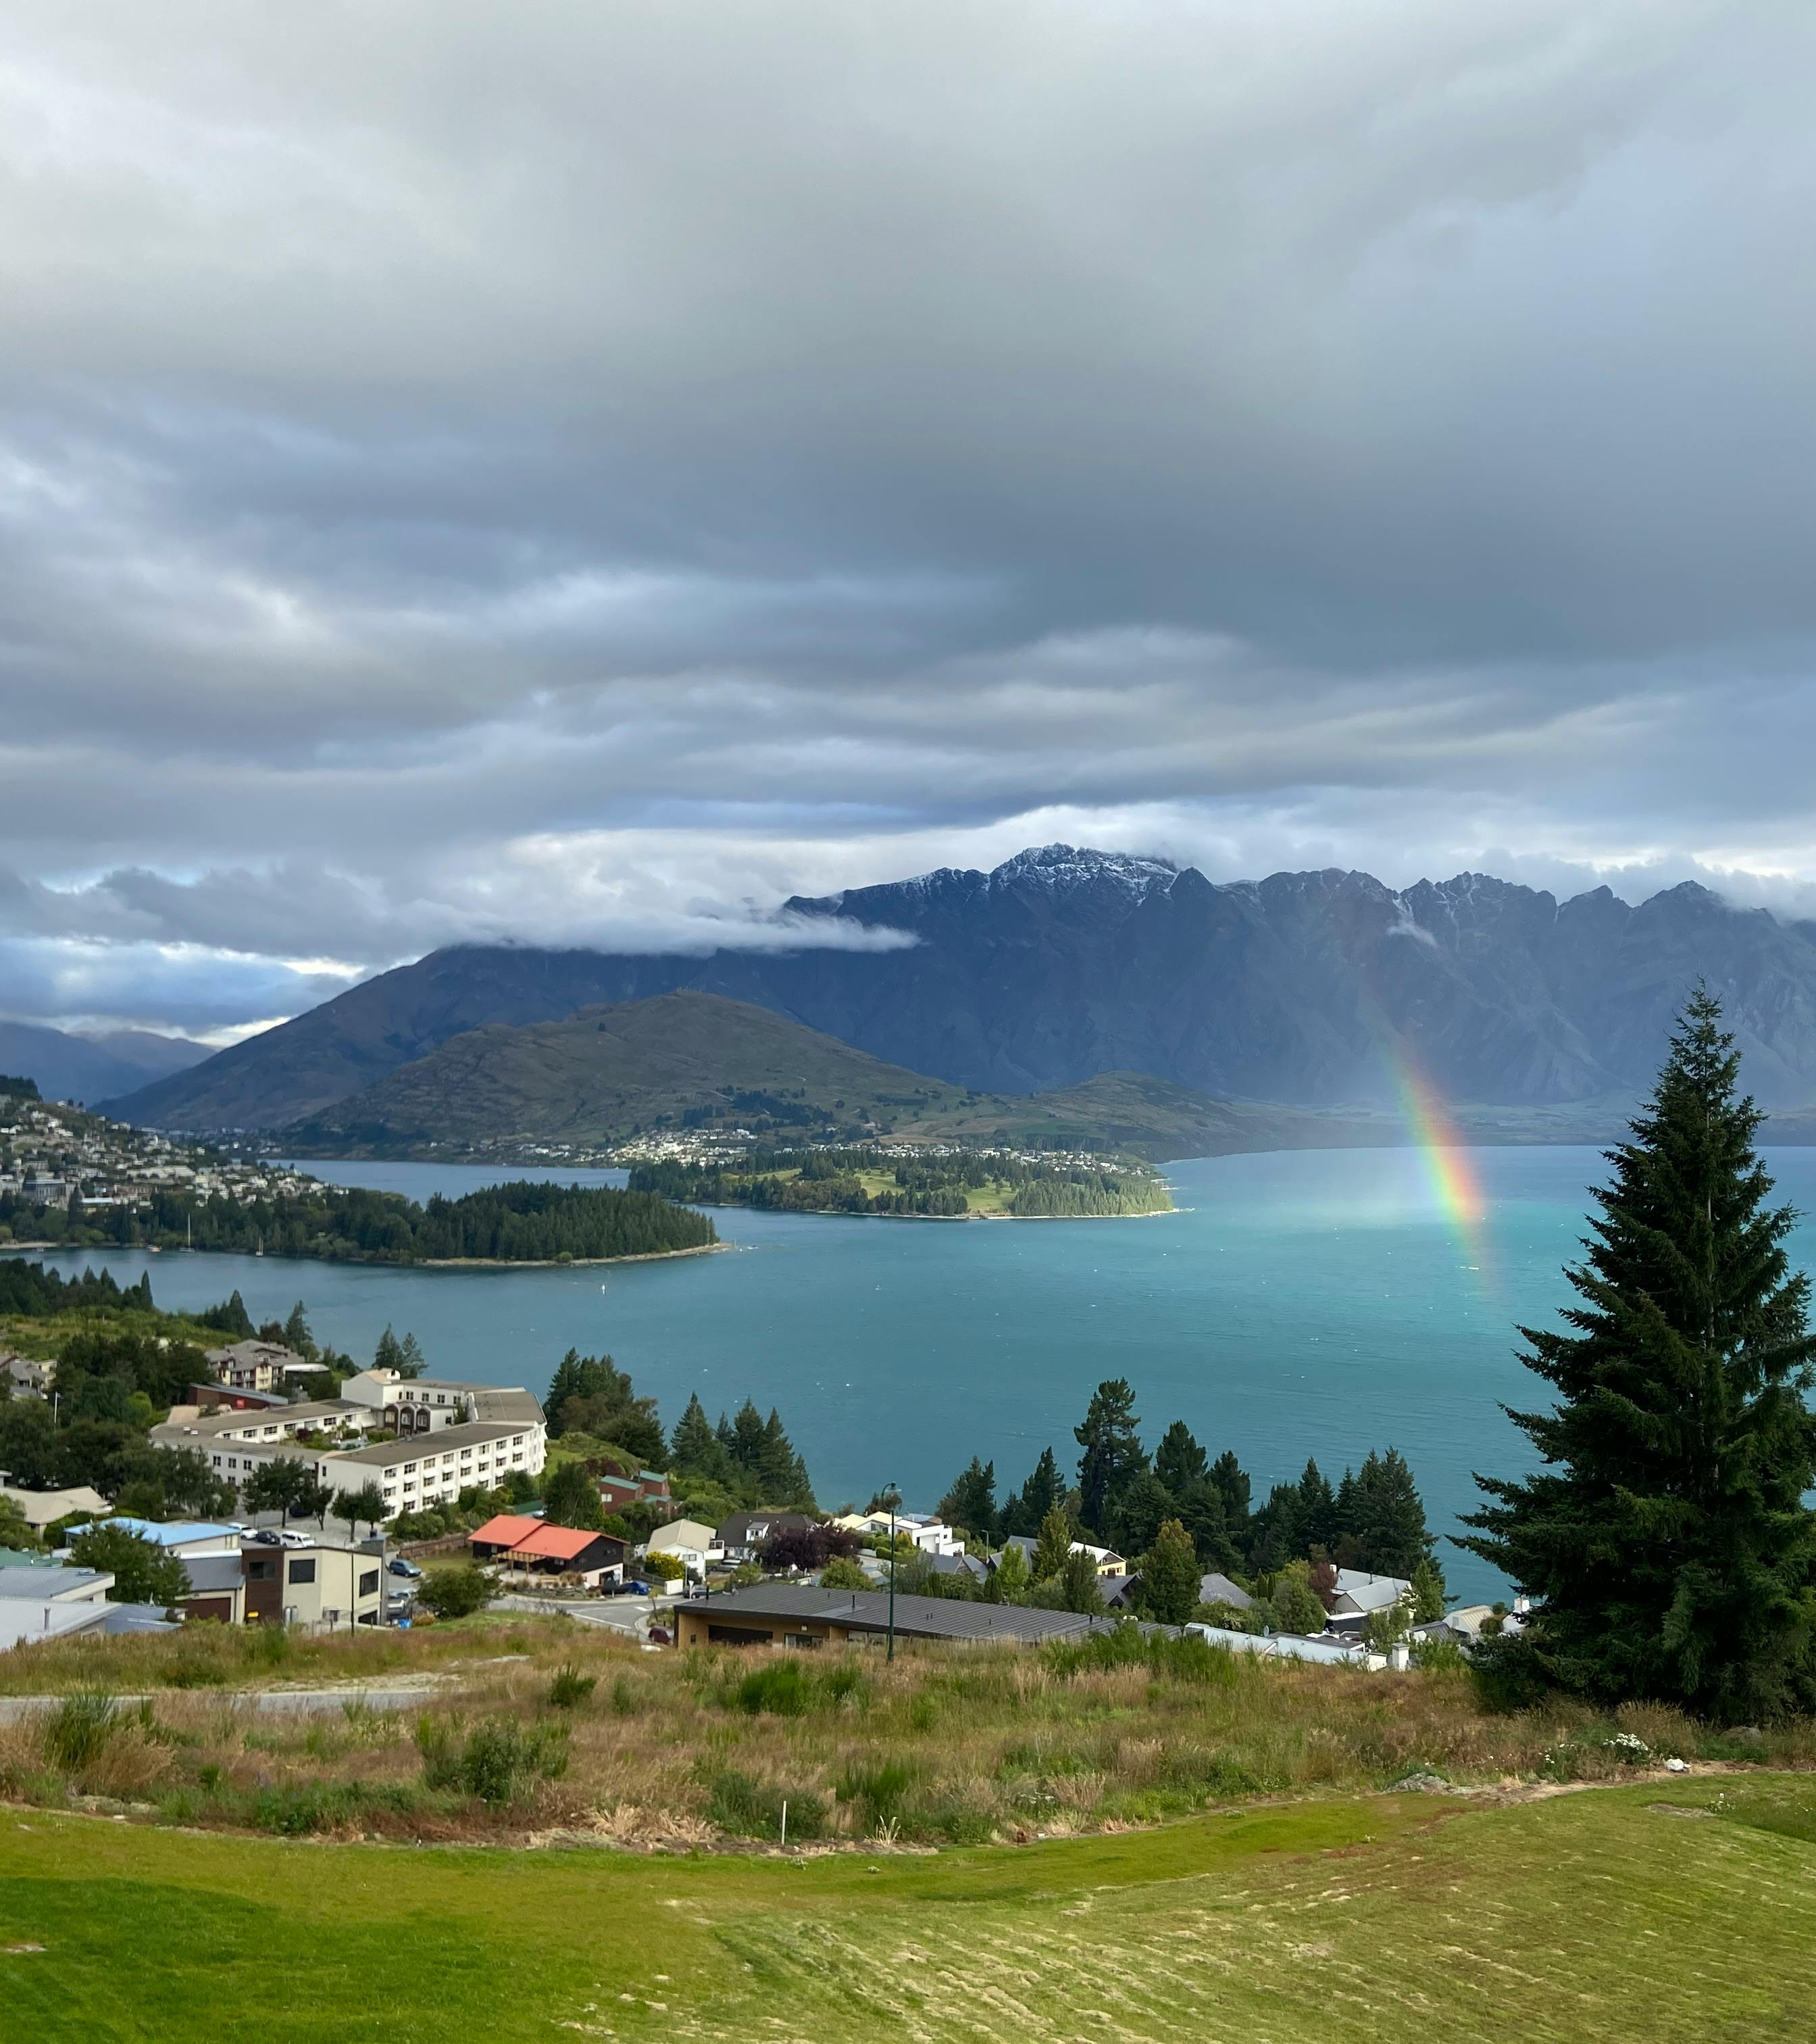
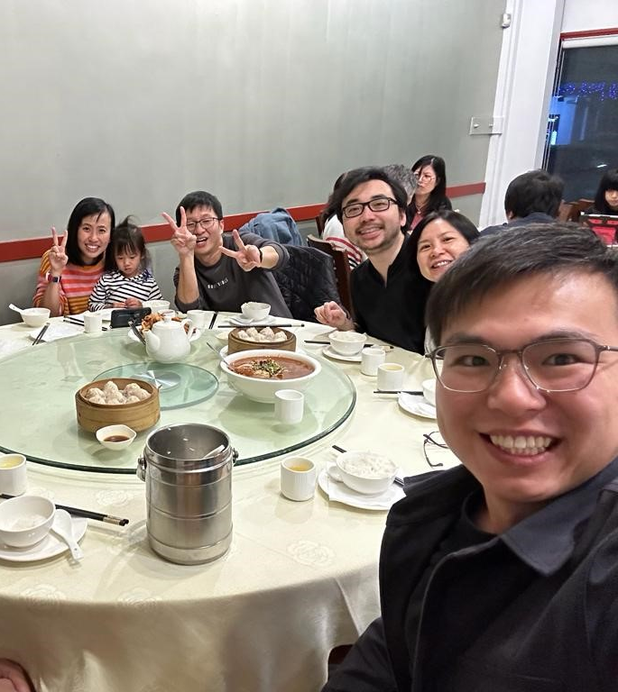
New mission work in New Zealand through SALEM in Hong Kong
Notes:
Over three years ago, a few South Asian Lutheran Evangelical Mission (SALEM) members who immigrated from Hong Kong to New Zealand began meeting online with SALEM leadership for Bible Study and fellowship. This group, located in Auckland, has grown to over 20 members. In January 2023, they began a monthly worship gathering facilitated by local leaders, and they continue to meet every week online and in person. Thirteen members of their group are currently enrolled in a foundational course at Asia Lutheran Seminary. These brothers and sisters welcome all newcomers to their group with open arms. They want to see many more Chinese-speaking people brought to faith and strengthened in Christ, and there are countless opportunities to do just that. Chinese people already make up five percent of the population of New Zealand, and experts predict that this number will grow to ten percent in the next 20-30 years. WELS is excited to continue assisting our sister church SALEM as they foster this new mission in New Zealand.

Slide 6
Missionaries partnering in Australia
Notes:
Representatives from WELS World Missions, Asia One Team, Commission on Inter-church Relations (CICR), and Evangelical Lutheran Synod (ELS) visited Australia in December 2023 to explore outreach opportunities. They met with two independent Lutheran churches in Brisbane and Maryborough, one of which is a member of the Confessional Evangelical Lutheran Conference (CELC), as well as members of our sister synod in Hong Kong who have immigrated to the area to discuss outreach partnerships. As a result of this visit, two missionaries from the Asia One Team, currently based in Chiang Mai, Thailand, agreed to relocate to begin outreach based in Brisbane, Queensland, Australia. (More on slide in outreach section)

Slide 7
Powerful partnerships with existing churches in Latin America
Notes:
WELS has powerful partnerships with existing churches in Latin America (Colombia, Venezuela, Haiti, Dominican Republic, Bolivia, Mexico, Puerto Rico, Chile and Peru), and they’ve worked together to design Academia Cristo and explore new connections. Iglesia Cristo WELS Internacional, a new synod made up of WELS sister churches across five countries throughout Latin America, helps facilitate this partnership.
One example: WELS’ sister church in Colombia, Luteranos Confesionales Colombia, celebrated the 50th anniversary of their synod in February 2024. What began as a three-man WELS missionary team has now extended through national leadership into many new cities in Colombia and continues to exponentially grow through the online presence of Academia Cristo. Pastor Henry Herrera, pictured far right, is instrumental in this work. As students from Colombia advance through the Academia Cristo program and are equipped to start groups, they are connected to leaders in the Colombian national church, like Pastor Herrera, who also serve as Academia Cristo professors and mission counselors and helps visit the most promising Academia Cristo students in the country. Pastor Herrera also serves as a bishop for a new Wisconsin Lutheran Seminary vicar each year, helping provide WLS students with valuable world missions experience.

Slide 8
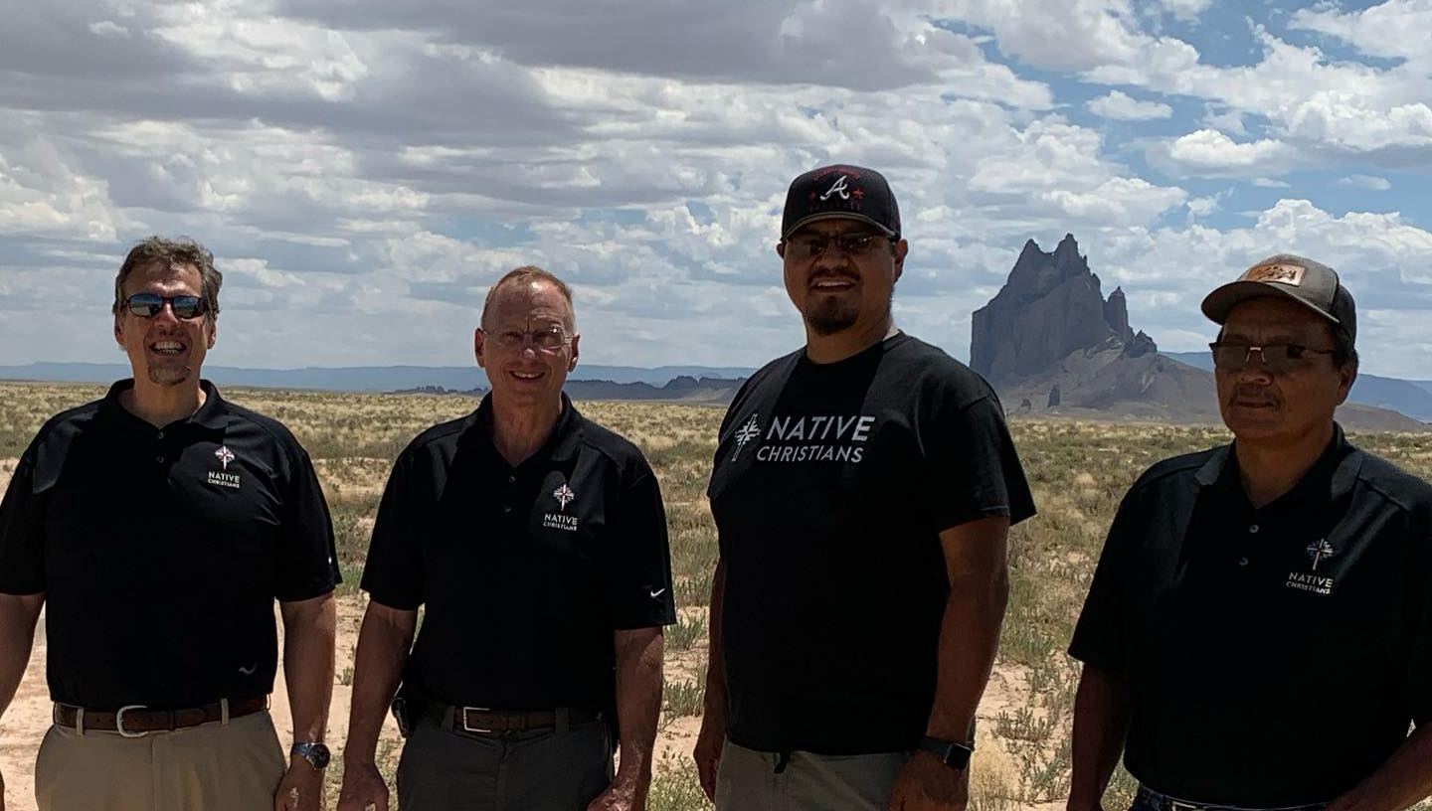
Native Apache Christians reaching out to friends and family from other tribes with the gospel
Notes:
In thanksgiving to God for 125 years, Native Christians was formed in 2018 to reach out to other Native American Tribes. Apache Christians are ready to serve as missionaries to the 572 tribes in the U.S. and more in Canada. The first outreach effort will be to the four corners area where there are four tribes and four colleges.
Pictured: The Native Christians team on an exploratory trip to the Four Corners region in July 2023. From L to R: Rev. Dan Rautenberg (Native American mission field coordinator), Rev. John Holtz, Rev. Kirk Massey Jr. (Apache pastor), Apache lay leader

Slide 9
Training Mission Partners

Slide 10
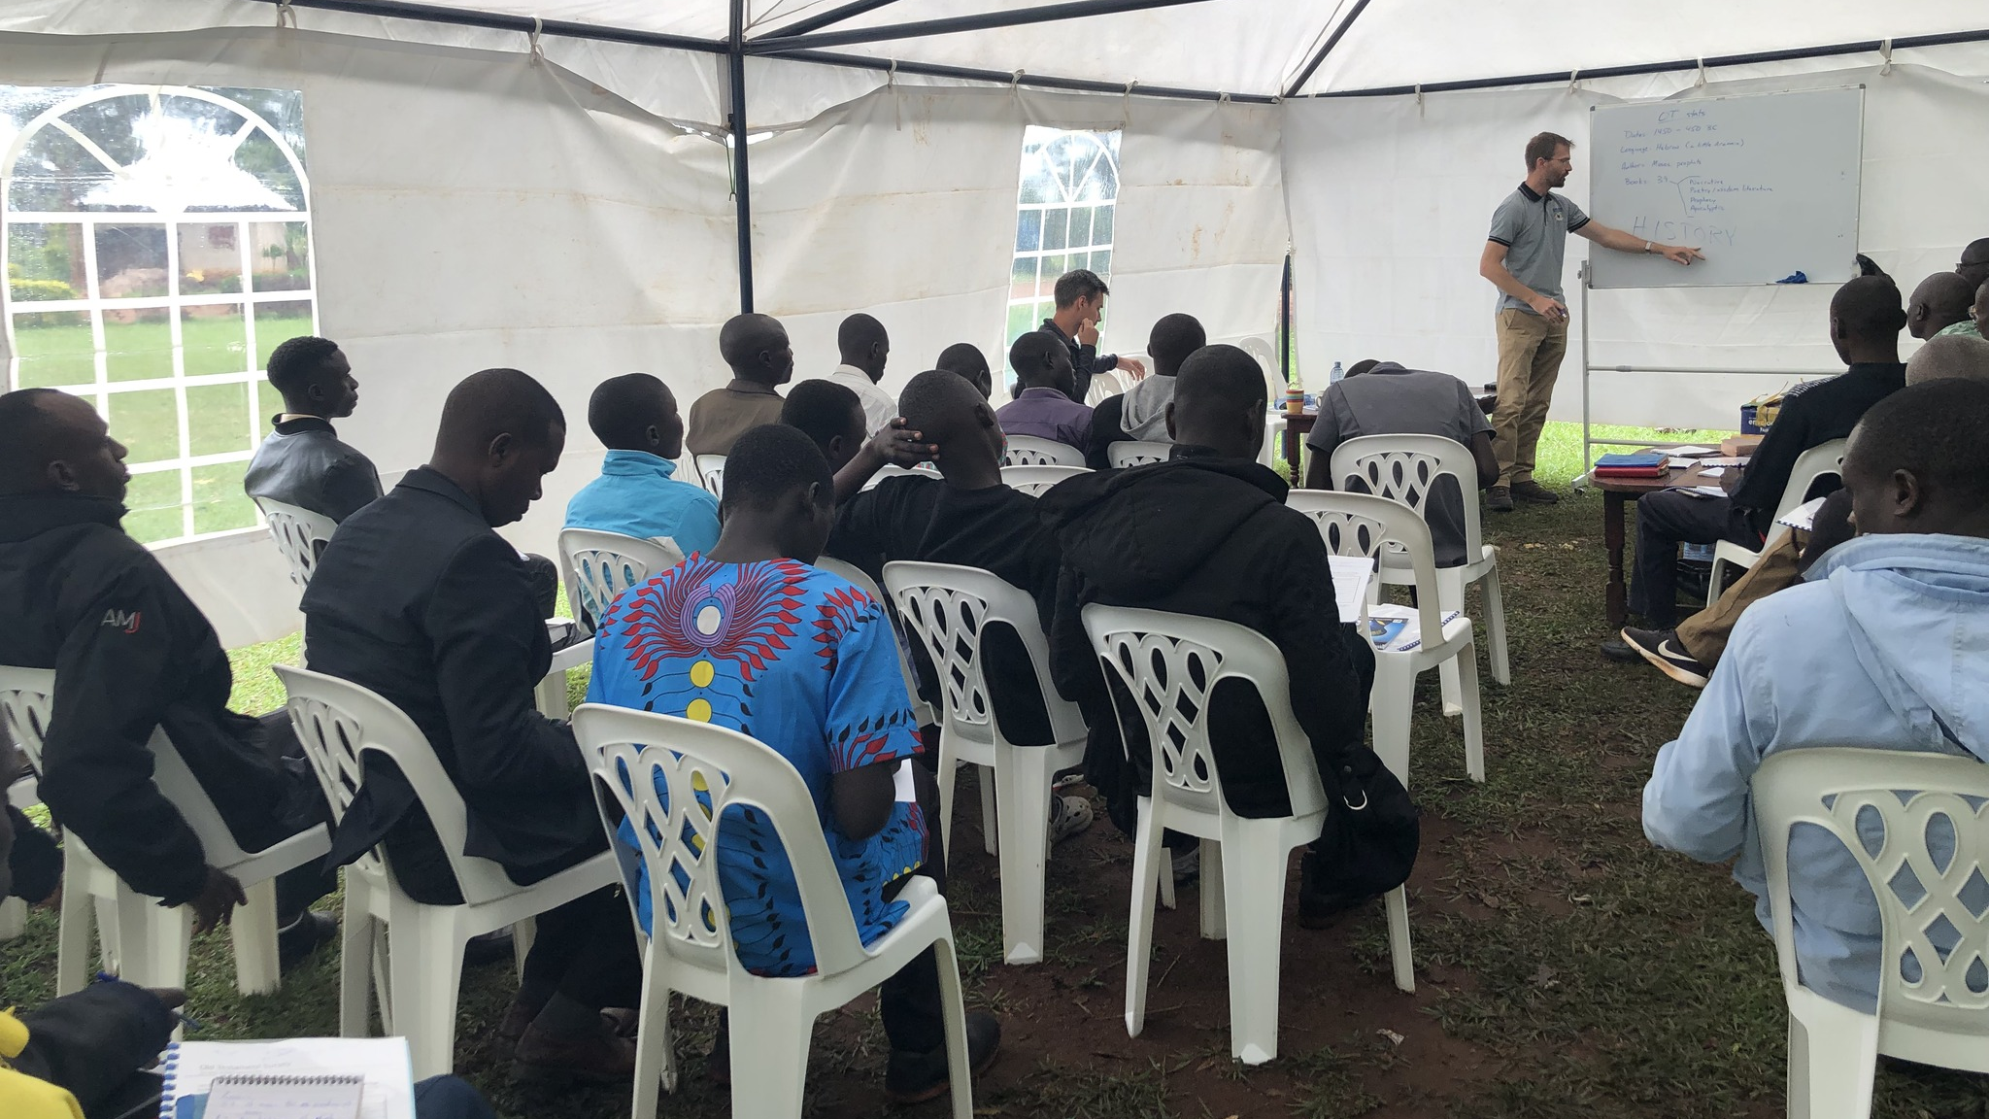
Longstanding theological education in Africa and opportunities in even more countries
Notes:
Previous WELS mission efforts have led to strong, independent church bodies in Zambia, Malawi, Nigeria, and Cameroon. Missionaries work closely with sister synods to support their seminary program. In addition, the Confessional Lutheran Institute, the theological education arm of the One Africa Team, is currently providing a Bachelor of Divinity degree program (BDiv) to 17 pastors and a Master of Theological studies (MTh) program for 3 pastors in addition to providing professional development and continuing education courses for pastors at all our African sister synods.
Individuals and church groups in additional African countries have reached out to WELS for fellowship and theological training. Fellowship has been declared with sister synods in Ethiopia, Kenya, and Uganda, and the One Africa Team continues to partner with them in training the next generation of church leaders. Missionary Ben Foxen is pictured leading a workshop for pastors of the Obadiah Lutheran Synod in Uganda. The One Africa Team is also visiting groups and synods seeking partnerships and teaching confessional Lutheran doctrine to future partners in Tanzania, Democratic Republic of the Congo, Cameroon, South Sudanese refugee camps, and more.

Slide 11
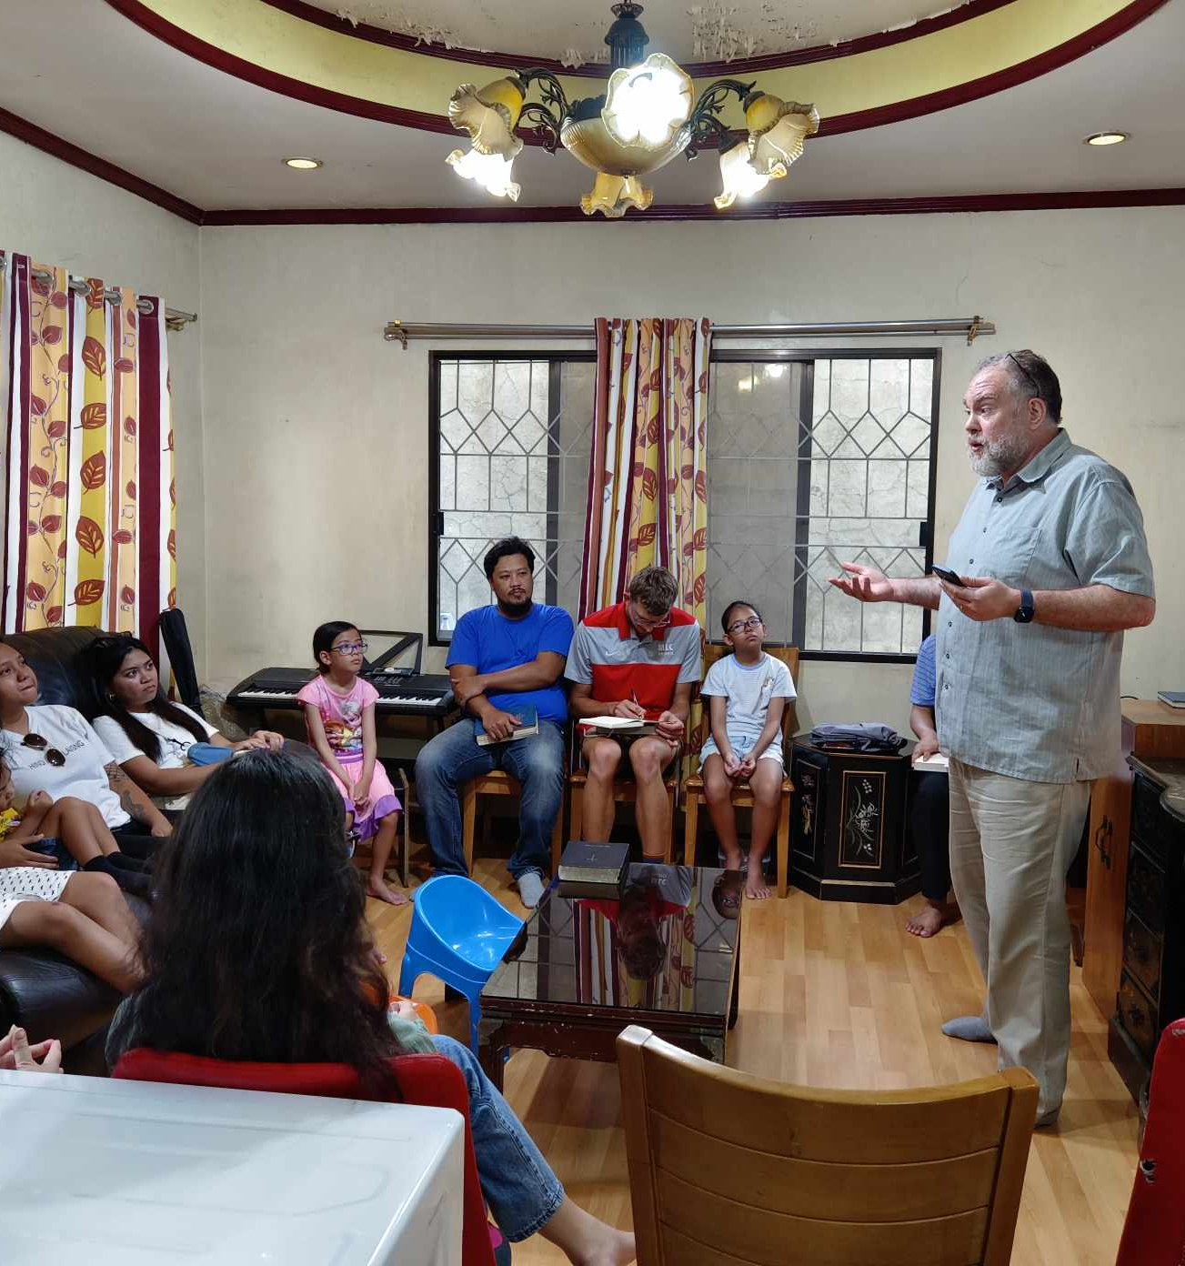
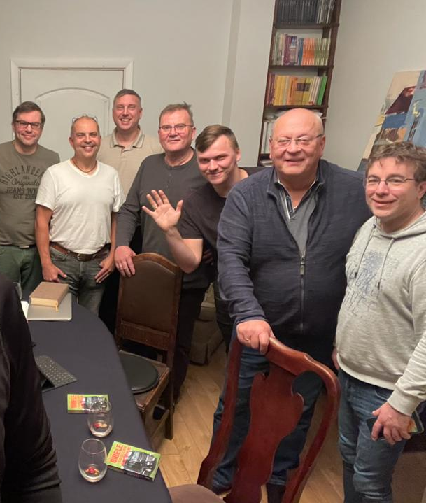
WELS-provided regional training through existing seminary programs
Notes:
In May 2023, the Asia Lutheran Seminary Governing Board approved an exciting expansion of ALS – the Regional Theological Education Program (RTEP). Under the leadership of new Asia Lutheran Seminary professor and World Missionary Guy Marquardt (pictured teaching on left), the RTEP will became a branch of ALS which coordinates visiting instructors, curriculum materials, consultation, and other assistance to training programs throughout Asia. The goal is to provide solutions to people in unique situations so that anyone who wants to study theology can study theology. The RTEP is currently working with programs/students in places like Nepal, Pakistan, Bangladesh, Indonesia, Philippines, Vietnam, and more.
The Missionary Luke Wolfgramm and his wife Jennifer relocated to Leipzig, Germany, in summer 2023 which serves as a central base of operations for travel throughout Europe. Missionary Wolfgramm is working closely with Holger Weiß, the rector of the seminary of the Evangelical Lutheran Free Church in Leipzig. Their goal is to make seminary training more available for students throughout Europe, including offering more classes in English, Europe’s common language. He and Weiß also provide continuing education for pastors in Europe.

Slide 12
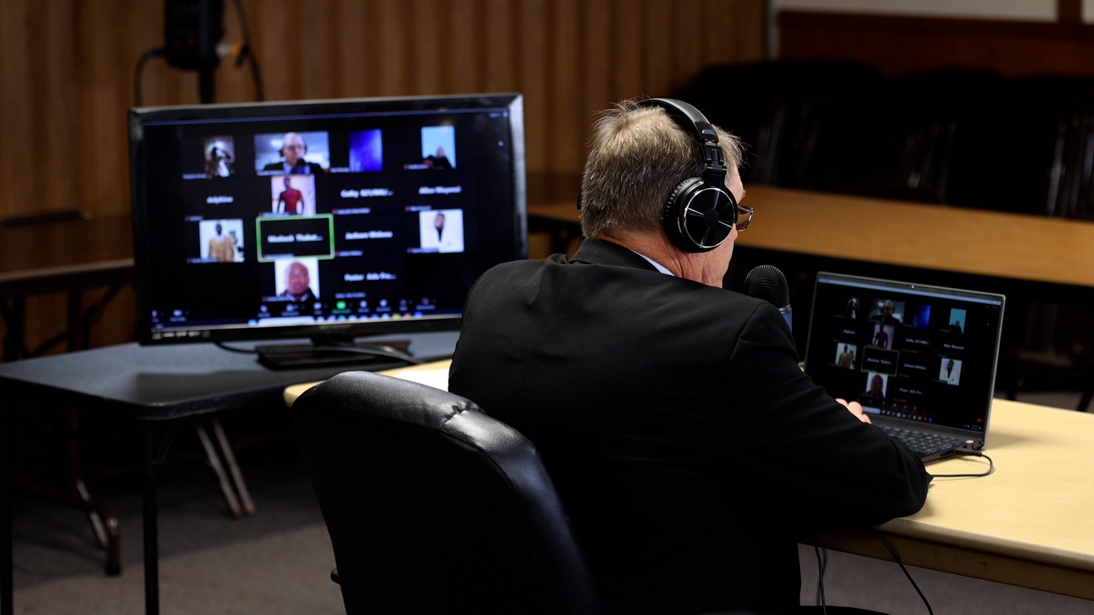
Notes:
Online theological training efforts are leading to church multiplication efforts beginning around the globe. 3,000+ students from 27 countries in Latin America have completed the self-study level of courses. 34 Grupos Sembrador (church plants) have been started by Academia Cristo students. There are more than 500 active TELL English students studying God’s Word to become group leaders and church planters, and more than 35 TELL students are connected to counselors for ongoing encouragement.

Slide 13
Finding New Missions

Slide 14
Notes:
The Board for World Missions (BWM) has four main functions:
Reach out to those who have not heard about Jesus yet.
Reach out to church bodies who contact us asking for help.
Mentor and train pastors and leaders to be confessional Lutherans.
Support this work in many languages through the production of materials such as videos, literature, publications, websites, advertising, and gospel tools through Multi-Language Productions.

Slide 15
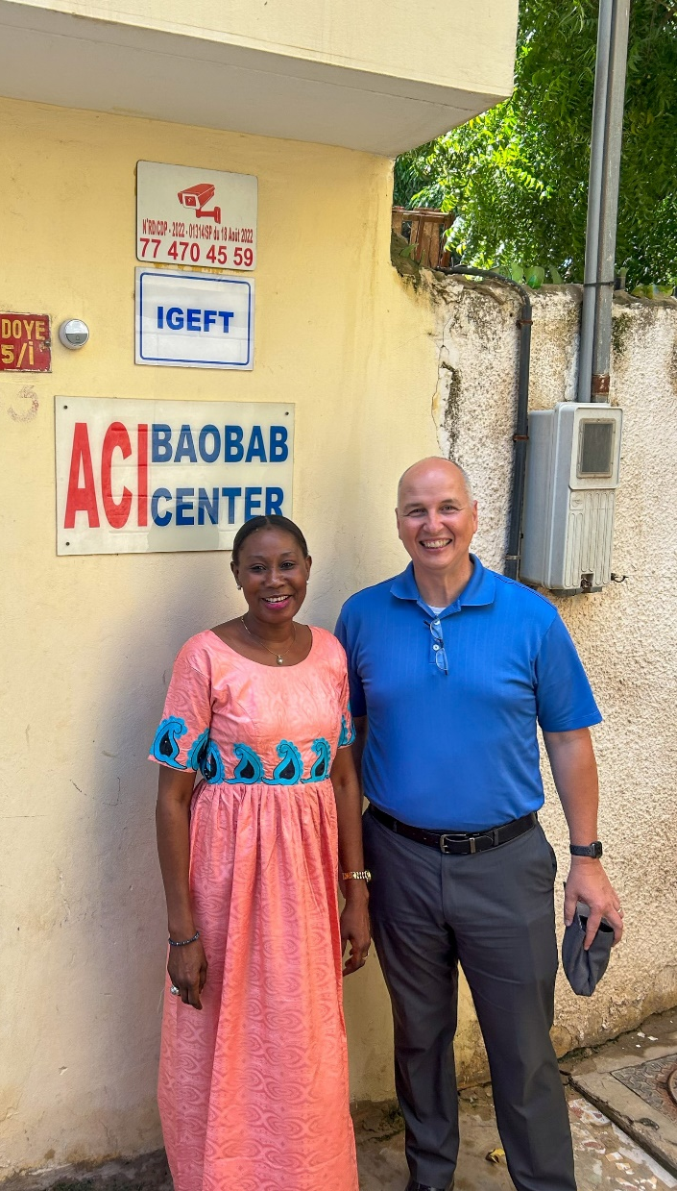
Plan in place to start a mission in Senegal
Notes:
The goal would be for two new missionaries to spend up to six months living with a Muslim family from the Wolof tribe, immersing themselves as they learn the culture and language of the people they are trying to reach with the gospel. Once time is taken to understand the culture and Muslim influence, more specific plans for outreach will be developed. The Board for World Missions is committed to supporting this new mission field for a minimum of two years, to give missionaries ample time to work within the culture while we rely on the Holy Spirit to produce his fruit in his time and place. Learn more about this opportunity at wels.net/mission-work-approved-in-senegal.
The country of Senegal in Western Africa has a population of almost 17 million people. The Wolof tribe makes up about 40 to 45 percent of the total population and is less than 0.01 percent Christian. Despite the fact that Senegal is an overwhelmingly Muslim country, the constitution staunchly defends freedom of religion and is a relatively peaceful and stable place.
Rev. Larry Schlomer, Board for World Missions Administrator, and Stefan Felgenhauer, Director of World Missions Operations, went on an exploratory trip to Dakar, Senegal, in September 2023. They had the opportunity to meet people from the business community, local charitable organizations, and an international school to determine how easy it is for Americans to live and work in the country. The highlight of the trip was connecting with a cross-cultural learning consultant (Pictured right with Schlomer) that provided a cultural study and who WELS can partner with for cultural immersion opportunities for future missionaries.

Slide 16
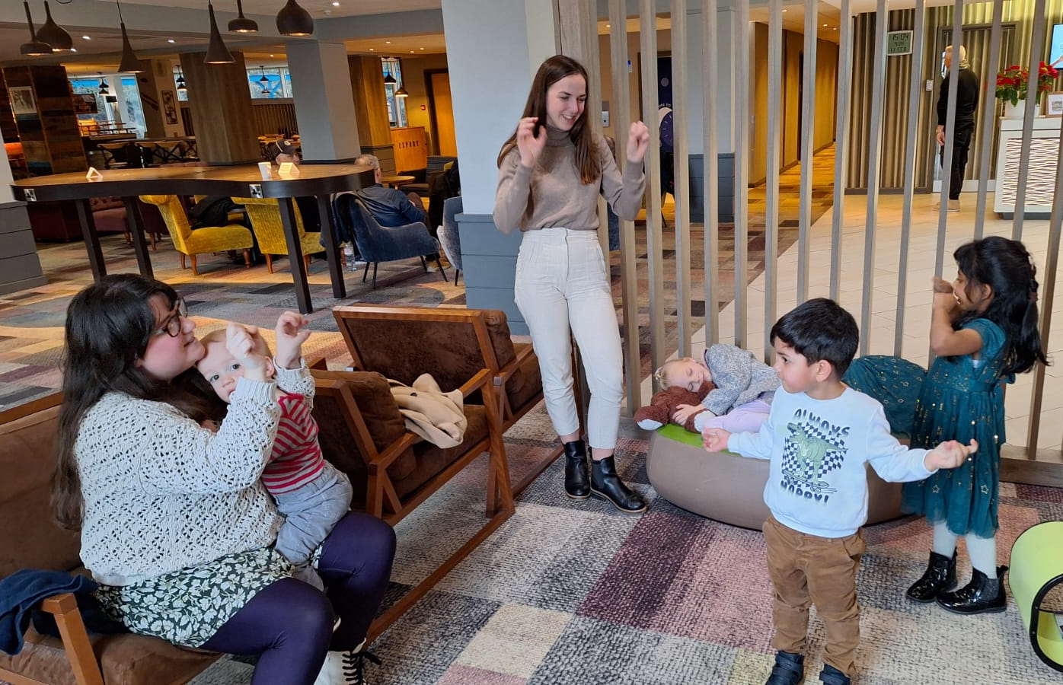
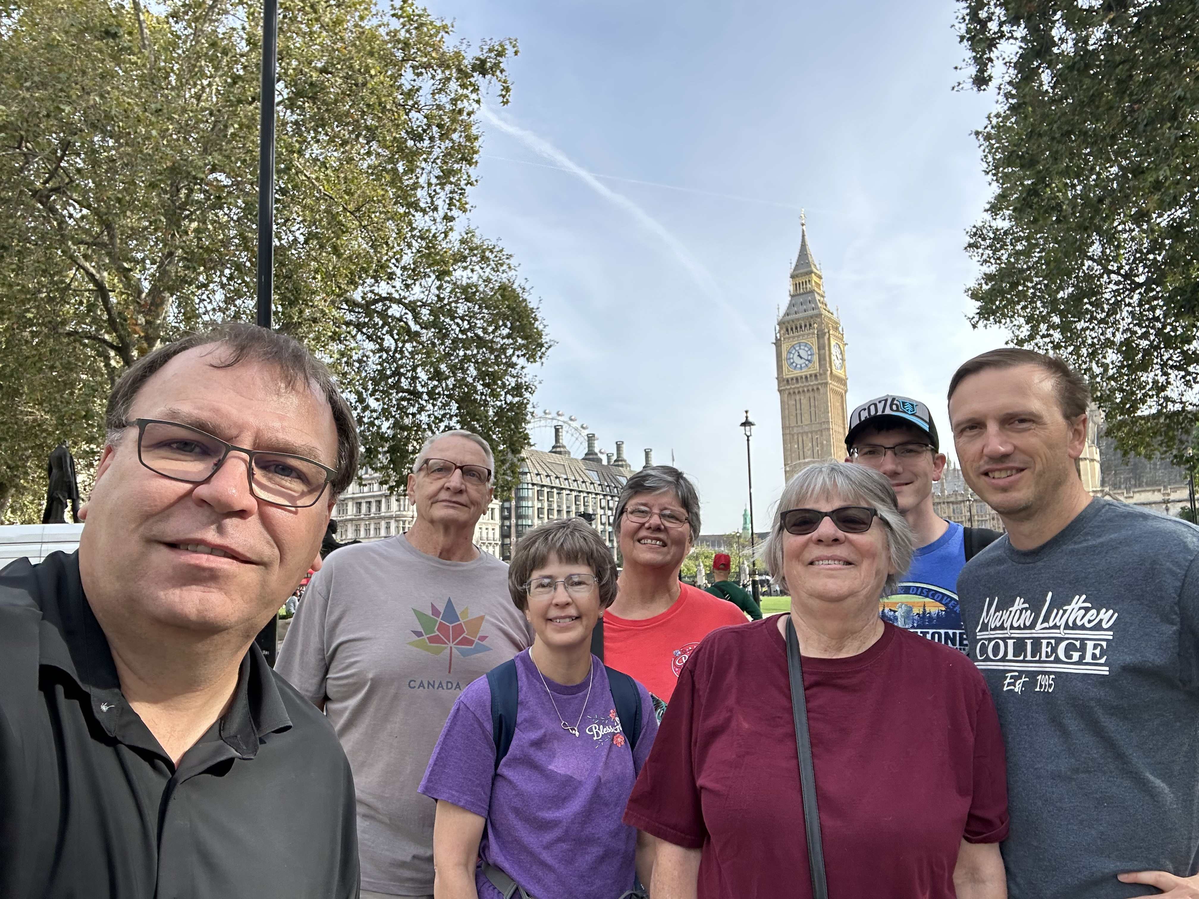
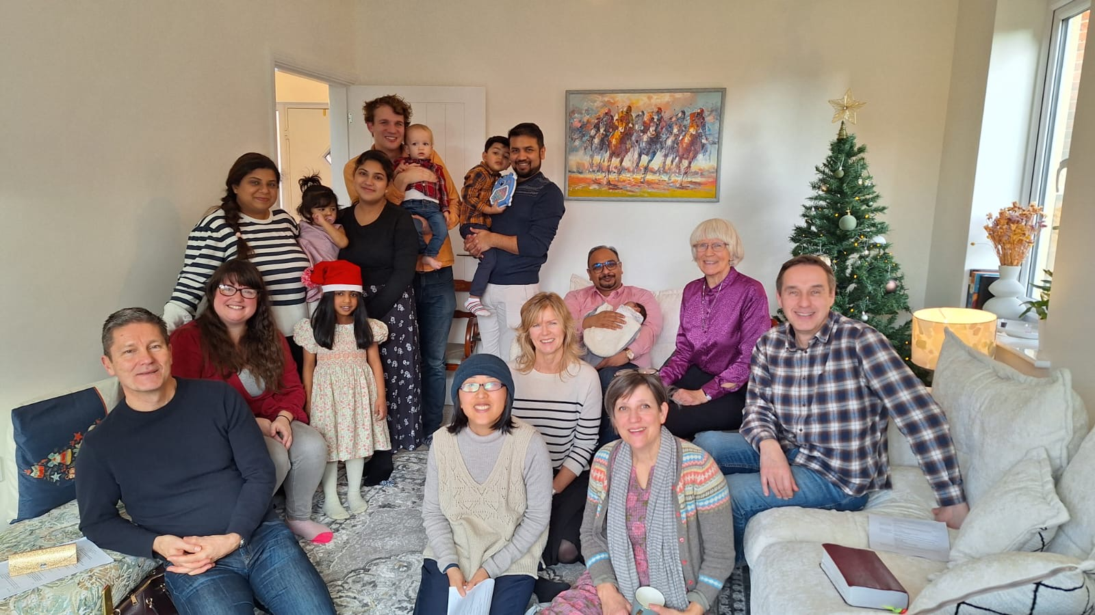
New church launching in London
Notes:
London is one of the most diverse and important cities in the world. Since the 1980s, the WELS European chaplaincy program has held monthly services in London for WELS-connected believers in the area. In recent years, many members from WELS’ sister churches around the world have been moving to the U.K. For example, more than 20 percent of members and leaders from WELS’ partner church in Hong Kong have already moved to the U.K., with more on the way.
In response to this opportunity, WELS World Missions has planted a new mission field in the U.K. Missionaries Michael Hartman and Conifer Berg are serving the group already gathering in London, connecting with contacts from other sister church bodies, and launching outreach efforts. The new church, Holy Word Lutheran Church, is launching public worship this summer in two different locations. With the Lord’s blessing, it is the prayer this mission work could provide a springboard for further in the U.K., made up of England, Wales, Scotland, and Northern Ireland, and the entire continent of Europe.
Groups of Mission Journeys volunteers are headed to London this summer to assist in getting the word out about this new church. The team is also working to develop additional online outreach efforts to increase name awareness.

Slide 17
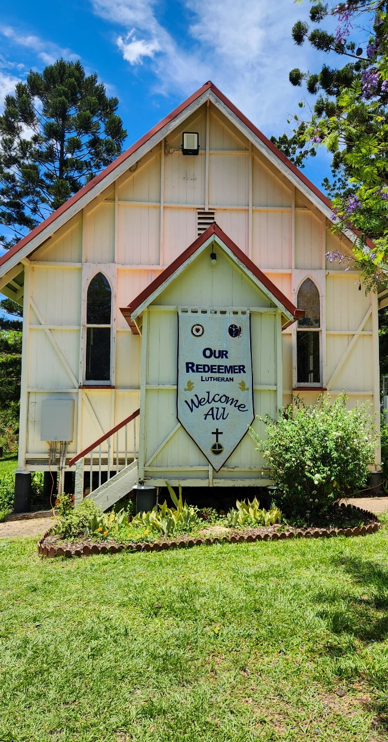
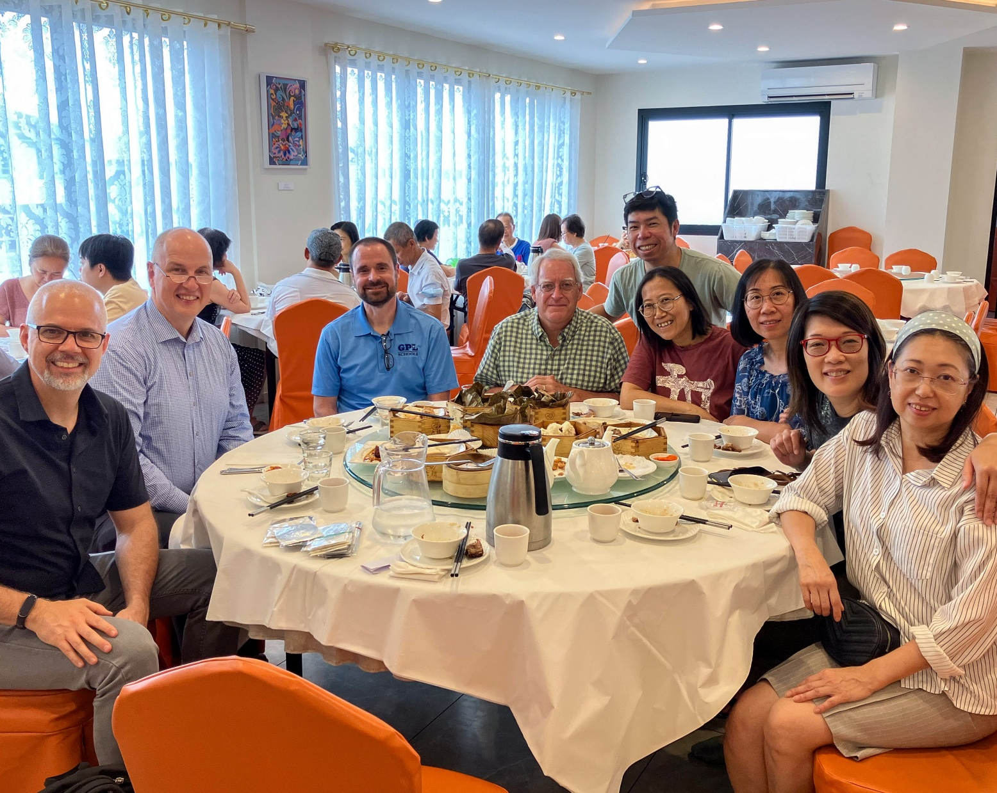
Outreach in Australia
Notes:
Missionaries Matthew Doebler and Peter Janke and their families will be moving to Australia in summer 2024. The purpose of this relocation is two-fold – reaching out to the native Australian population with the gospel in conjunction with two of WELS’ partner churches and expanding outreach to a large Chinese population that has immigrated to the area. Members from WELS’ sister church in Hong Kong who also immigrated have already started gathering family and friends around the gospel message. Both missionaries would remain on the Asia One Team as they continue their work with contacts throughout Asia.
Pictured L to R: Our Redeemer in Brisbane (ELS affiliated), Rev. Matt Doebler (Asia One Team), Rev. Larry Schlomer (World Missions administrator), Rev. Benjamin Tomczak (Commission on Inter-Church Relations), Rev. Dr. Steve Witte (Asia One Team), with Chinese members of SALEM who emigrated from Hong Kong to Australia.

Slide 18
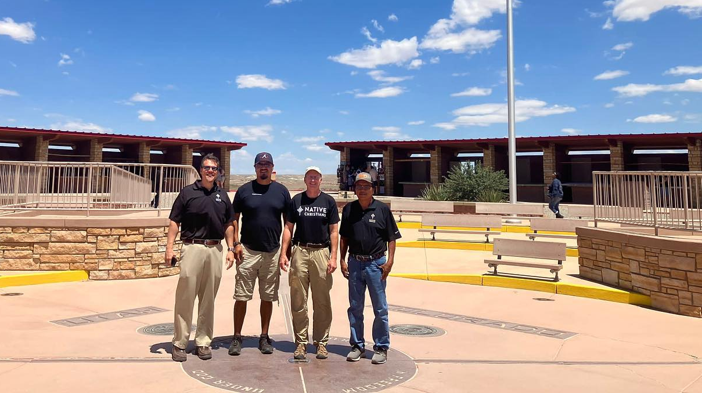
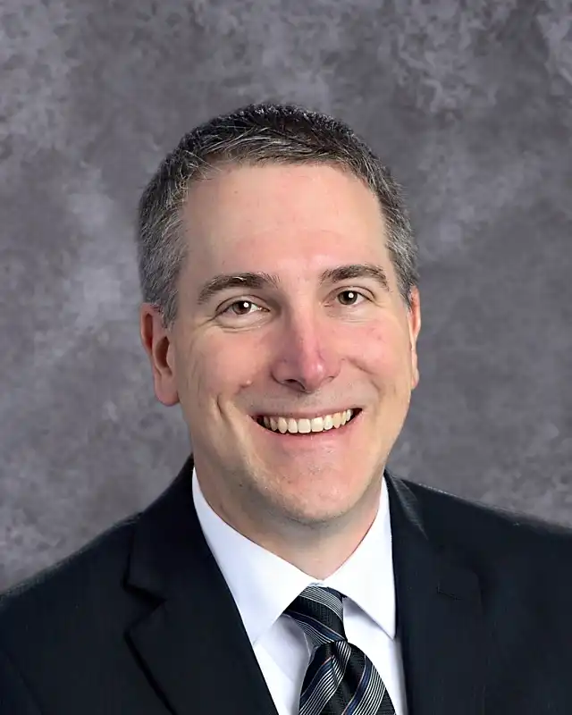
New missionary for Native American outreach in the Four Corners region
Notes:
The Board for World Missions has approved a new missionary position to coordinate outreach to the Native American tribes in the Four Regions area of Arizona, New Mexico, Utah, and Colorado. Rev. Nate Wagenknecht from Faith in Anchorage, Alaska, received and accepted this new call in February 2024. Missionary Wagenknecht is being tasked with developing a new model for Native American outreach, working closely with native Apache members who want to reach out to friends and family members from other tribes with the pure gospel message. He will work closely with Missionary John Holtz, who leads the Discipleship arm of the Native Christians Network and is training Apache WELS members for service and outreach through the Apache Christian Training School (ACTS) program. Coordination is needed to develop existing opportunities previously identified through Christ the Rock in Farmington, N.M., and expand digital outreach efforts.
Pictured: The Native Christians team on an exploratory trip to the Four Corners region in July 2023. From L to R: Rev. Dan Rautenberg (Native American mission field coordinator), Rev. Kirk Massey Jr. (Apache pastor), Rev. John Holtz, Apache lay leader

Slide 19
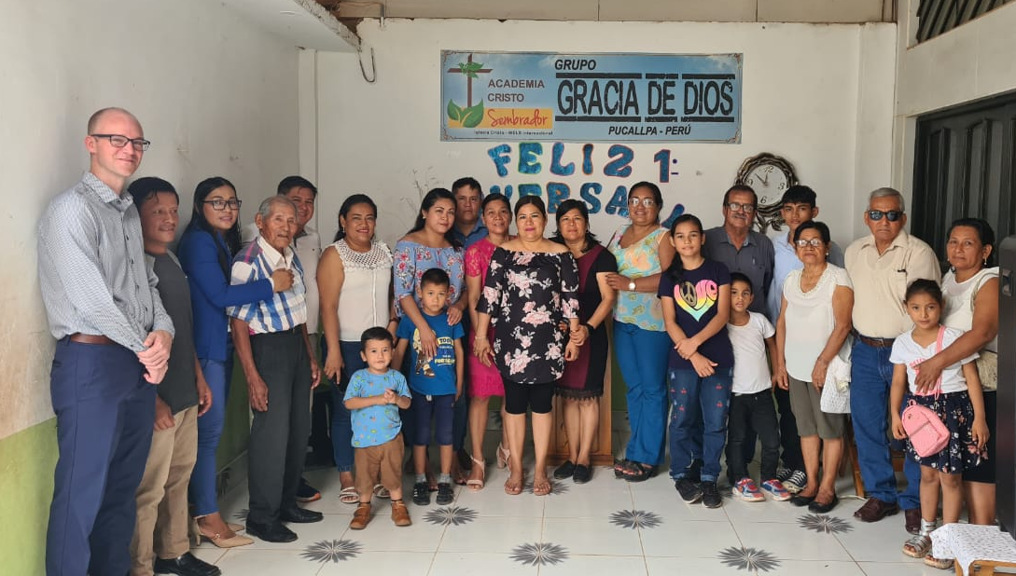
34 groups meeting regularly in Latin America for worship and study
Notes:
34 groups planted by Academia Cristo students have completed a course on sin, grace, faith, and works. These groups continue to meet regularly for worship and study. They are called Grupos Sembrador. Iglesia Cristo WELS Internacional issued 39 calls to advanced Academia Cristo students who are now “public ministers”, called to gather their people around the Means of Grace as they work towards becoming full-fledged churches as part of Iglesia Cristo.
Pictured: Amelia Torres Zambrano and her group in Pucallpa, Perú. Around 30 souls gather to worship there each Sunday. Amelia is totally on board with the biblical principle of male leadership and is working towards that goal, enabling men in her group to help lead their worship and encouraging them to study in Academia Cristo live classes. Please pray that God would grant willing and capable men to lead our group there. In the meantime, Amelia is serving as a very faithful ¨Deborah.¨ She is teaching members of the group God´s Word in its truth and purity, has a plan for the its ministry this year, and has even helped the group purchase a plot of land for a future church.

Slide 20
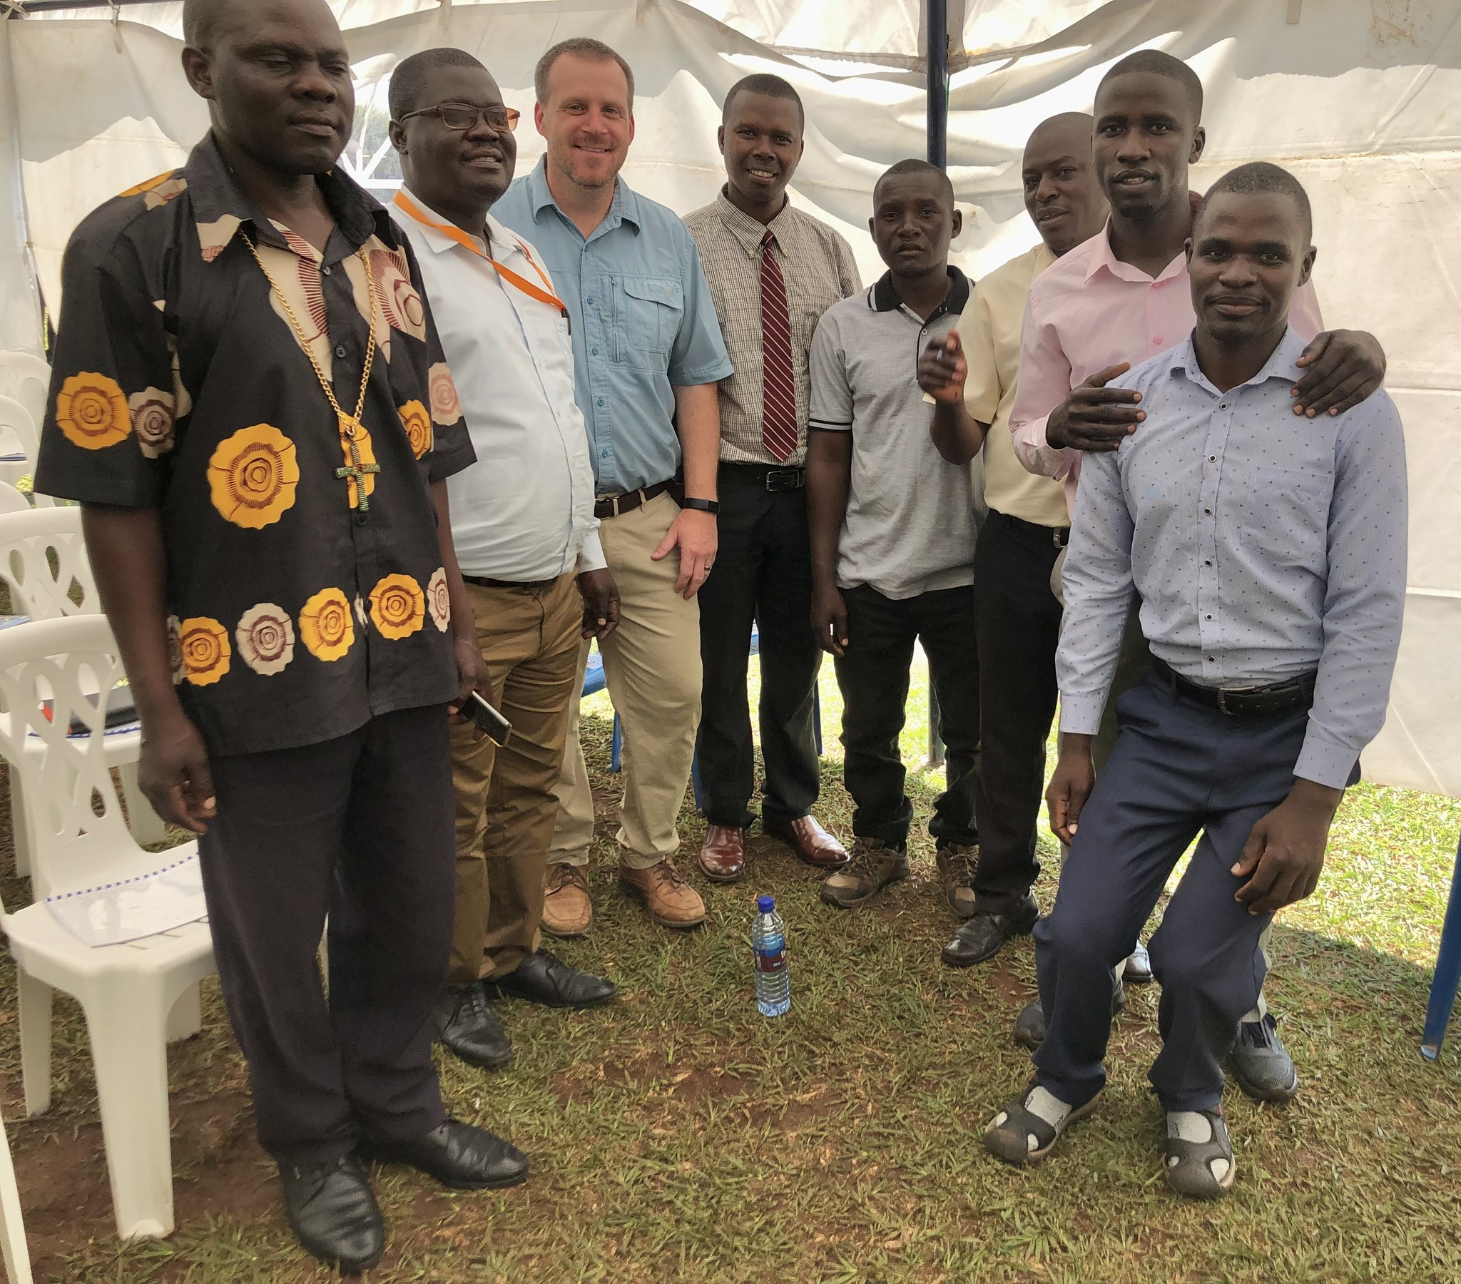
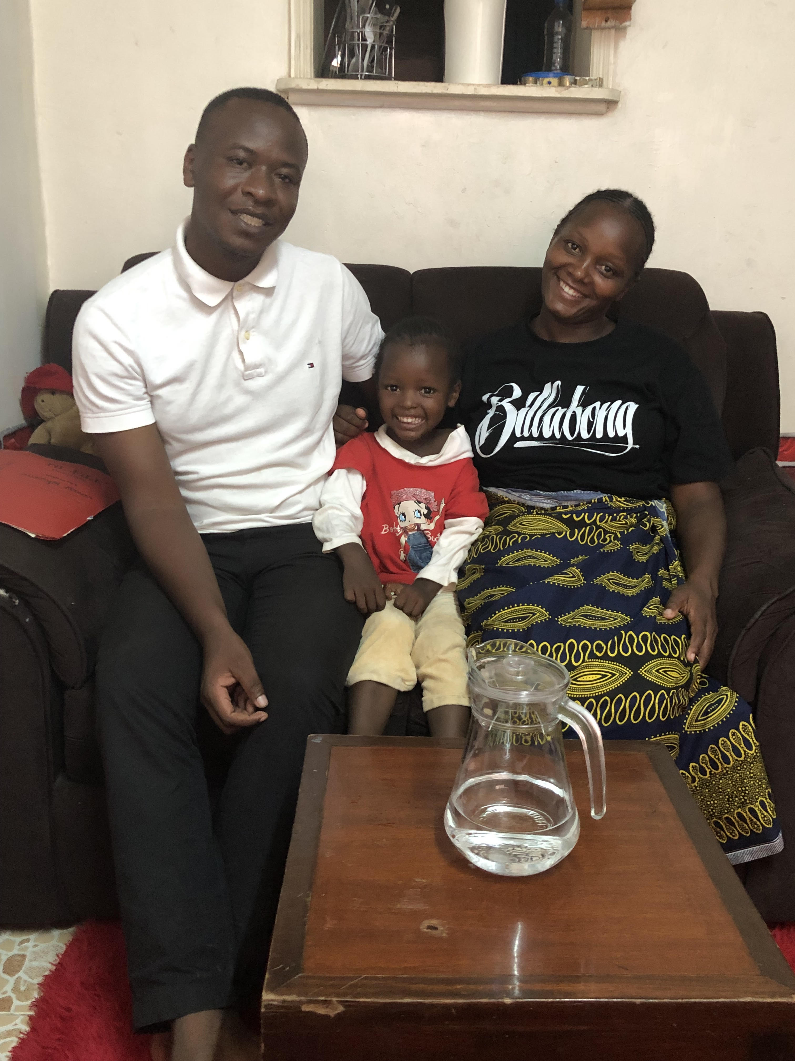
TELL Network expanding rapidly throughout Africa
Notes:
Multi-Language Productions (MLP) operates the TELL Network, an online training and church multiplication program offered in English, Mandarin, Spanish, and Tagalog. Working closely with WELS world missionary teams, TELL Network provides Bible study curriculum focused on leadership training for students across the globe, preparing them to gather groups, lead Bible studies, and plant churches.
There are more than 500 active TELL English students studying God’s Word to become group leaders and church planters.
More than 35 TELL students are connected to counselors for ongoing encouragement.
TELL Mandarin has enrolled more than 1,200 students.
Pictured left: The TELL Africa Team hosted a special workshop in Uganda in January 20204 where locals and TELL students came together to learn about God's word. (TELL Missionary Joel Hoff with TELL students)
Pictured right: Elijah Adongo, a TELL student from Nairobi, Kenya. In March 2023, he attended a special TELL event in Nairobi. Elijah continues his studies with TELL and shares what he has learned with others.

Slide 21
All to God’s Glory!
“After this I looked, and there before me was a great multitude that no one could count, from every nation, tribe, people and language, standing before the throne and before the Lamb.”
Revelation 7:9

