Slide 1

Notes:
“How beautiful are the feet of those who bring good news!” (Romans 10:15) How beautiful those are through whom God chooses to proclaim his gospel! It really is a wonderful thing that God would choose humans to be the vessels who proclaim his word to the world. God could have used any number of other means to bring the saving message of the Gospel to the people of this world, but God chose to do it through frail vessels of clay like us! It is a humbling and marvelous thing! What makes our feet so beautiful is the message of forgiveness and peace with God and life everlasting that we bring to people.
The work of our church body is divided into 4 different areas of ministry: Home Missions, World Missons, Ministerial Education and Congregational Services. Our work in Ministerial Education is to coordinate the efforts in WELS to provide a preaching and teaching ministry qualified to proclaim the Gospel universally. As we go about that work of training, we do so guided by the question: How can we train as many men and women for ministry as possible.
We had a new a new administrator start January 1: Pastor Charlie Vannieuwenhoven He is getting acclimated to his new work.
Our work in ministerial education is to prepare these proclaimers who go out with beautiful feet to bring this message to the world!

Slide 2





Three Tiered, Four School System
1 College
1 Seminary
2 Prep Schools
Notes:
In our training of called workers, we are blessed with a 4 school, 3-tiered system: 2 preparatory high schools – Luther Preparatory School in Watertown, WI and Michigan Lutheran Seminary in Saginaw, MI. We have a unique college of ministry: Martin Luther College in New Ulm, MN. This is unique among church bodies. There are no other church bodies that have a single purpose training college for their called workers. Those who graduate from MLC in the pre-seminary program then go on to Wisconsin Lutheran Seminary to finish their training. What a special gift of God it is to have a single purpose college where every student is at least considering ministry and where everyone who teaches them once stood in those callings of congregational or school ministry. What a wonderful blessing to have a school that lives and breathes ministry, where everything from chapel to sports to activities are seen from a ministry aspect. It is important for us to be thankful to God and recognize what a beautiful, unique system we have that is the envy of most church bodies. It is a tremendous blessing to have schools where almost every interaction is filtered through the lens of raising up servant-hearted called workers who have seen that in action from called workers in counseling, advising, instructing, and on athletic court/field/pitch/track.

Slide 3

Luther Preparatory School
Located in Watertown, Wisconsin
Enrollment: 386
  94 Seniors
  98 Juniors
  110 Sophomores
  84 Freshmen
48 of 94 graduates plan to enroll at MLC
  18 in Pastor Track; 29 in Teacher Track; 1in Staff Minister
Historically, 50% have enrolled at MLC.
Notes:
Here are some quick statistics and information about each of our schools. (You can go through these pretty quickly. Each school can spend a little more time on their school) 25% of the students at MLC are graduates of Luther Prep. 40% of the students at Wisconsin Lutheran Seminary are graduates of Luther Prep. 1 in three pastors and 1 in 4 teachers in our church body graduated from LPS.

Slide 4
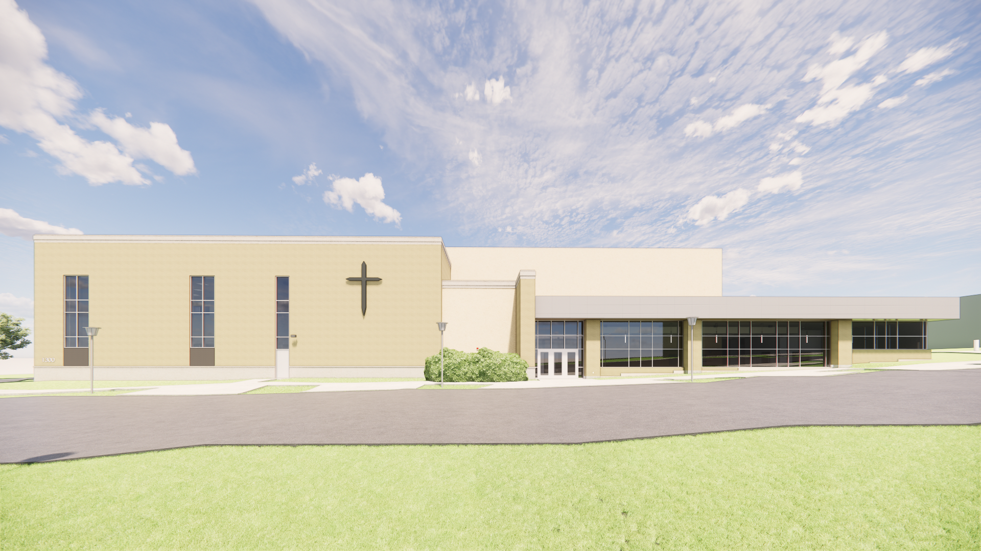
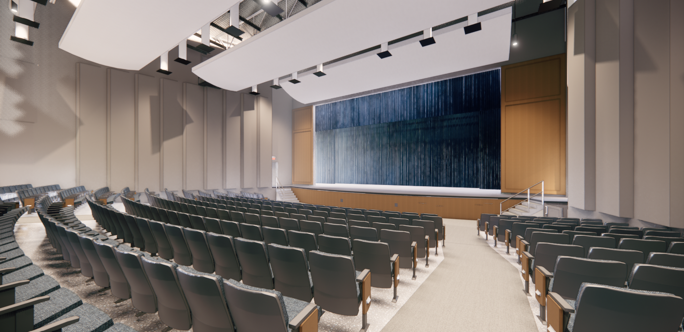
Luther Preparatory School Auditorium Project
“Magnify”
Notes:
The big project at Luther Prep is their Magnify campaign, raising money for a new auditorium.
Replaces the current auditorium built in 1912 as gymnasium
The current auditorium will revert to a gymnasium
This will give rehearsal space to the expansive band and choir program, seat over 700 for performances, and provide updated and adequate bathroom facilities
Total cost is estimated at $16 million
$11.2 million (70%) is needed to begin construction
$9.1 million has been received to date
You will find more information and how to participate in the project at lps.wels.net/magnify

Slide 5
Luther Preparatory School Auditorium Project
Total cost is estimated at $16 million
  $11.2 million (70%) is needed to begin construction
  $9.1 million has been received to date
You will find more information and how to participate in the project at lps.wels.net/magnify

Slide 6
Michigan Lutheran Seminary
Located in Saginaw, MI
Enrollment: 184
  47 Seniors
  49 Juniors
  47 Sophomores
  41 Freshmen
8 of 47 graduates plan to enroll at MLC
Historically, 35-40% have enrolled at MLC.
Notes:
MLS will be offering a second dual credit course with MLC - Intro to Fine Arts Course. It is a course that fits well within our mission to train future servants/musicians for the church whether in public ministry or as well-trained musicians for congregations. MLS now has 7 courses in which students can achieve college credit.

Slide 7
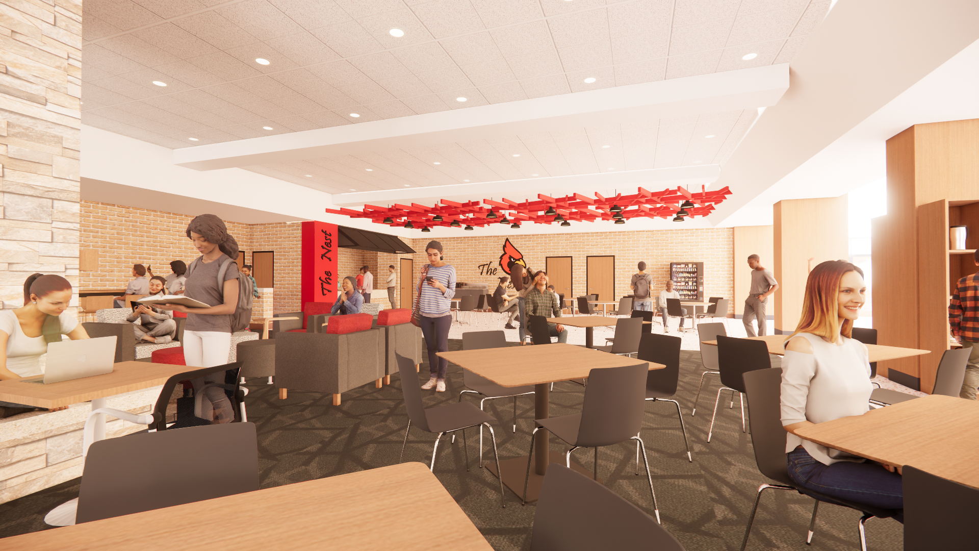
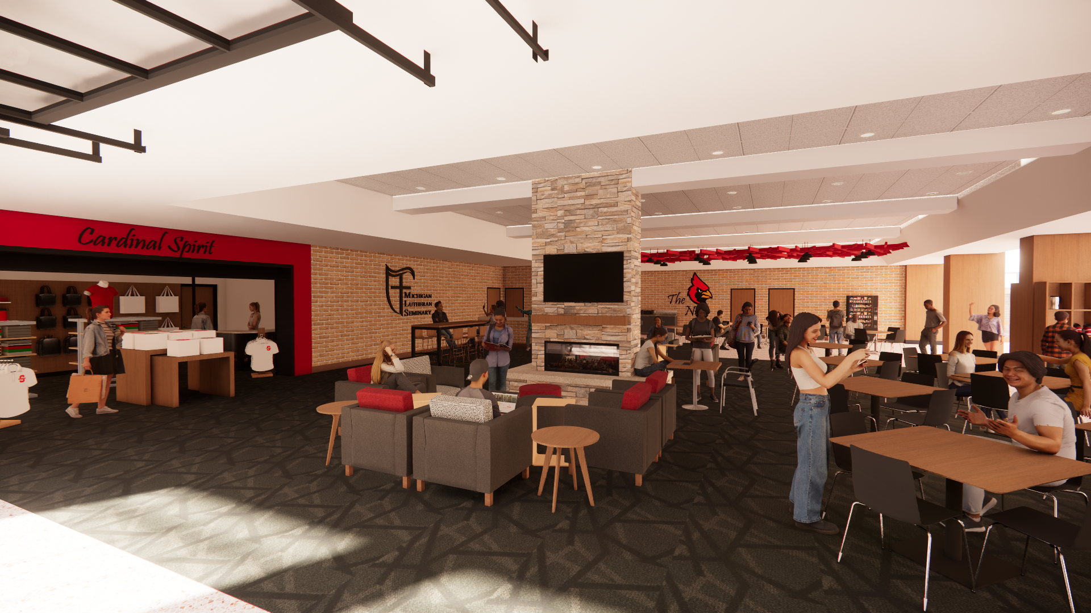
Michigan Lutheran Seminary Commons Project
Notes:
MLS has been given permission to move forward with Phase 1 of their Master Site Plan entitled "Throughout All Generations". The first phase will include a much needed renovation of the MLS Commons (the main social hub for all students and guests), the Administration Office (last renovated in 1985), and the Sunkens Gardens. MLS is doing a readiness assessment with plans to hire an architect and builder for the project with a hope to begin work next summer. Estimated costs are about $2.5 million, but we are very excited to announce that a generous donor has provided a lead matching gift of $1.25 million - meaning every dollar up to $1.25 million will be matched provided that it is given before the end of October.

Slide 8
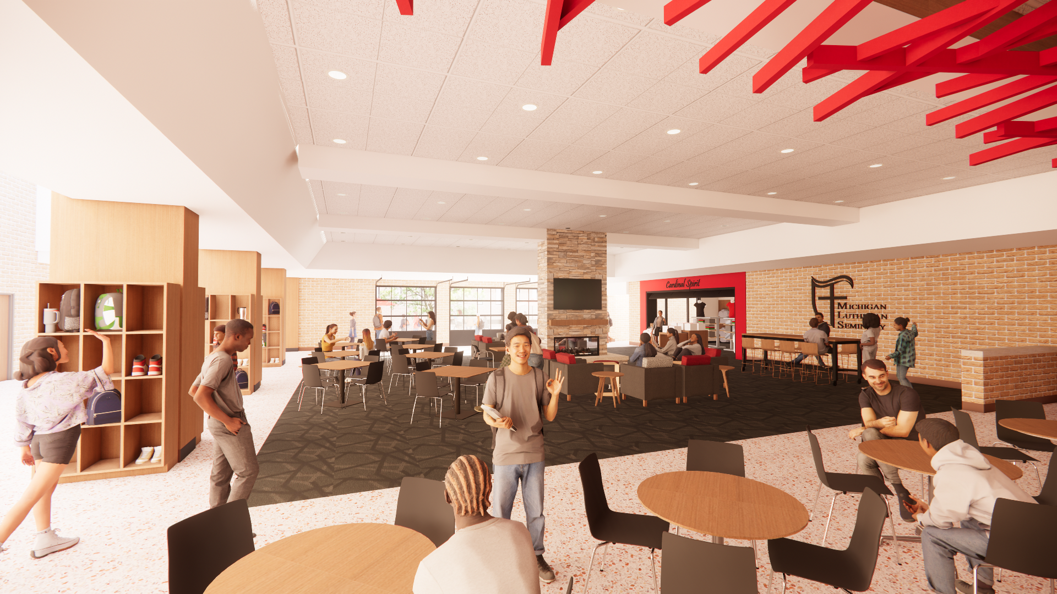
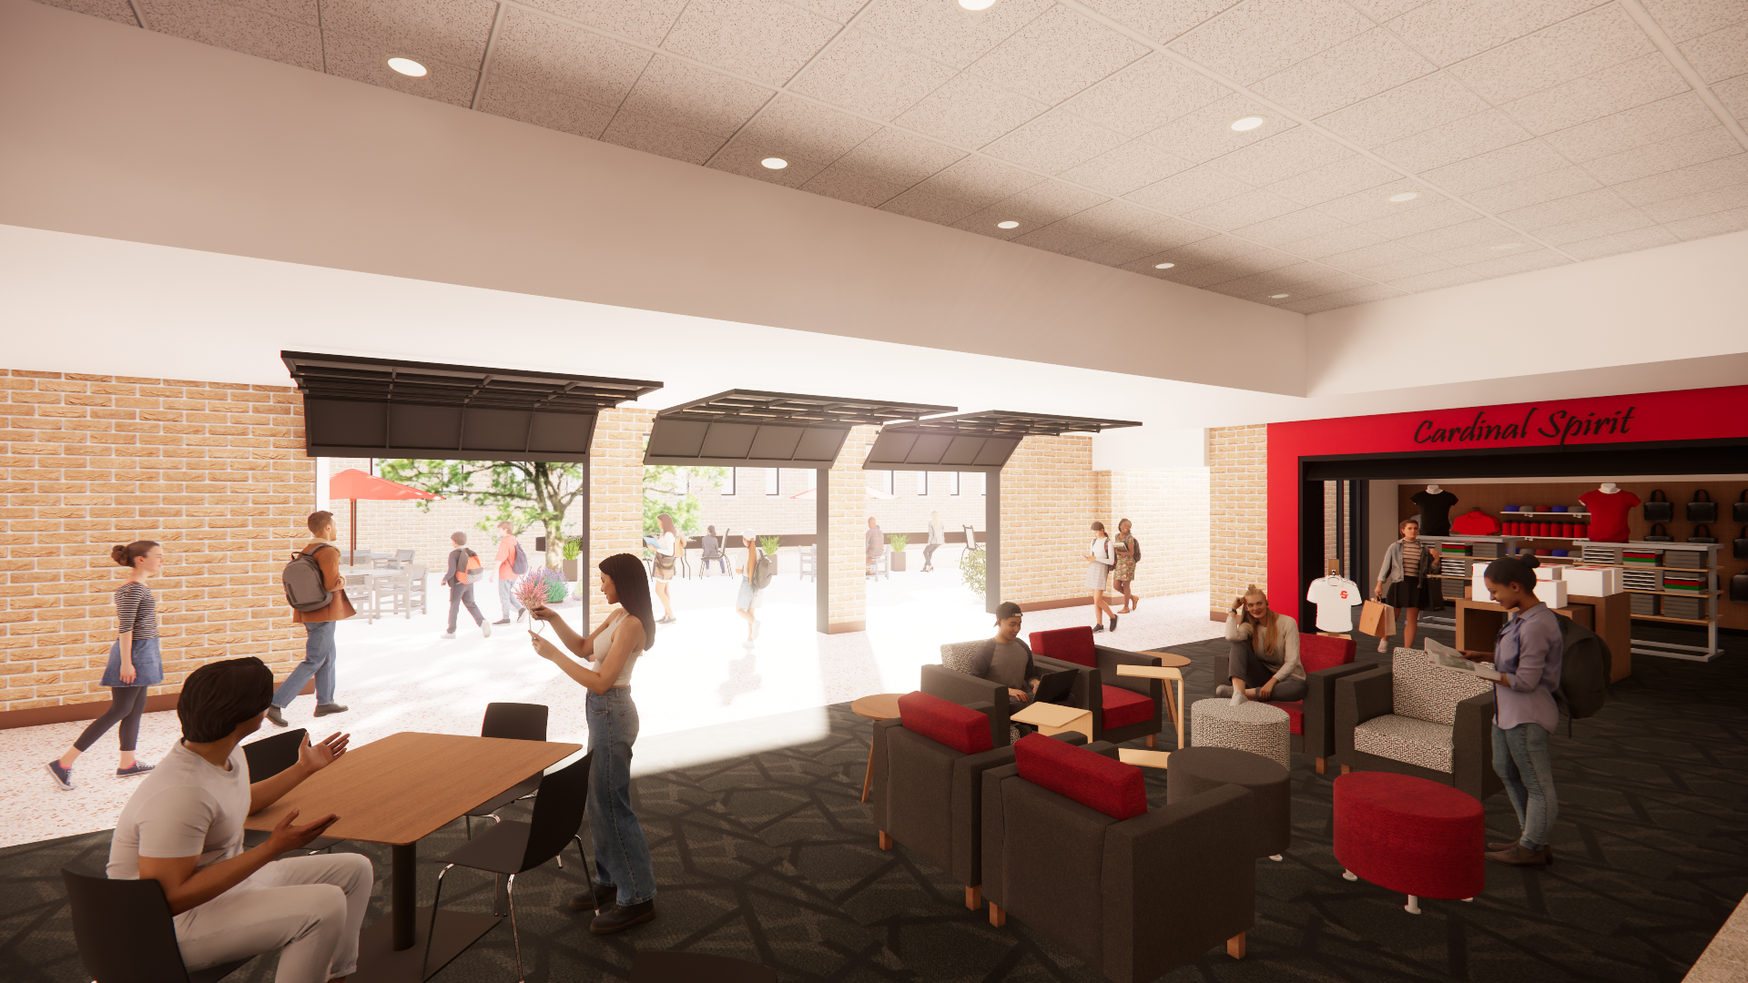
Michigan Lutheran Seminary Commons Project

Slide 9
Martin Luther College
Located in New Ulm, MN
Enrollment: 626
  170 Pre-Seminary
  449 Education
  83 Teachers and Staff Ministers Presented for Calls in May
Alternative Pathway to Professional Licensure Eligibility (APPLE)
Ministry Certification
Dual Credit Classes
Notes:
MLC offers three different tracks of study to prepare men and women to meet the public ministry needs of WELS: the pre-seminary track for men to prepare them for entrance to Wisconsin Lutheran Seminary, the teacher track for men and women to prepare them to serve in Early Childhood Centers, Lutheran Elementary Schools and Lutheran High Schools, and the staff ministry track to prepare men and women for various ministry roles within congregations.
MLC offers various continuing education and graduate studies programs to help current called workers with continuing education. MLC offers Ministry Certification classes for those WELS members who already hold teaching degrees and/or licenses from other institutions who wish to be certified to teach in WELS schools.
Because many schools have extended part-time jobs and provisional calls to those who have not received formal training as Christian educators, MLC has developed the Alternative Pathway to Professional Licensure Eligibility (APPLE) to support this growing family of educators. APPLE is designed for returning, adult learners who have completed a two- or four-year degree at another institution but do not yet have an education degree.
Vice President of Academics/Provost Dr. Jeff Wiechman is working with different schools to launch more dual-credit HS/college courses.
At MLC: 80 Teacher candidates and 3 staff ministry candidates were presented for calls. All but 1 were assigned. 17 were reassigned to their present field of labor. 110 teacher vacancies remain after the assignments were made.

Slide 10
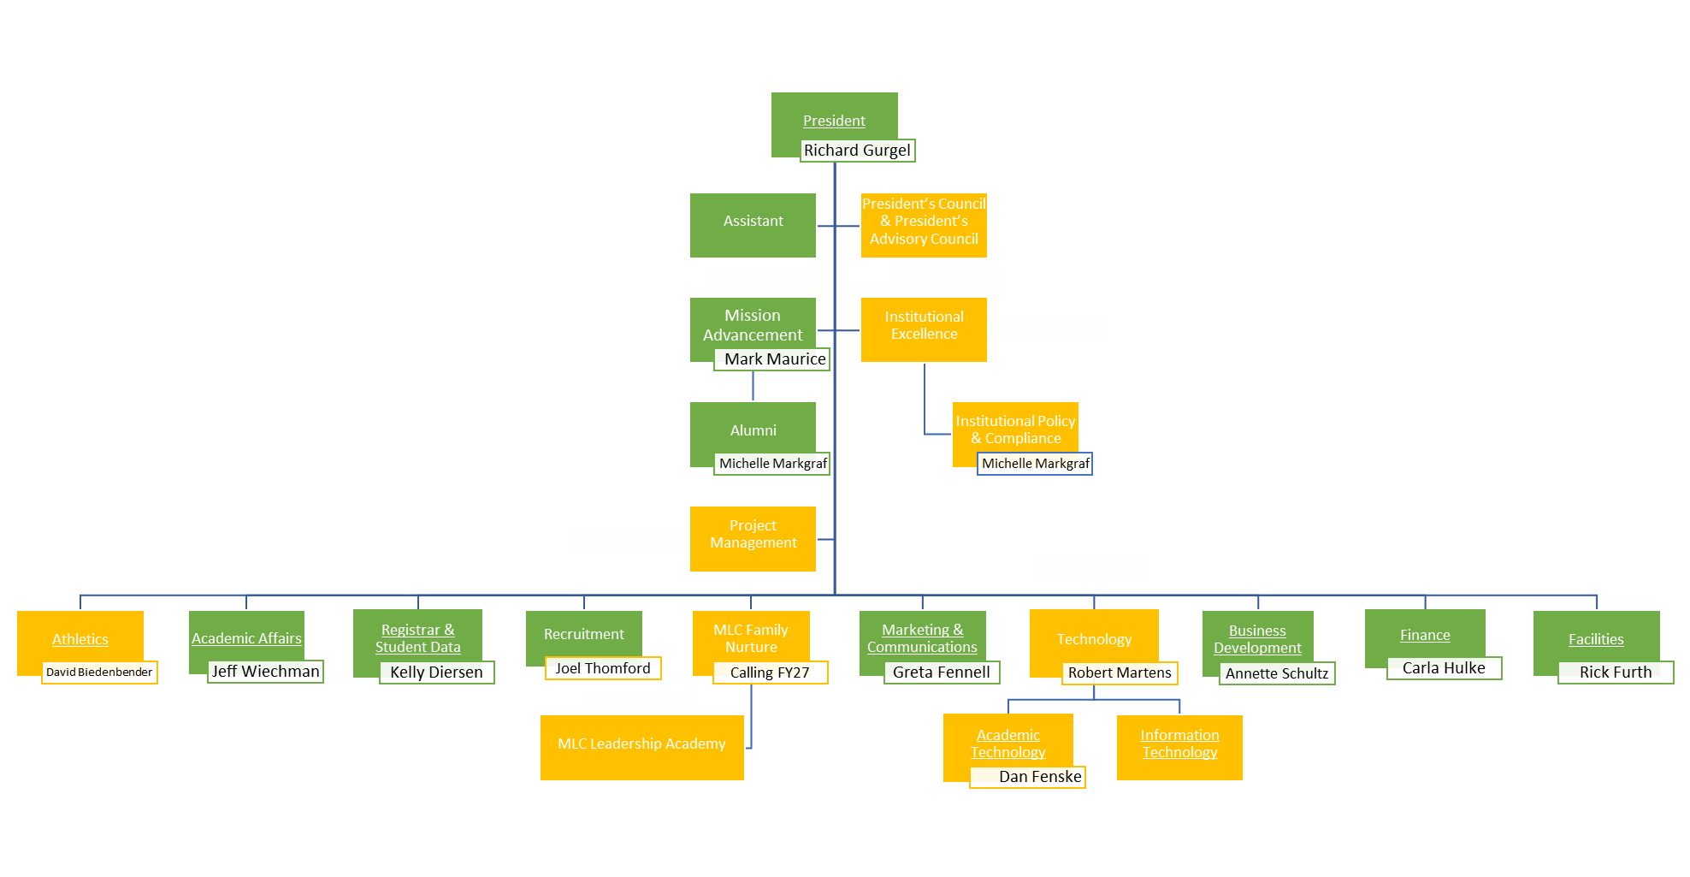
Martin Luther College – Project Sunrise
Notes:
MLC had a group of consultants from the Association of Governing Boards assess MLC and offer recommendations in 2024. They had 3 recommendations:
Priority 1: Improve Fiscal Sustainability and operational efficiency
Priority 2: Expand Educational Opportunities and Accessibility
Priority 3: Enhance Brand Identity and Outreach
The Project Sunrise reorganization came out of Priority Recommendation 1. They are moving from 5 VP’s to 10 rooms to flatten out the decision making. This will hope to make decision making more efficient as there are less levels of approval.
They have added a Marketing and Communications person – Greta Fennell. Established an MLC Procurement Office
Centralizing of purchasing all across campus. President’s monthly sync meetings with room leaders to stay focused on priorities/goals and regularly monitor budget performance in each area
New budgeting process to help room leaders/budget owners to grow in what it means to plan/forecast well (FP&A assistance from Financial Services)
Balanced budget being readied to present to the SC for FY28 & FY29
Long term goal next biennia: wean ourselves from using investment income to balance budget (invested instead in campus improvement/capital projects)

Slide 11
Wisconsin Lutheran Seminary
Located in Mequon, WI
Enrollment: 151
  42 Seniors
  37 Vicars
  43 Middlers
  29 Juniors
  49 men presented for Calls in May
Continuing Education
Pastoral Studies Institute
Grow in Grace
Notes:
There are 40 pastors officially pursuing a master’s in sacred theology degree through the seminary’s continuing education program.
The Pastoral Studies Institute of Wisconsin Lutheran Seminary guides the preparation of men who would like to serve only their own people groups as evangelists or pastors.
There are 41 students in North America being trained for service as pastors via the Pastoral Studies Institute program. The students come from 13 different people groups in 33 different locations.
Grow in Grace, the institute for pastoral growth at WLS, offers opportunities for the theological and professional growth of called workers already serving in our fellowship.
At WLS, 46 men were presented for Assignment. With 1 man from 2024 being reassigned to another field of labor, 3 men being reassigned to their present fields of labor for another year and 3 PSI students, 52 were assigned. 128 vacancies remain after all the assignments were made.

Slide 12
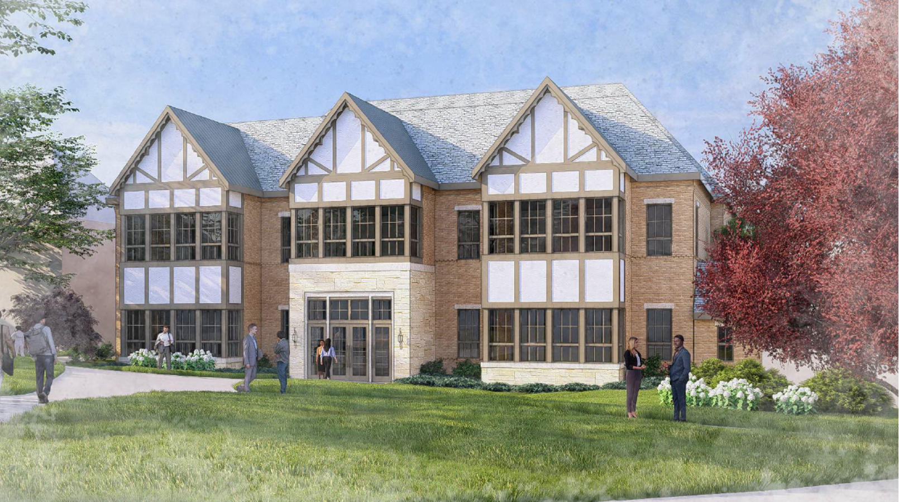
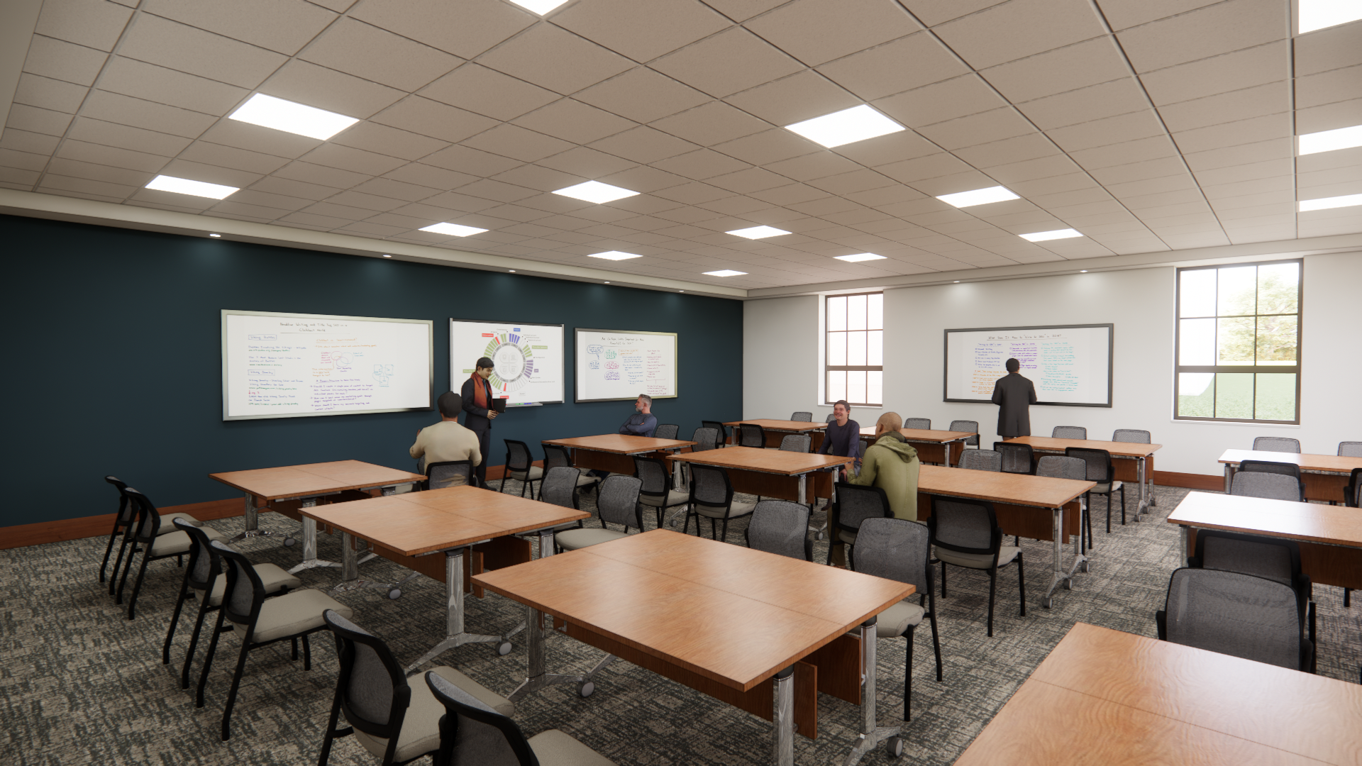
Wisconsin Lutheran Seminary Building Project
“Compelled”
Notes:
The building project at the Seminary is an Education Center with 6 classrooms and 5 small-group meeting spaces, pass through connector with the library, a gathering area on the back of the auditorium, and adding professor offices on the first and second floor of the classrooms.
Pictured is the classroom building with 1 classroom.

Slide 13
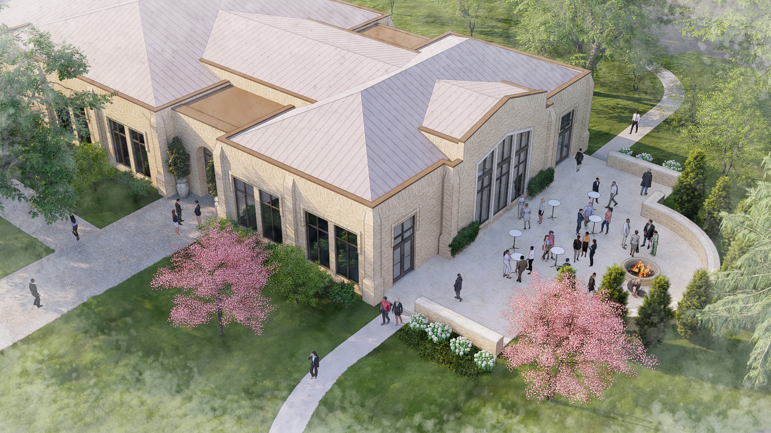
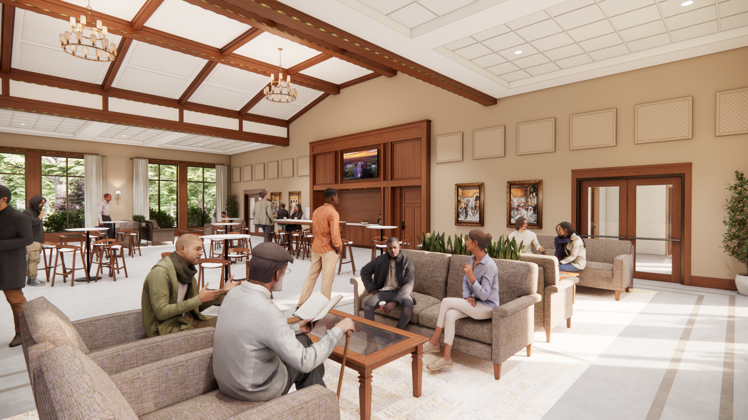
Wisconsin Lutheran Seminary Building Project
“Compelled”
Notes:
Pictured is the Gathering Hall attached to the current auditorium/gymnasium.

Slide 14

Wisconsin Lutheran Seminary Building Project
“Compelled”
Broke Ground on May 20
Total cost is estimated at $15.5 million.
Between gifts, three-year commitments, and funds the seminary’s governing board has designated for the building project, 70% of the project cost has been achieved.
  You will find more information and how to participate in the project at wisluthsem.net/compelled
Notes:
Pictured is the connector with the library, which serves as the student lounge, where faculty and students will spend time each day in informal study..

Slide 15
Key Issues and Challenges
Notes:
Now that we have talked about where we are at in our Ministerial Educational schools, it’s important to take a look into the future to see where we are going. To have a clear picture of where we are going, we want to make sure we have an understanding of the key issues and challenges that we are facing in Min Ed right now.

Slide 16

THE STRATEGIC ISSUE IN WELS:
The Exodus of Young Adults
In only four years, the 24-to-35-year-old demographic in WELS declined 13.5%.
(2016 to 2020)
Notes:
The main point of his section is to help people see that the pool of young people to draw from for ministry is shrinking. We are actually doing well with the percentage of young people who are studying for ministry. That pool which we draw from is shrinking. We have less young people who are having kids. Families are having the same number of kids as previously. There are just less families having kids. (You don’t have to spend a lot of time with these numbers explaining every little detail. The main picture is the pool of candidates is shrinking and the need for teachers continues to rise.
We have been losing young people. The Congregational Services report will talk more about this. This decline in young people will have ramifications for ministerial education down the road as the birth rate and WELS school enrollment drops.

Slide 17
MARRIAGES IN 2024
915 total in WELS
25% of those marriages occurred in 2.6% of congregations (~30 churches).
Two-thirds of congregations had zero marriages.
Notes:
The back door losses among young WELS members is showing up in other statistics. In 2024, for the first time, WELS had fewer than 1000 marriages synod-wide. Two-thirds of congregations didn’t have any marriages last year. So, yes, we are facing challenges. This will have ramifications for Ministerial Education down the road.

Slide 18
Notes:
Here is the graph that shoes the narrative of births to marriages. The number of kids per family is staying the same, there are just less marriages taking place.
This shows that the narrative, “WELS young people just aren’t having kids” is false. When you compare births to marriages the ratio has been trending up since 1980. How is this possible? The explanation seems to be that of the young women who have left WELS in large numbers over the past two generations, it skews toward those who were more progressive – low interest in marriage and kids; high interest in career. So, the women who remain in our congregations are more interested in family than average. Families are having the same if not more children, we just have fewer families who are having children.
Note especially the birthrate drop in 2020. We went from having over 9,000 births/year in the 1980’s to under 3,000 the last 5 years.

Slide 19
Notes:
For the last 30 years, WELS has been declining.
Current WELS membership is around 322,000 compared to 413,000 in 1995.
3,445 youth confirmations in 2024 (the lowest total in WELS history) compared to 6,111 in 1995.
Compare births with youth confirmations 14 years later to find an average attrition rate:
1985 - 9,034 births / 1999 - 5,992 youth confirmations
2000 - 7,396 births / 2014 - 4,180 youth confirmations
2010 - 6,532 births / 2024 - 3,445 youth confirmations
We lost a little more than 3,000 in every period.
In 2020 things changed...
Births have been in the 2,800 to 3,000 range for the last 5 years.
That is less than half the number of births compared to just one decade ago.
So if we follow the trends and fast forward, beginning at 2034 (14 years after 2020), the number of WELS confirmations would be around 1,400-1,600.
This simply illustrates that we have obviously become worse at retaining young WELS members. This illustrates how many leave between birth and youth confirmation. If you look at between birth and college aged, it jumps to a loss of 60%. We retain just 40%. This isn’t unique. The LCMS has worse numbers.

Slide 20
Notes:
MLC enrollment trends are following the same trends as WELS births 18-21 years prior as well as Youth Confirmations 4-7 years prior. This is fairly self evident. It just shows that the current enrollment at MLC (at least in 2024) is right where you’d expect it to be, given that we have fewer WELS kids. You will find the same thing at our Prep Schools.

Slide 21
WELS “ENROLLMENT CLIFF”
Pool of Students for Each Grade: 24/25 School Year Versus 14/15 School Year
FOURTH GRADE POOL
14/15 School Year = 7,006
24/25 School Year = 5,678
-19%
Notes:
This just illustrates that the enrollment cliff is coming. It gets big in about 4th grade, where we have 20% fewer WELS kids than a decade ago. We have MORE 4th graders, obviously, because we have more non-WELS kids. But WELS kids (who would go to a prep school or MLC)… way fewer.
This decrease will continue to make its way through the grade schools. This drop is 4 years away from affecting our high schools. It is 8 years away from affecting our college.

Slide 22
There are multiple models that reasonably allow for a forecast of increased enrollment at MLC over the next six to seven years.
HOWEVER…
There is no reasonable model that avoids producing a forecast demonstrating a precipitous drop in the next decade, as the enrollment cliff works its way through our system.
Notes:
This is a graph of enrollment for MLC with projections into the future.
Model A: Based on Reported College Aged Members
Model B: Based on Reported Youth Confirmations
Model C: Based on Births to WELS members
Model D: Based on Births & Spiritual Gains/Losses
There are multiple models that reasonably allow for a forecast of increased enrollment at MLC over the next six to seven years.
HOWEVER…
There is no reasonable model that avoids producing a forecast demonstrating a precipitous drop in the next decade, as the enrollment cliff works its way through our system.
These models are based off the assumption that the "status quo" (in WELS demographics, in recruitment for ministry, etc.) does not change. We are hoping some of our efforts with the Ministry Recruitment Counselors will help to offset these drops. But even if the MRC’s are able to help increase the number from 4% of college students at MLC to 5%, that won’t fully offset the drops that we see.
These graphs show that if we do nothing, we will have major problems. These are the impetus for why we are looking for solutions to the challenge.

Slide 23
Notes:
We see the same thing happening at our Prep schools.
30% of MLC graduates are LPS Grads
40 % of WLS graduates are LPS Grads
The need for pastors and teachers is GROWING.
The pool of future called workers is smaller now than it was, and it will get smaller. And….

Slide 24
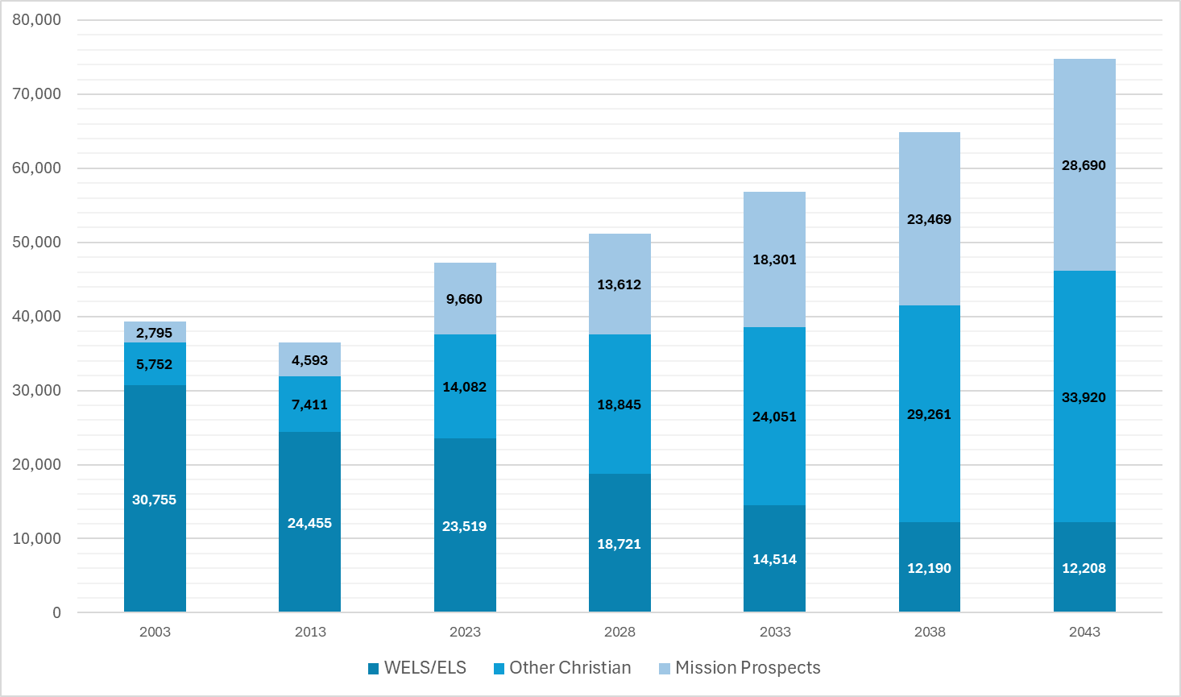
WELS’ SCHOOLS FUTURE ENROLLMENT
74,819
+31.6%
38.3%
+20.3%
56,866
47,261
45.3%
16.3%
Notes:
You see the growth of our WELS schools over the past year years. This was made a couple years ago. I’ll note that this growth has slowed. In business it’s called the “invisible hand,” which means eventually invisible market factors curb growth. The fact that we have so many teacher vacancies is leading some schools to slow or even curb growth.

Slide 25
What are we doing about this?
Notes:
Our responsibility in Ministerial Education is not only to take care of the institutions we have established for our ministerial education today, but to look ahead and strategically position ourselves so that we can meet the challenges and opportunities of tomorrow. As you have noticed, there are some challenges ahead for ministerial education. But in these challenges, we also find opportunities.

Slide 26
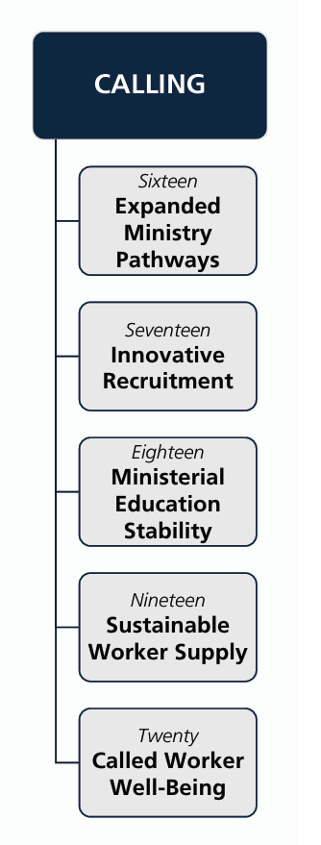

Notes:
The WELS Long-Range Strategic Plan, “Christ Through Us”, was approved last year at the Synod Convention. The Priority section “Calling” affects Ministerial Education.

Slide 27
Christ Through Us Strategic Plan 2025-2035
Sixteen
Expanded Ministry Pathways
APPLE – Alternative Pathway to Professional Licensure Eligibility
Ministry Certification – Both Teacher and Staff Ministry
Encourage congregations with multiple pastors to consider a Staff Minister instead (Evangelism, Worship, Discipleship, Youth and Family, Counseling, looking at business and technology, etc.)
Congregational Assistant Program
Notes:
Goal 16 is Expanded Ministry Pathways. The Synod in convention asked us to be aggressive in finding expanded pathways through which people in our church body can enter into ministry.
APPLE – Alternative Pathway to Professional Licensure Eligibility – Designed for someone with a 2 or 4 year degree but it isn’t a teaching degree. It offers and Elementary Education degree for non-traditional students. APPLE builds on prior academic and professional experience, allows flexible pacing through course content, and mirrors MLC’s on-campus program with slight credit modifications.
Ministry Certification – Both Teacher and Staff Ministry. Teacher certification is for those who already possess a teaching degree or license. Staff Ministry certification is for those who hold a bachelor’s degree. Ministry Certification is the responsibility of the WELS Conference of Presidents who ensure that ministers of the gospel are properly prepared to carry out the ministry work entrusted to them.
Encourage congregations with multiple pastors to consider a Staff Minister instead (Evangelism, Worship, Discipleship, Youth and Family, Counseling, Business, etc.) A congregation with multiple pastors likely does not need preaching help but can use ministry help. This is where staff ministers come in. 4-year degree instead of an 8-year master’s degree.
Congregational Assistant Program – This program is run through MLC and offers training for lay people to assist in ministry. This program is currently being evaluated, but the materials are still available. Especially in this time where we have a shortage of pastors, this gives Lay people a chance to participate more in ministry. What an opportunity for us to help lay people serve more in ministry in our congregations.

Slide 28
Christ Through Us Strategic Plan 2025-2035
Sixteen
Expanded Ministry Pathways
Think Tank Task Force
Notes:
This group was formed in the summer of 2025 and was appointed by President Schroeder and has been especially focused on helping to solve the teacher vacancy challenge.
The gap between supply and demand for teachers will widen increasingly for the foreseeable future. The demand for teachers greatly outpacing current ministry training pathways is a challenge. But it does give us the opportunity to look at what we are doing and evaluate what we might be able to do differently and/or better.
The church has 5 entities addressing the challenge teacher vacancies: Synodical Council, Conference of Presidents, Board for Ministerial Education (along with MLC), Commission on Lutheran Schools, 400+ individual ministries.
A Think Tank Task Force exists to pull all these entities together to properly address this challenge.

Slide 29
Think Tank Recommendation
Sixteen
Expanded Ministry Pathways
The WELS Board for Ministerial Education, Synodical Council and Conference of Presidents has invited Wisconsin Lutheran College and Martin Luther College to work with the BME to explore possible solutions to the WELS teacher shortage.
Notes:
This is one solution that has been offered. It is by no means a silver bullet to solve this issue completely. But it might be able to help.
Each year, we need approximately 200 teachers to replace the teachers we lose each year through retirements and resignations. We have had @ 100 graduates from MLC the last number of years (only 84 this year) assigned into ministry. We have already been finding ½ of our new teachers outside of MLC. We don’t know where these discussions will go. At this point, we are only sitting down to talk to see what could be. We feel that it is in our synod’s best interest to research every possible solution.

Slide 30
Christ Through Us Strategic Plan 2025-2035
Seventeen
Innovative Recruitment
Ministry Recruitment Counselors
Notes:
A WELS member whose church had been calling for a pastor for a long time thought to himself, “We have to do something about this!” The Ministry Recruitment Counselor program is the result of this. This generous donor offered to fund 5 ministry recruitment counselors for 4 years to see what we might be able to do to solve this vacancy issue.
Since we have started this, we have come to realize who woefully short we have fallen in talking about ministry from a synodical level. We have left recruiting for ministry to our 4 min ed schools. They do a great job. But we haven’t done much from a synodical level of talking about ministry and the joys of being a minister of the gospel and encouraged people to think about ministry.
Each one of us plays an important role in recruiting and training young people for ministry. Data shows that parents have the biggest influence on the path young people take in their vocations. Parents, have you taken the time to encourage your children to consider ministry for their life’s vocation? Church members, you also can have a big impact on our young people. Have you encouraged a young person by speaking with them about the gifts they have for ministry? Pastors and teacher—you recruit for ministry (or against ministry) by the way that you go about your ministry. What a privilege to hold the hand of the aged Christian and escort them into heaven as you keep their eyes focused on Christ! How moving to see the tears swell up in the eye of the prospect who for the very first time by the work of the Holy Spirit starts to understand grace! How awesome to be the one God used to pour water over the head of that little child and know that through that the Holy Spirit is powerfully working faith in that child! We recruit for ministry when we live in the joy of being able to serve God’s people! We are working to develop a culture of ministry in our church body where parents, grandparents, pastors, teachers and congregation members alike are encouraging our young people to consider ministry. Your encouragement can have a huge influence on our young people and can lead more of them into the public ministry!
“Encourage the encouragers, Influence the influencers, Recruit the Recruiters”
New Website Resource: www.considerministry.com
If there is a Ministry Recruitment Counselor present to share information, this is the time to introduce him/her.
If there is not, you can move forward to the final 2 slides.

Slide 31
Ministry Recruitment Counselors
Seventeen
Innovative Recruitment
4-year project funded by private donations
“Encourage the encouragers, Influence the influencers, Recruit the Recruiters”
New Website Resource: www.considerministry.com

Slide 32
Ministry Recruitment Counselors
Seventeen
Innovative Recruitment
Currently, there are 5 MRCs working regionally throughout the country
  AZ-CA and PNW Districts - Mary Heckendorf, Reno, NV
  WW and NW Districts – Pastor Mark Schroeder, Johnson Creek, WI
  SEW and MI Districts – Sam McKenna, Lake Mills, WI
  D-M, MN and NE Districts – Pastor Dave Russow, New Hope, MN
  SC, SA, and NA – Pastor Don Patterson, Georgetown, TX

Slide 33
“How beautiful are the feet of those who bring good news!” (Romans 10:15)
Pastor Charlie Vannieuwenhoven
Administrator, Ministerial Education
charles.vann@wels.net
813-787-4854

