Slide 1

Notes:
As you heard, we fall under the Board for Home Missions and work side by side with multiple partners in the gospel, especially highlighting your District Mission Board.

Slide 2
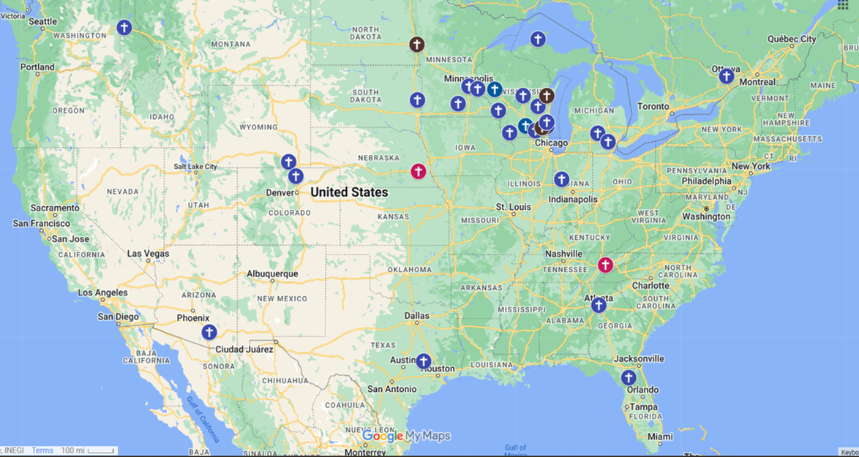
2020-2021 School Year
Notes:
27 Known Locations & Color Code
Brown = Unsubsidized (3)
Blue = Subsidized (24)
Red = Trying new ones (2) – didn’t work out after 2020-21

Slide 3
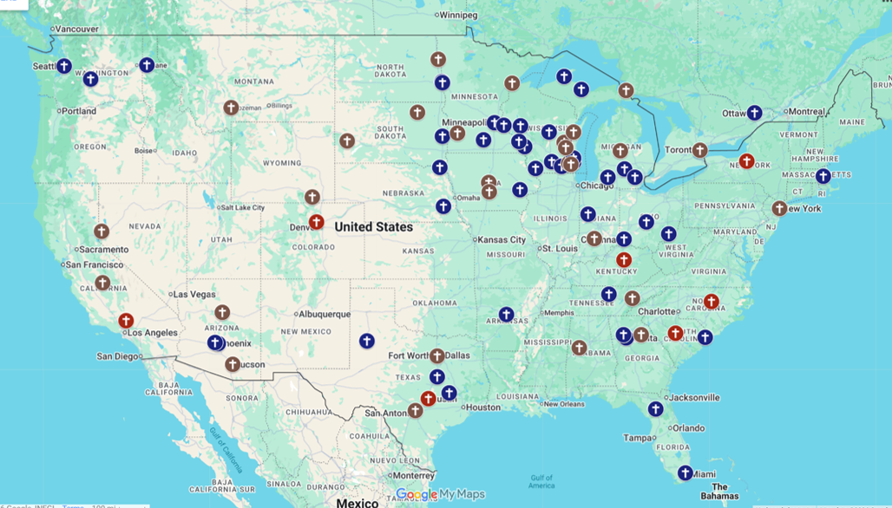
2026-27 School Year
Notes:
As you heard/now see for 2026-27 we’re starting with almost 80 locations. There are 51 locations receiving funding and another 28 that aren't that are more intensely active with their local colleges. The six in red are the newly funded locations for 2026-27.

Slide 4
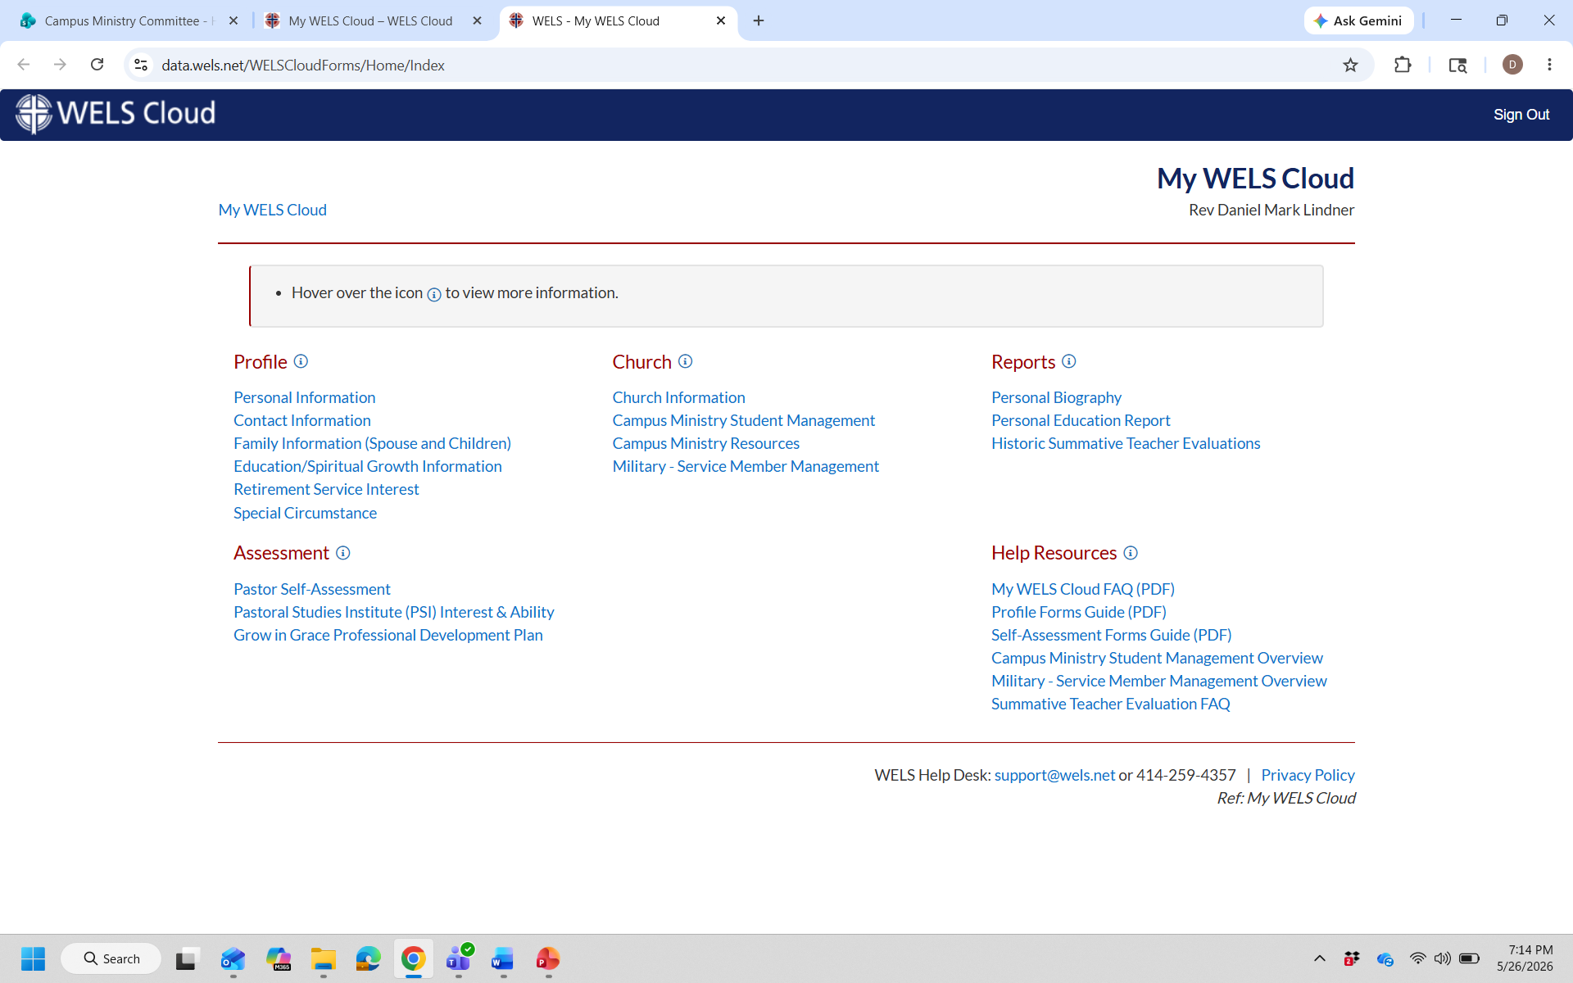
Notes:
As you've heard (if applicable), one of the best ways you can help WELS Campus Ministry is sharing your names with Synod. As you do that, our assumption is that you'll be talking with your members who are in college letting them know that you hope this place is their home away from home church and you intend to strengthen your relationship with the pastor/people serving them. We don't just collect the names and contact information for the sake of collecting them. Our hope is that it equips others to reach out to them and serve them.

Slide 5

Online
2026-2027 School Year Launch
Notes:
(Supposed to look like a computer): It's this, WELS Online Campus Ministry or WELS Campus Ministry Online). The intent was/is this. This was driven with the thought that we need something to serve students who are 25 miles or more away from a W(ELS) congregation. We wanted to try offering a regular Bible Study. We had conversations to try and work with those trying something similar. That led into further development that is producing online resources to aid in what was meant to be a weekly zoom gathering and an app POINT OF EMPHASIS – the primary objective was to provide an way that students could get together that can’t get together in person due to distance. Again, that led to including other resources. One of those things is the app. (Slide of WELS Online Campus Ministry App).

Slide 6
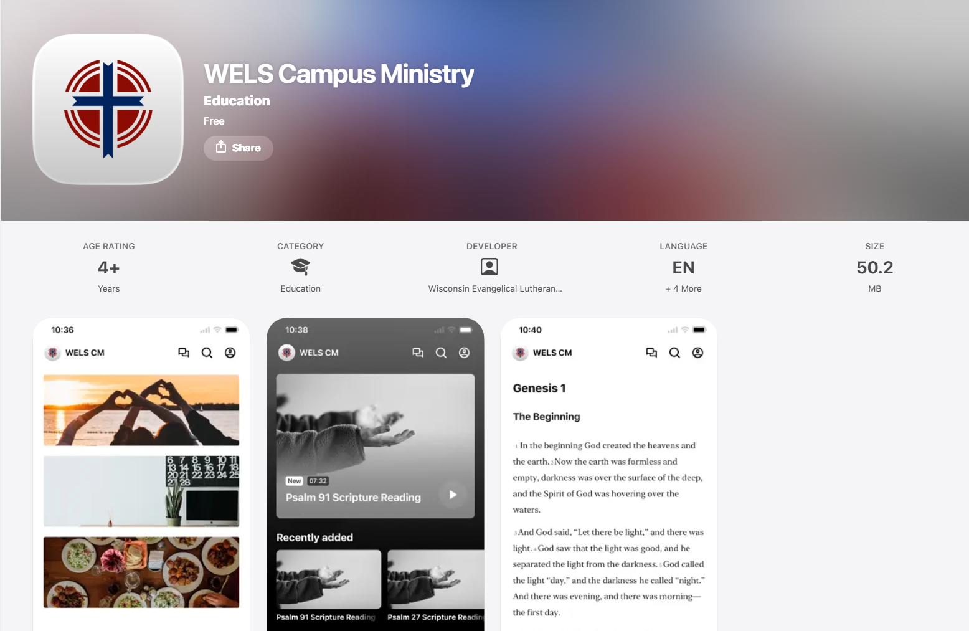
WELS Campus Ministry App
Notes:
This app is one where you will start see the building of material going into it and our hope is that we'll be able to get you something even more detailed by mid to late summer. WELS Campus Ministry wants you to know about it. We've done some tests with it. We're recruiting people to lead it (we had 18 interested from our Conference a few weeks ago). More information will be coming. The app is available.

Slide 7
What we hope to accomplish with this:
Give students the opportunity to:
Gather ​- Provide an online Bible Study option for students who are 25 miles+ from one of our W(ELS) congregations. (Weekly with potential expansion connected to time-zones),
Grow​ - Provide reading plans, devotions, videos, sermon studies, and other resources​. We’re working with multiple partners in the gospel who are already producing these things while also looking for others. An example is the WLC Theology staff who is producing 15, 30, and 45 minute video materials that can be utilized with a group or by the individual on their own time.
Go​ - We hope this will allow students (and us) to connect with more students. We will also try to regularly advertise things like mission journey and conference/retreat opportunities so these students can also gather in person​.
Partner - Identify exploratory opportunities and locations for the BHM District Mission Boards and potential landing spots for students who may want to serve or reinforce a Core Team.
Notes:
The current strong emphasis is serving students with something online who cannot gather in person. The hope is that the local contact pastor will try to do something with them in person about once a month and provide rides if needed to get to worship.

Slide 8

So then, just as you received Christ Jesus as Lord, continue to live your lives in him, rooted and built up in him, strengthened in the faith as you were taught, and overflowing with thankfulness. See to it that no one takes you captive through hollow and deceptive philosophy, which depends on human tradition and the elemental spiritual forces of this world rather than on Christ.
Colossians 2:6-8
Thank you!
Notes:
In the meantime, we have these areas in our District (verbally share them). And we have more being explored. Again, please make sure to get Synod the information of your college students. If you have any questions, I'm around and our WELS Campus Ministry Committee would love to help (a key guy to talk to is WELS Campus Ministry Mission Counselor is Pastor Dan Lindner. I can get you his contact info).
Thanks you!

