Slide 1


WELS Home Missions/
100 Missions in 10 Years
2026 MN District
Convention

Slide 2
1 Timothy 1:15-16
¹⁵ Here is a trustworthy saying that deserves full acceptance: Christ Jesus came into the world to save sinners—of whom I am the worst. ¹⁶ But for that very reason I was shown mercy so that in me, the worst of sinners, Christ Jesus might display his immense patience as an example for those who would believe in him and receive eternal life.

Slide 3
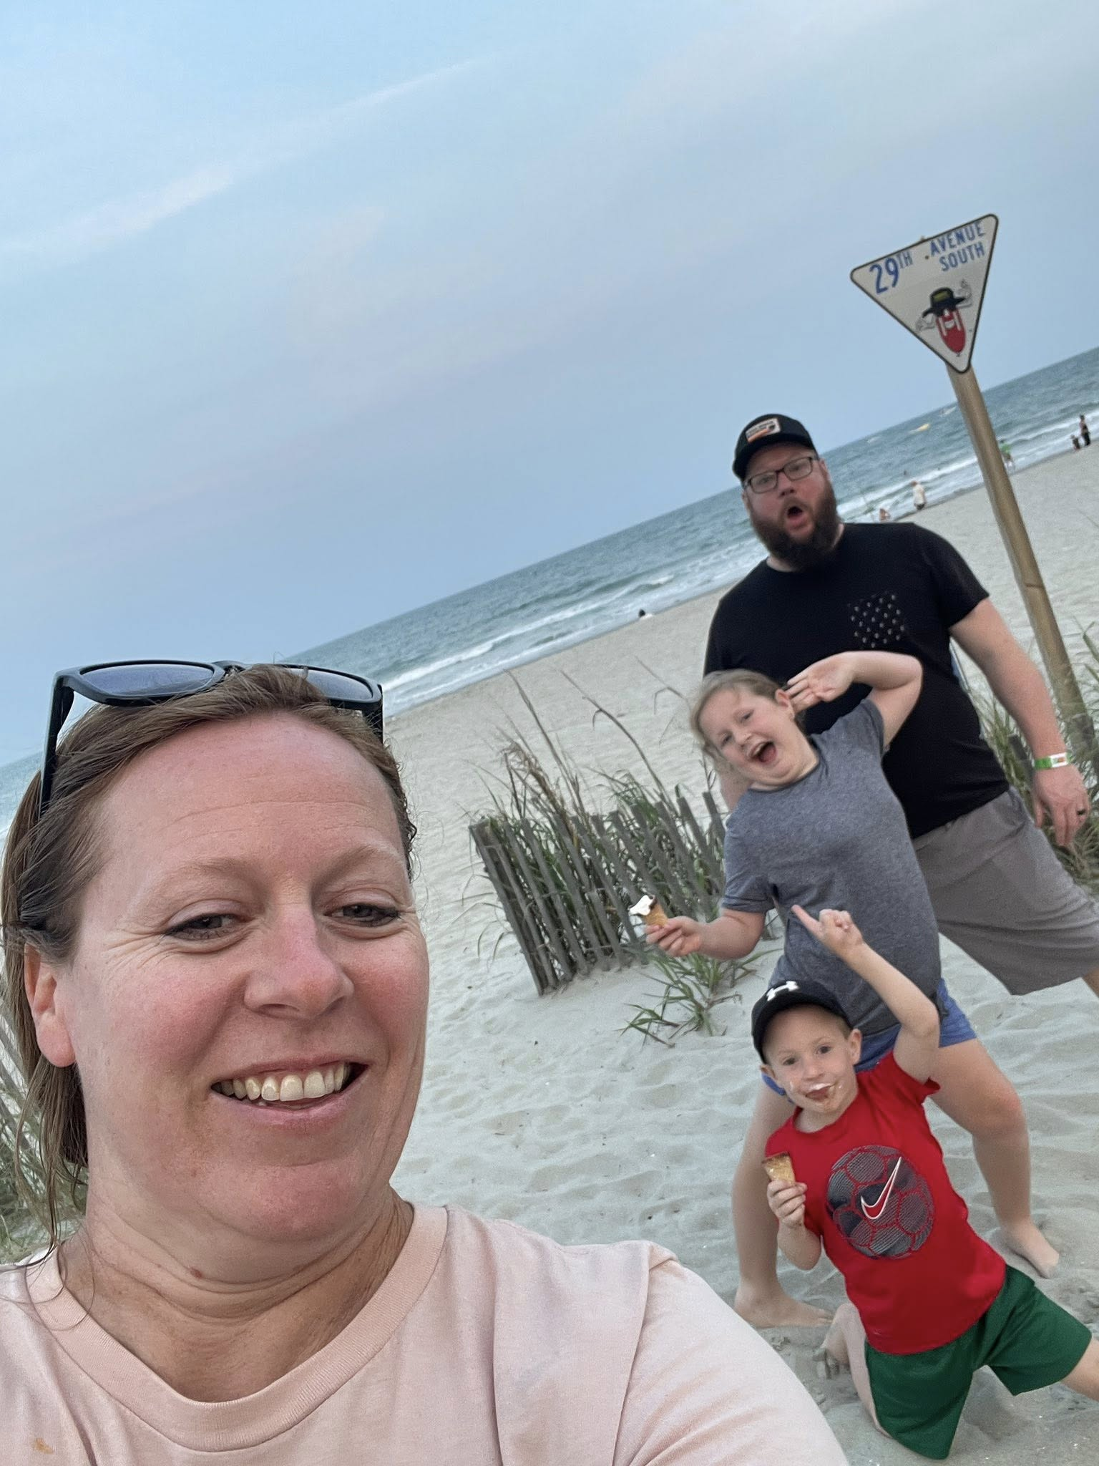
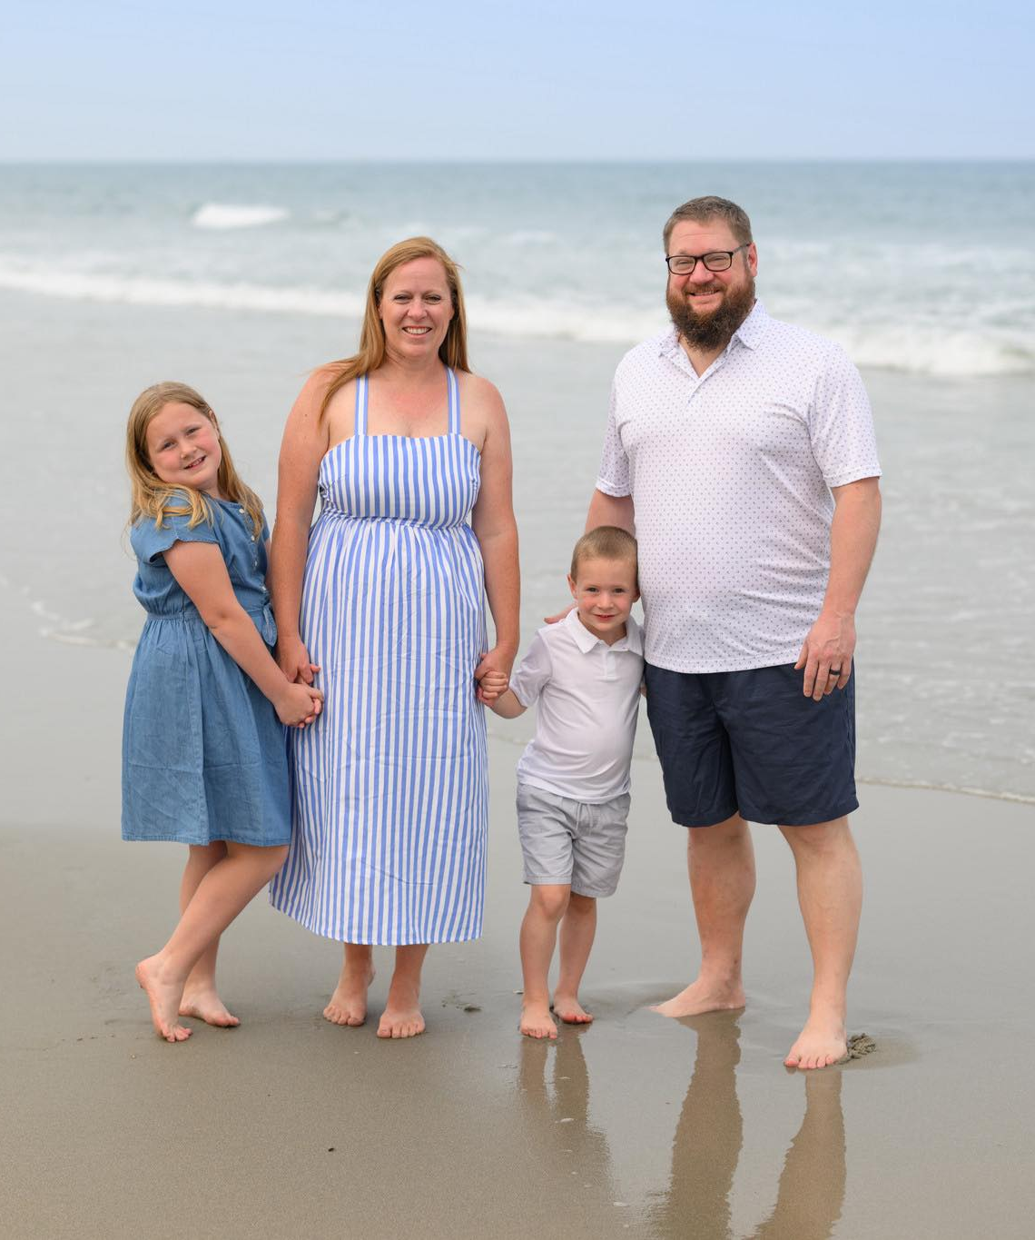

Slide 4

2026 New Starts:
Bastrop, Texas
Greeneville, Tenn.
North Marana, Ariz.
Notes:
At its spring meeting, the WELS Board for Home Missions approved three new mission starts, continuing its work of bringing the gospel to growing communities across the United States while navigating ongoing financial and manpower challenges.

Slide 5
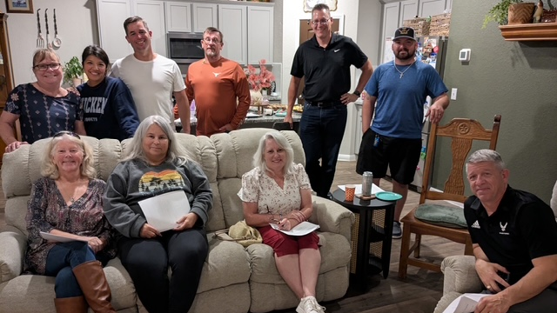

New Start – Bastrop, Texas
Notes:
Located about 25 miles east of Austin, Bastrop is experiencing rapid growth fueled by new residential development and expanding economic activity. Major employers now headquartered in Bastrop, including X and Starlink, have drawn new families to the area. As Bastrop continues to expand, many residents lack church connections, and a confessional Lutheran presence remains limited. Members of Holy Word in Austin, Texas, have formed a committed core group that has been meeting regularly, engaging the community through service and outreach, and building relationships with residents. Bastrop presents a timely opportunity for a new Home Mission start.
Fast facts:
Bastrop County’s population has grown by more than 15 percent since 2020. Large master‑planned developments continue to add thousands of new homes.
A committed core group from Holy Word in Austin has been meeting regularly since mid‑2025, using the name 7:37 Ministry during the early stages of outreach. The name connects Jesus’ invitation in John 7:37, “Let anyone who is thirsty come to me and drink,” with the local 737 area code.
Core group members have actively engaged the community through service partnerships with the Bastrop Food Pantry, outreach booths at local events, neighborhood activities within large residential developments, and door‑to‑door food canvassing, building relationships that have led to ongoing conversations and growing interest.

Slide 6
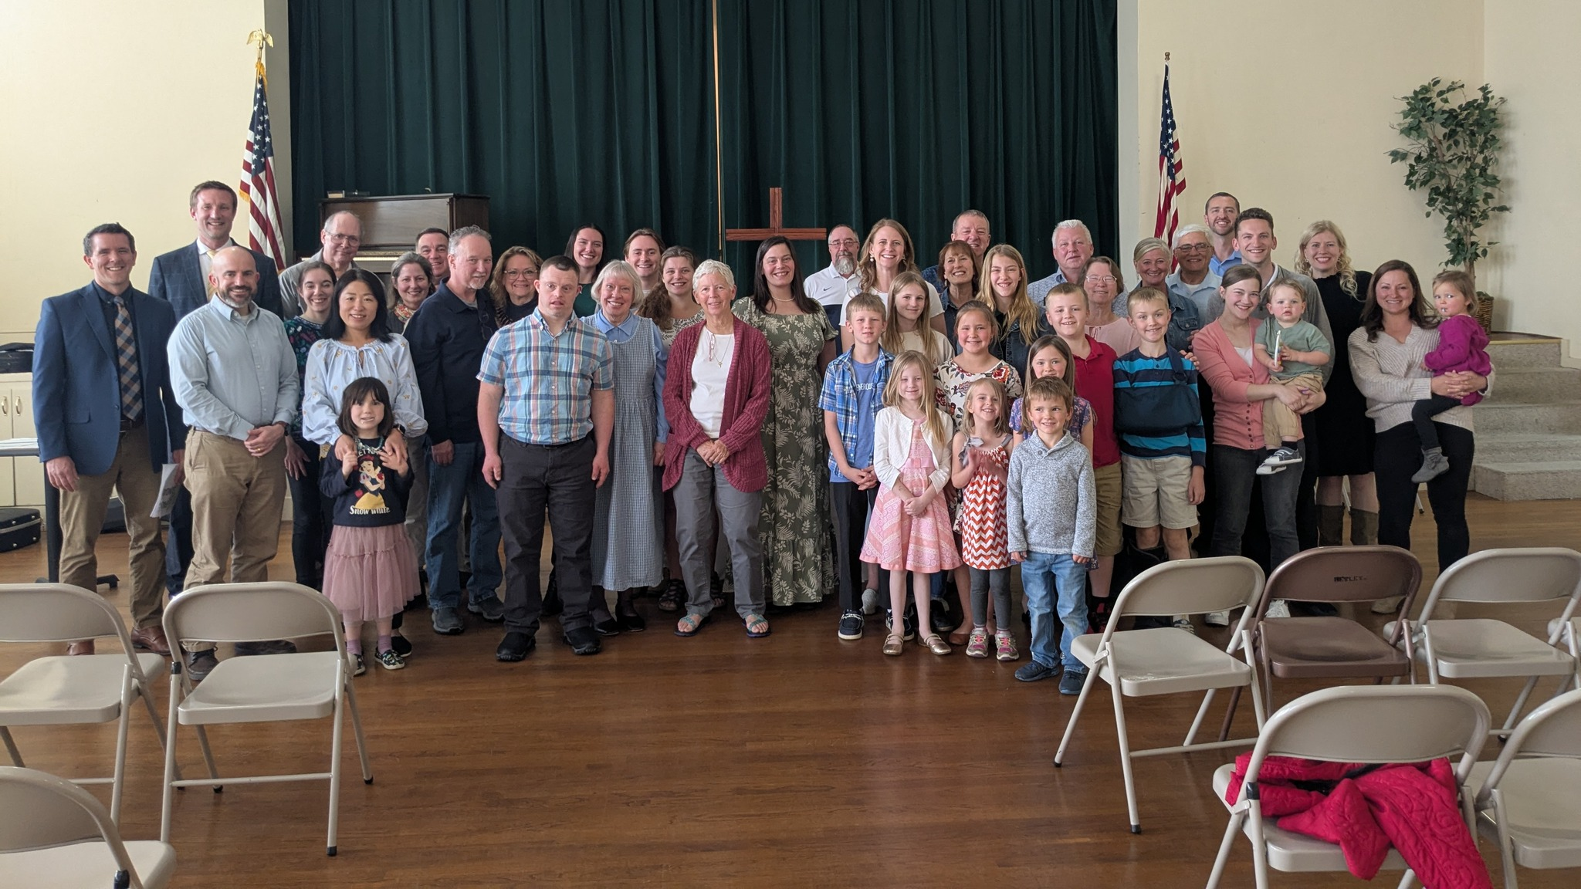
New Start – Greeneville, Tenn.
Notes:
Greeneville, Tenn., is a growing community positioned between the Johnson City/Kingsport/Bristol metro area and Knoxville. While the area reflects strong Bible Belt culture and openness to conversations about faith, currently no confessional Lutheran church serves the community. A committed core group, supported by nearby WELS congregations in Johnson City and Morristown, has been meeting regularly and actively engaging with the community. Greeneville represents an opportunity to establish a confessional Lutheran presence in a community where none currently exists.
Fast facts:
Greeneville serves a county population of approximately 70,000 people, functioning as a regional hub for surrounding rural communities.
The nearest WELS congregations are located 33–35 miles away in Johnson City and Morristown.
A core group of 14 people has been meeting regularly and has already hosted public worship services, drawing more than 40 people to its first service (pictured) and averaging mid‑20s attendance at subsequent gatherings.
Outreach efforts have included door‑to‑door canvassing, participation in community events, and local advertising, resulting in nine new families added to the prospect list and multiple repeat worship visitors.

Slide 7
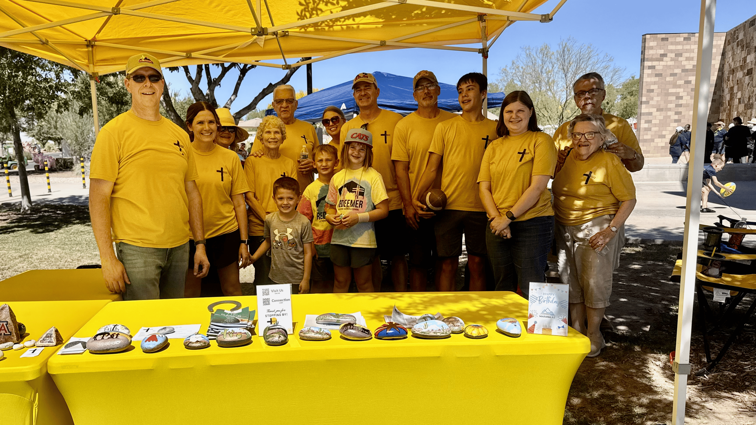
New Start – North Marana, Ariz.
Notes:
North Marana is one of the fastest growing areas in the Tucson metro area, now home to more than 60,000 residents. A new mission effort—known locally as Mission Marana—is already active in the community, with a committed core group that gathers for Bible study and regularly serves at local events across North Marana. With strong local leadership and a clear focus on serving before being served, this new mission is positioned to grow alongside a rapidly expanding population of young families.
Fast facts:
A strong core group of 20–25 people has been meeting regularly since fall 2024 for Bible study, outreach, and mission planning.
Through service at local events such as Founders Day, Movies in the Park, food drives, and holiday festivals, Mission Marana has built community trust and developed a prospect list of more than 150 contacts.
Nearby WELS congregations are actively supporting the effort, including a four-year financial commitment from Shepherd of the Hills.
Plans are in place to begin public worship services in 2027.

Slide 8
2026 Enhancements:
Good Shepherd, Holmen, Wis.
Mount Olive, St. Paul, Minn.
Resurrection, Chesapeake, Va.
Notes:
In addition to the new mission starts, the board approved three Home Missions enhancement grants.
Good Shepherd, Holmen, Wis.: Good Shepherd is a thriving congregation serving the fast-growing community of Holmen, just north of La Crosse, Wis. With a strong culture of outreach, regular door-to-door engagement, and a visible presence at community events, the congregation continues to connect with new families moving into the area. Little Lamb Preschool has become one of Good Shepherd’s most effective ministry bridges, regularly introducing unchurched families to the gospel. A short-term Home Missions enhancement grant will support the calling of a staff minister to build on that momentum, strengthen follow-up and discipleship, and help the congregation keep pace with growth.
Mount Olive, St. Paul, Minn.: Mount Olive is a historic congregation located between downtown Minneapolis and St. Paul, Minn., in a highly populated urban neighborhood. With a debt-free facility and a creative, mission-minded core group, Mount Olive is uniquely positioned to serve as a healthy WELS presence in the urban core. Lay leaders have long been involved with other WELS churches, including a Merge for Mission effort, while continuing to invest locally in worship, children’s ministry, and community engagement. This enhancement grant will support a full-time pastor who will build on existing momentum as Mount Olive grows as a vibrant city church reaching people across the Twin Cities.
Resurrection, Chesapeake, Va.: Resurrection Lutheran Church is an established congregation with a highly visible campus in Chesapeake, Va.—one of the state’s largest and fastest growing cities. In recent years, the congregation has regained momentum under the leadership of a retiring pastor who helped strengthen worship life, stewardship, and outreach. A Home Missions enhancement grant will provide a short-term bridge as Resurrection calls a new pastor, allowing the congregation to build on that progress and continue reaching its community with the gospel.

Slide 9
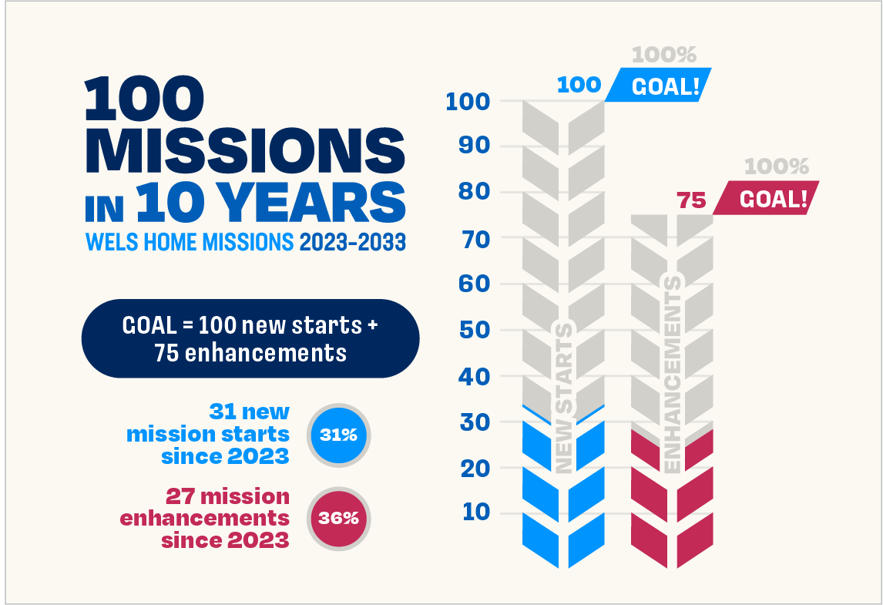
Balancing gratitude, needs, and stewardship
Notes:
Since the launch of the 100 Missions in 10 Years initiative in 2023, 31 new missions have been approved for funding by WELS Home Missions. Approving three new mission starts at the recent meeting of the Board for Home Missions is cause for thanksgiving, but it falls short of the desire to approve ten new starts each year. It does, however, reflect current realities. In WELS today there are 150+ pastoral vacancies. Additionally, Congregation Mission Offerings (CMO) and special gifts to Home Missions have not kept pace with the rising costs of establishing and supporting new missions.
As Home Missions leadership continues this initiative, the focus remains on faithful stewardship. The challenge is not a lack of gospel opportunities, but discerning how best to deploy the finite resources our synod has. This is not a new struggle for the church, but one God’s people have faced throughout history as they seek to balance zeal for mission work with wise use of limited resources.
Even amid these challenges, God continues to work powerfully through dedicated core groups, WELS congregations, and pastors serving in mission settings. Through ongoing prayers, generosity, and partnership, home mission churches are proclaiming Christ, strengthening believers, and reaching the lost with the gospel that endures for eternity.

Slide 10
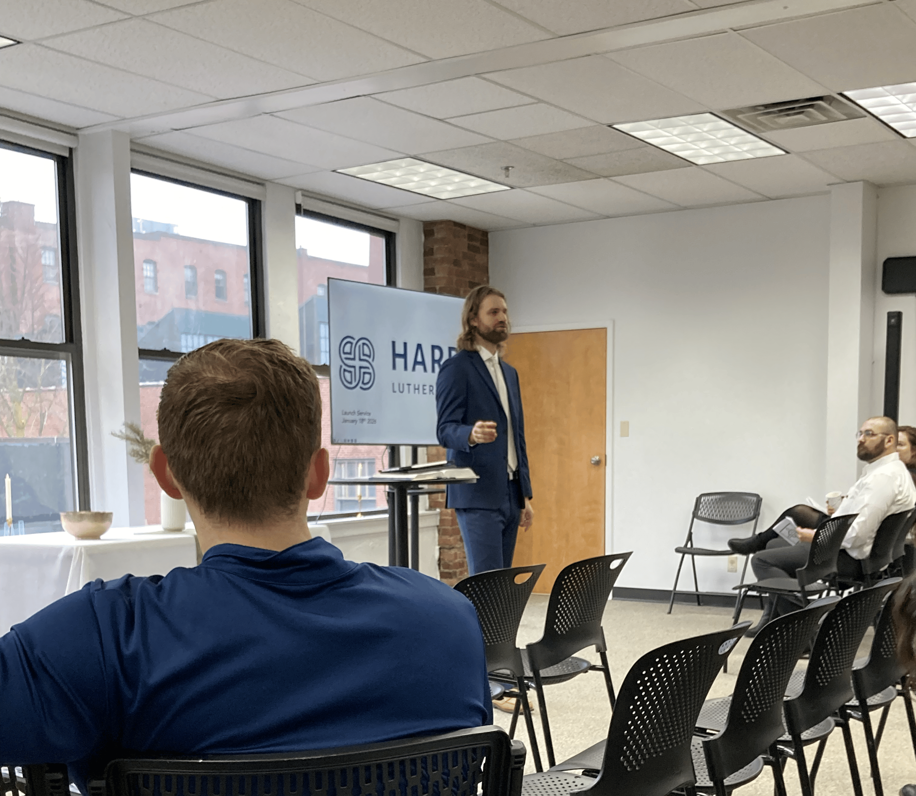
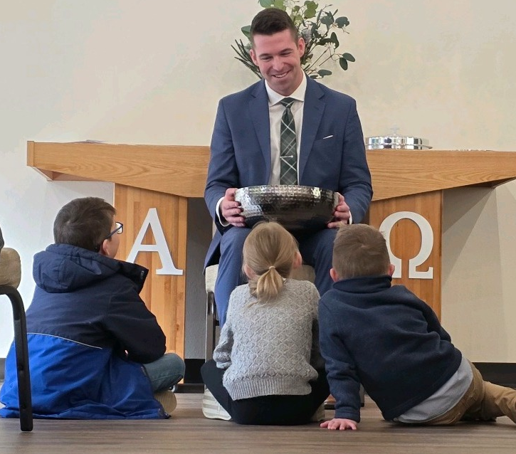
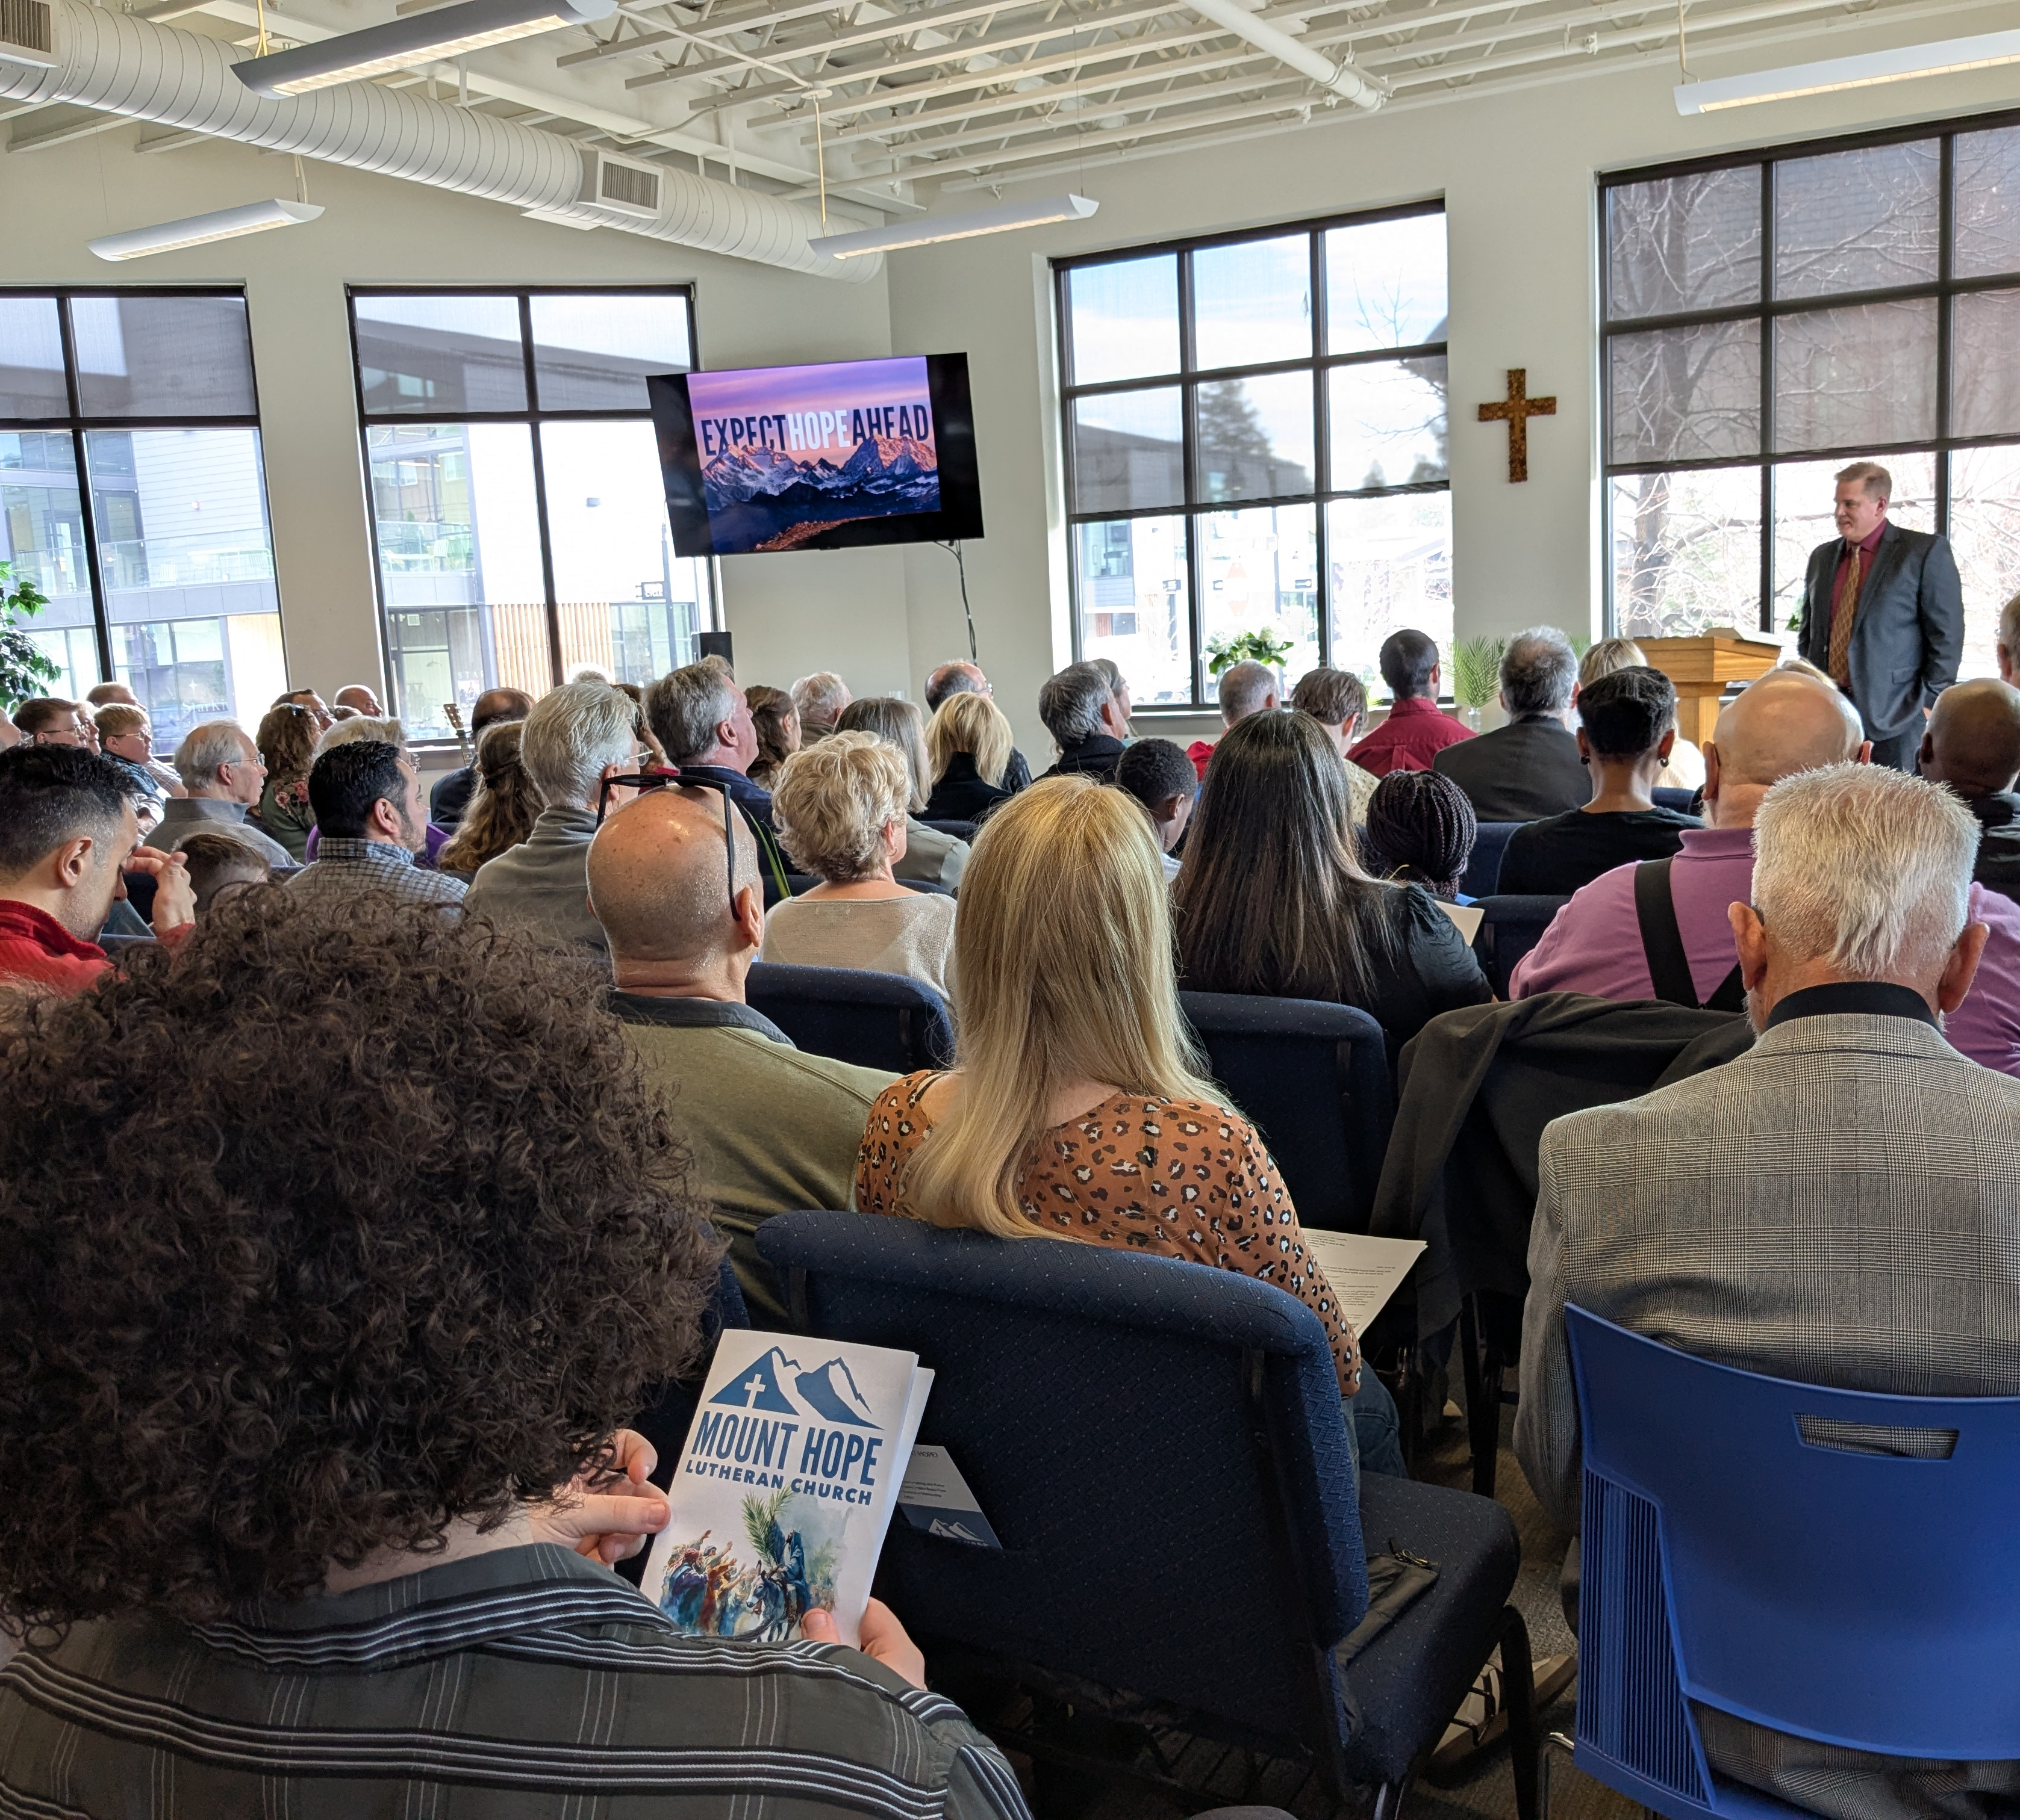
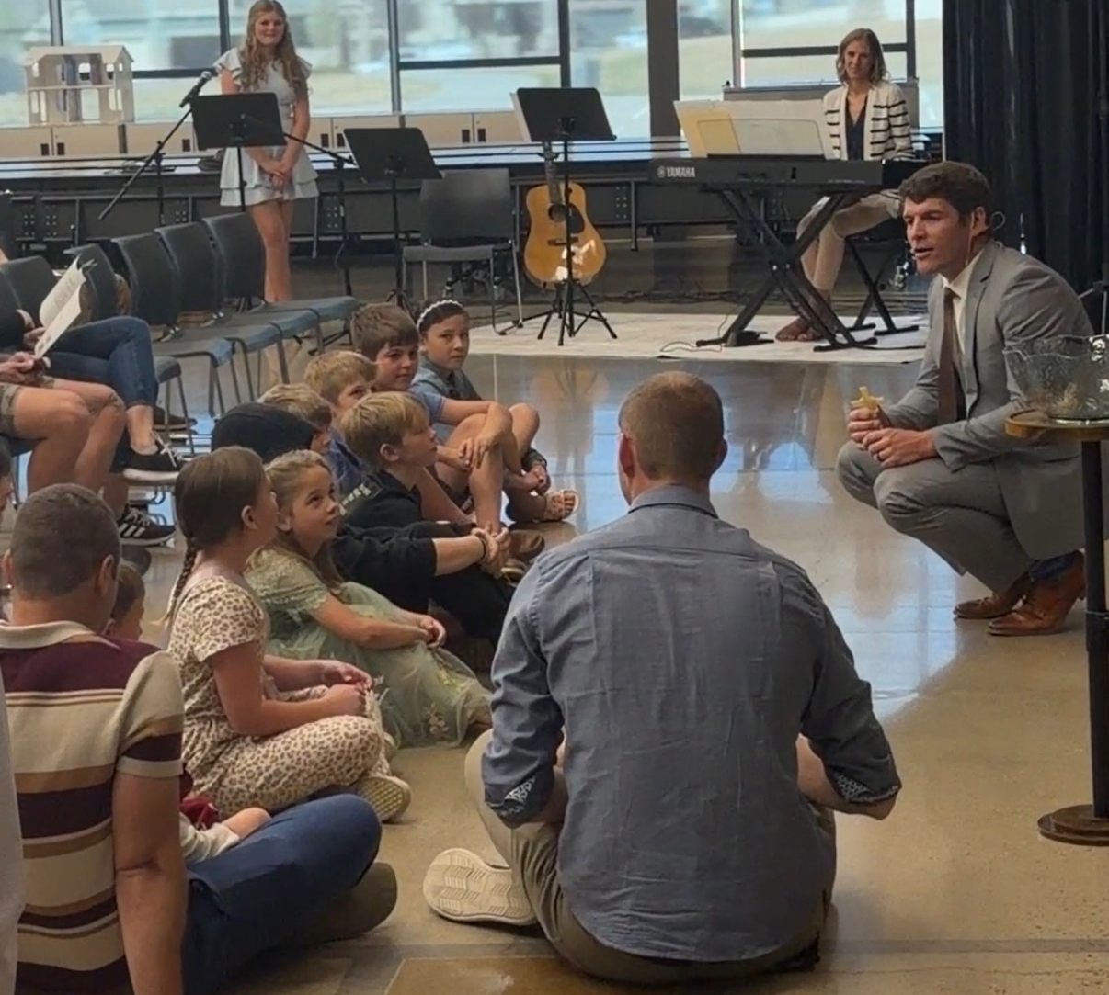
Home missions celebrate grand openings
Harbor –
Boston, Mass. (Jan. 18)
Cornerstone - Centerton, AR (Feb. 22)
Mount Hope –
Bend, Ore. (March 29)
Redemption –
Erie, Colo. (March 29)
Crossroads –
Chicago, Ill. (April 5)
Notes:
Harbor – Boston, Mass. (pictured top left) - Harbor Lutheran Church hosted their launch service in their newly finished worship space on Jan. 18. Harbor was approved as a new mission start in 2023, the first year of the 100 in 10 initiative.
Cornerstone - Centerton, AR (pictured top right) - Cornerstone in Centerton (Bentonville), Ark., celebrated their worship launch on Feb, 22. Cornerstone was also approved as a new mission start in 2023, the first year of the 100 in 10 initiative.
Mount Hope – Bend, Ore. (pictured bottom left) – Mount Hope had over 90 people at their grand opening on March 29, including 45 visitors/prospects from the community. Mount Hope was approved in 2024.
Redemption – Erie, Colo. (pictured bottom right) - Redemption welcomed 73 people to its launch service on March 29, including nearly 30 visitors from the community. Redemption was approved in 2025 and launched public worship just a year after approval.
Crossroads – Chicago, Ill .– Crossroads, a mission restart that was approved in 2024, relaunched public worship on Easter Sunday.

Slide 11

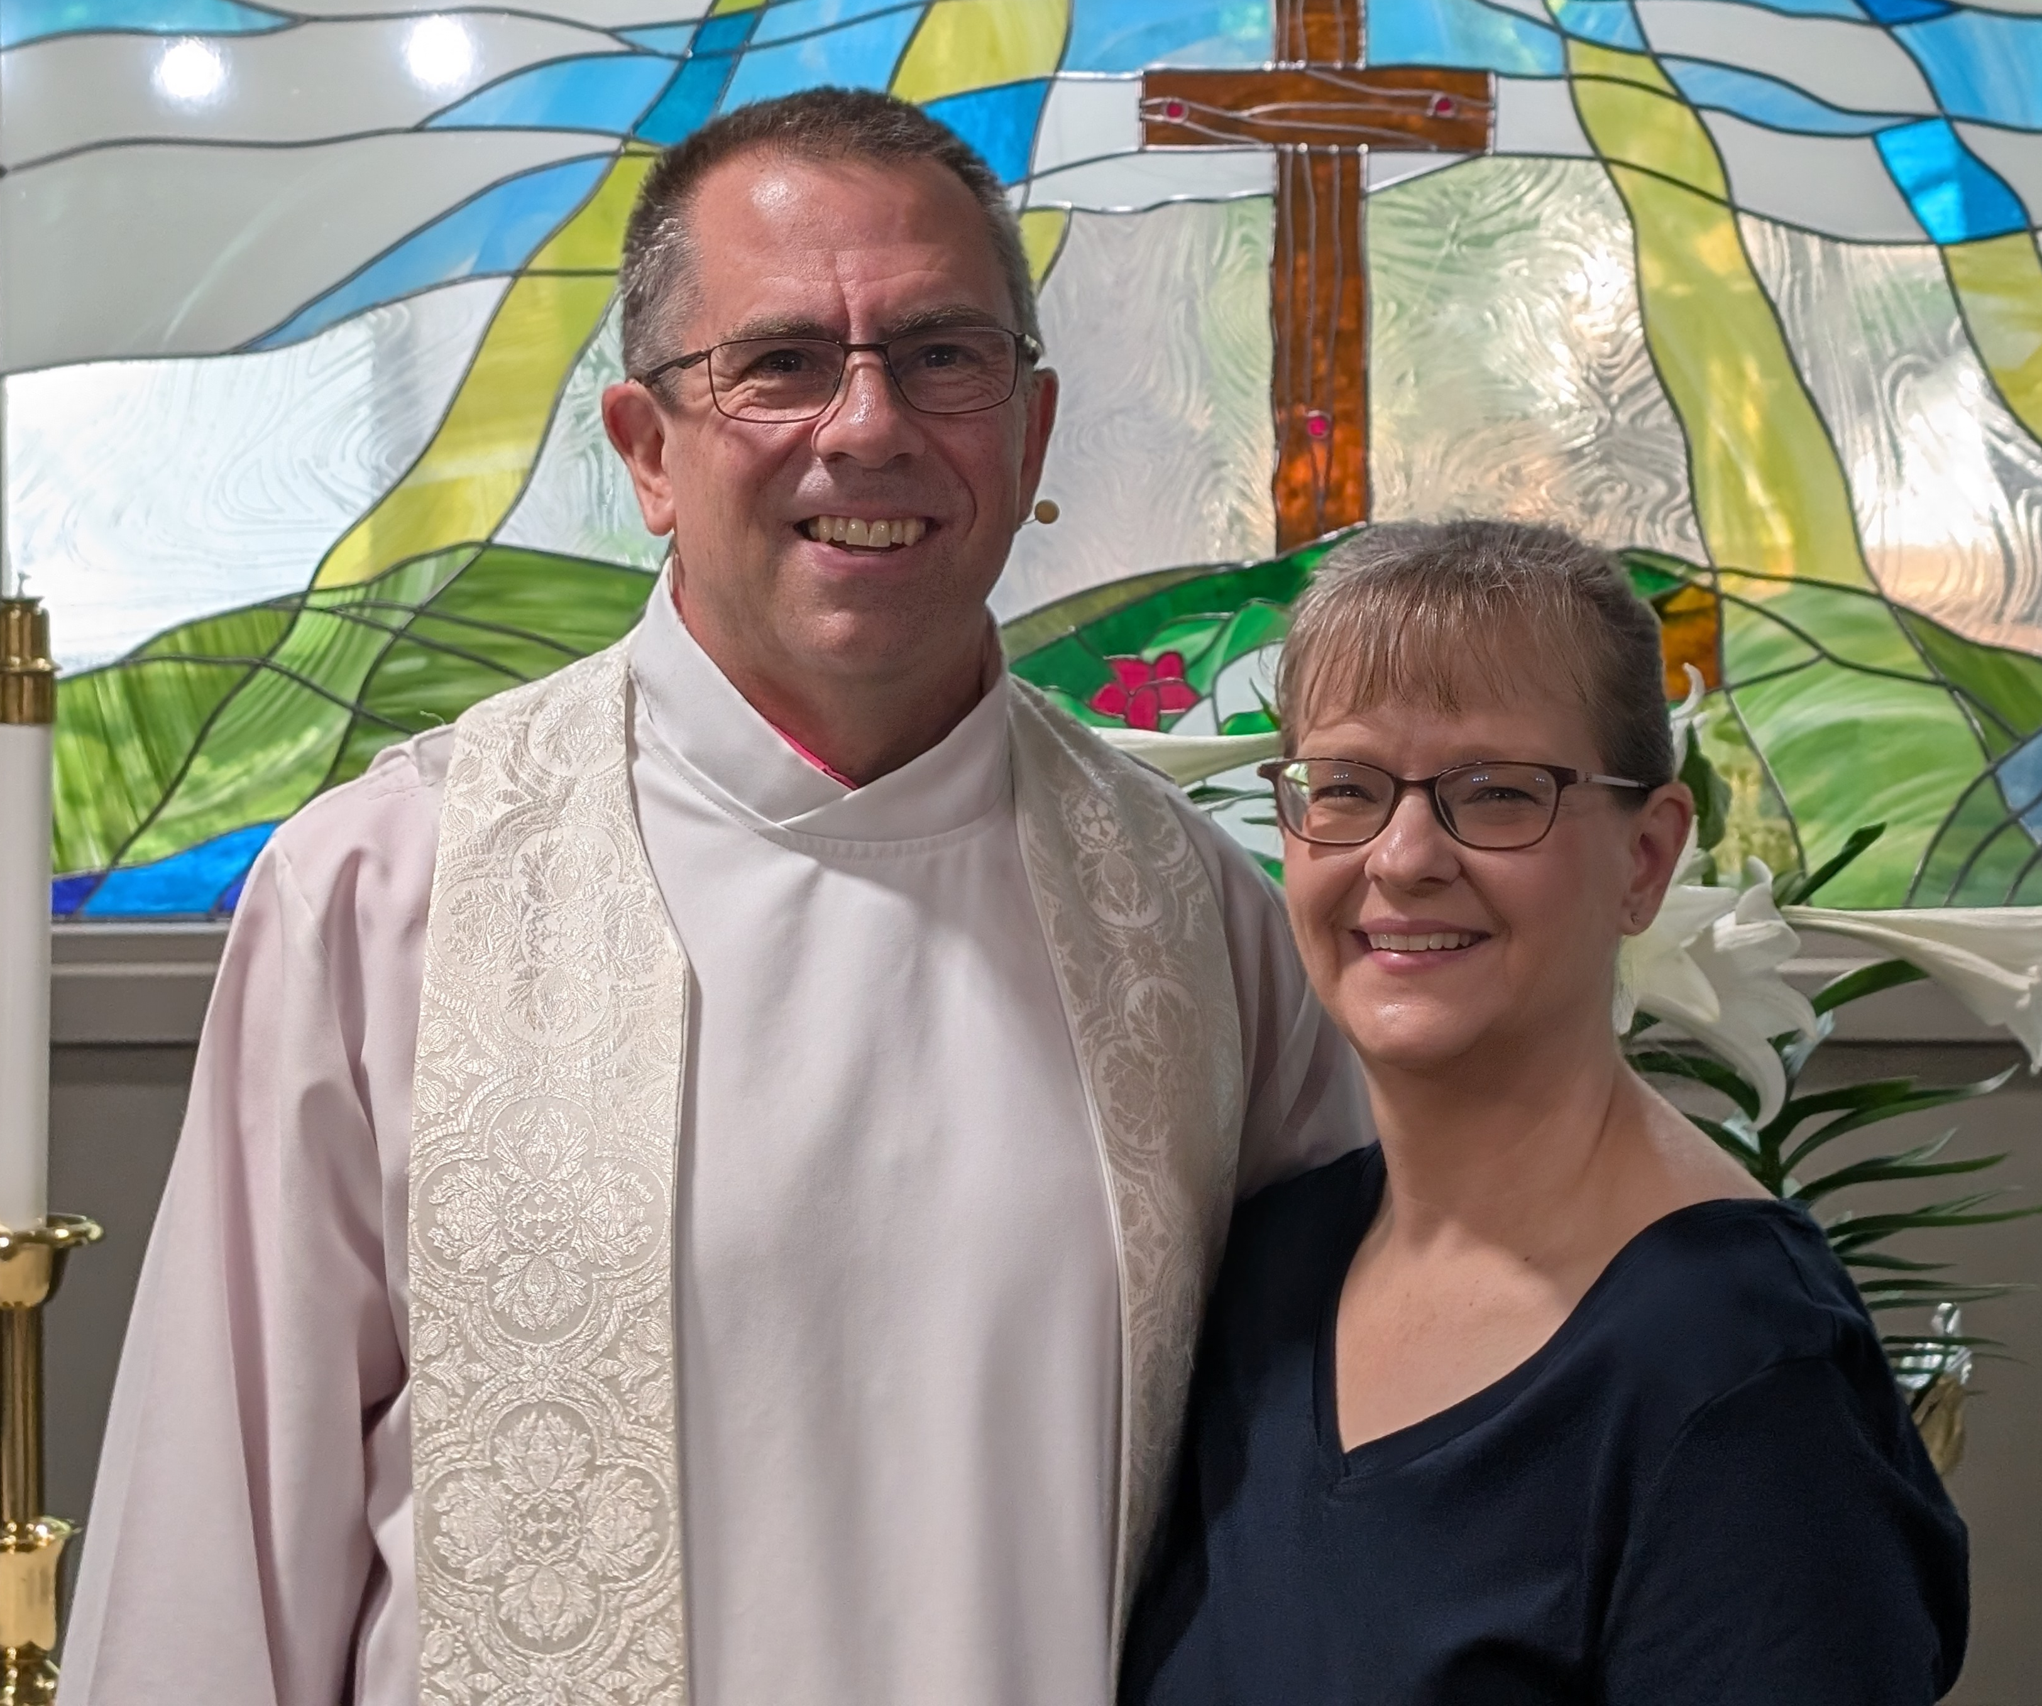
Commissioning of new Home Mission Counselor,
Rev. Nathan Strutz
Notes:
Taste of Missions will be held on Saturday, June 13, 2026, at Wisconsin Lutheran Seminary, Mequon, Wis. The event kicks off with the commissioning of new home and world missionaries.
Rev. Nathan Strutz, new Home Missions Counselor, will be commissioned as part of that special service. He began serving as a mission counselor for WELS Home Missions in April 2026. He is supporting the South Atlantic, Southeastern Wisconsin, Northern Wisconsin, Nebraska, and Colorado mission districts as they work to plant new mission churches and support and encourage existing home mission congregations. Strutz has served in home missions throughout his entire ministry. His first call was to a dual parish in Holmen and Galesville, Wis. (1997-2010), where the congregation in Galesville established one of the first multi-site ministries in WELS by opening a new location in Arcadia, Wis. Strutz also served at Resurrection in Verona, Wis. (2010-2022), and Tree of Life in Cary, N.C. (2022-2026). New mission efforts were started at both congregations during his time of service. He has served as chairman of the Western Wisconsin District Mission Board and as a member of the Board for Home Missions Executive Committee.
Missionaries assigned to home mission congregations will also be invited to participate in the commissioning upon graduation from Wisconsin Lutheran Seminary in May. Stay tuned for more information as it becomes confirmed! If you can’t attend in person, tune into the livestream.
Additional resources you can use to promote the event within your congregation can be found at tasteofmissions.com/resources.
Learn more and register at tasteofmissions.com.

Slide 12
MINNESOTA DISTRICT Mission Board (MN DMB)
Serving Minnesota, Iowa, and Missouri areas
September 2025

Slide 13
MN DMB: Members
Rev. Stephen Schmiel (Chair) Faith, Prior Lake, MN
Rev. Rev Mark Kaesmeyer West Lutheran High School, Plymouth, MN
Rev. Rob Guenther St. John’s, New Ulm, MN
Rev. Brian Schmidt Beautiful Savior, West Des Moines, IA
Mr. Daryl Schultz Resurrection & Life, Rochester, MN
Mr. Glen Schulz Zion, Springfield, MO
Mr. Galen Holzhueter Saint Mark, North Mankato, Mankato

Slide 14
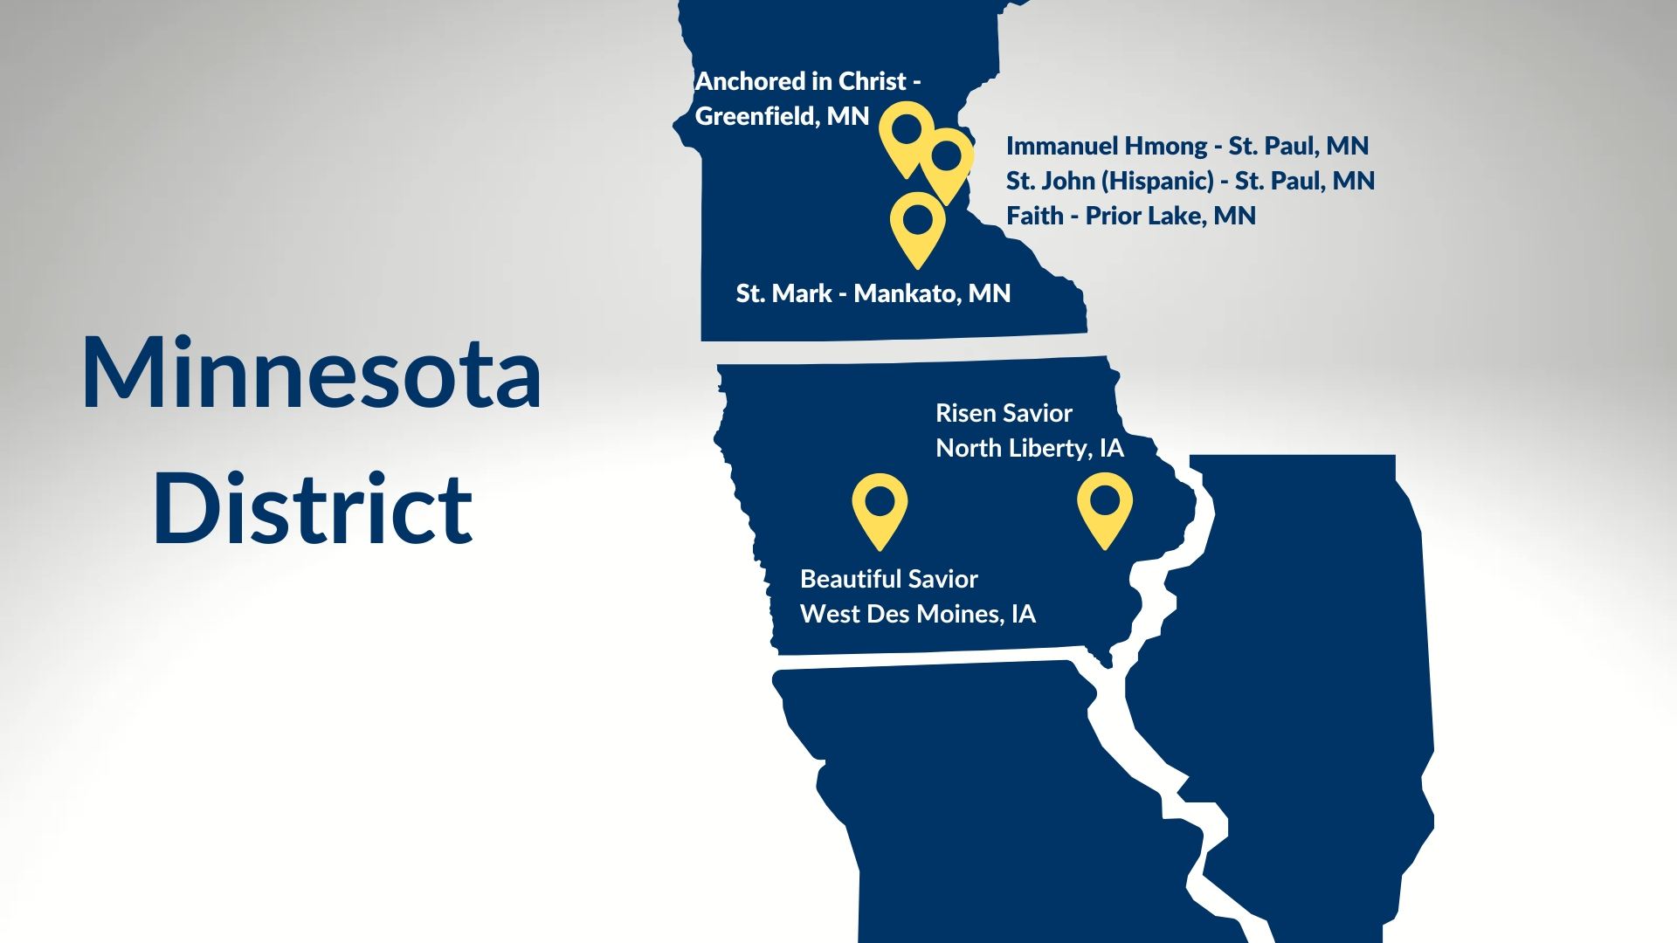
Immanuel Hmong Inver Grove Heights, MN
Mount Olive St. Paul, MN
Faith, Prior Lake, MN

Slide 15
Minnesota District
Churches: 170
Early Childhood Ministries: 44
Lutheran Elementary Schools: 34
Lutheran High Schools: 3
WELS College: 1

Slide 16
MN DMB: Behind the Scenes
Monthly Virtual meetings, plus annual in-person Summer planning event
Synod BHM Meetings 2 times a year
Shepherd new and existing home missions
Help navigate CMR, MPSA, BIR, etc..

Slide 17
TYPES of HOME MISSIONS
Unsubsidized Missions:
Not receiving, or no longer receiving, subsidy but wants to continue working with Home Mission Board
Self-Funded Congregation
Subsidized Missions:
New Mission Start
Mission Enhancement

Slide 18
TYPES of HOME MISSIONS
Mission Enhancement:
Church has a high number of prospects and cannot keep up with the baptisms, confirmations, BIC classes and family counseling.
Church has a cross-cultural ministry that is serving a group of prospects. The congregation feels they are ready to serve the group with a full-time pastor.
Church and/or School has potential opportunity to reach local community by expanded ministry (Preschool, Learning Center, Building Capacity Plans, expanded programs)
Church has an excellent opportunity to reach out a local college. The church believes they need resources for 3 years to help them add staff to develop a campus ministry.

Slide 19
TYPES of HOME MISSIONS
Restarts:
Taking an existing but struggling congregation and re-launching with new core leadership, vision, and strategy.
Congregation or Area of Congregations faces ministry struggles. Requests help to do outreach ministry or strives to overcome special circumstances.
Restarts may include:
  Replant: Relaunch under new pastor/vision while retaining property.
  Revitalization: Refreshing ministry with existing congregation and assets.

Slide 20
MN DMB: HOME MISSIONS
Immanuel Hmong Inver Grove Heights, MN
Mount Olive St. Paul, MN
Faith, Prior Lake, MN
New Starts:
  Risen Savior, North Liberty, IA (2021)
Restarts:
  Beautiful Savior, West Des Moines, IA (2023)
Cross Cultural:
  Immanuel Hmong, St. Paul, MN (2013)
Enhancements:
  Faith, Prior Lake, MN (2024)
  Saint Mark, Mankato, MN (2025)
  Mount Olive, St. Paul, MN (2026)
Unsubsidized:

Slide 21
MN DMB: Pipe Line
Immanuel Hmong Inver Grove Heights, MN
Mount Olive St. Paul, MN
Faith, Prior Lake, MN
Cross Cultural Exploration
Divinity, St. Paul:
  Cross Cultural Hmong Exploration
  Josiah Vang beginning tent ministry
  Encouragement for MN District:
    Consider Mission Offering Designation
New Hope, Princeton, Minneapolis:
  Alexandar Xiong, PSI Graduate
  Cross Cultural Hmong Exploration
Pilgrim, Minneapolis:
  Hispanic Exploration

Slide 22
MN DMB: Pipe Line
Immanuel Hmong Inver Grove Heights, MN
Mount Olive St. Paul, MN
Faith, Prior Lake, MN
Opportunities on the Radar:
  Ankeny, IA (New Start)
  Lincoln Heights/Des Moines, IA (Cross Cultural Hispanic Outreach)
  Somerset, WI (New Start / Dual-site)
  Bloomington (Unsubsidised / Enhancement)
  Austin, MN (Enhancement, Cross Cultural Hispanic Outreach)
  Goodhue, MN
  St. Mark Bemidji, MN
  Hope Andover, MN

Slide 23

High school graduations are approaching:
Share student information with
WELS Campus Ministry!
Notes:
WELS Campus Ministry provides resources, support, and encouragement to WELS congregations that serve college students.
Almost every university in the United States and Canada has an assigned campus ministry contact pastor. Each contact pastor receives a list of WELS student that are attending their school. By sharing information with WELS Campus Ministry, these contact pastors know who the students are and can help them stay connected to Christ and strengthen their faith while at school.
We need your help in this process! Please work with the high school/college age students at your congregation and get them signed up with WELS Campus Ministry. Instructions on how to share student information can be found at wels.net/cmtoolkit, and you can encourage students to sign up directly at wels.net/college.

Slide 24
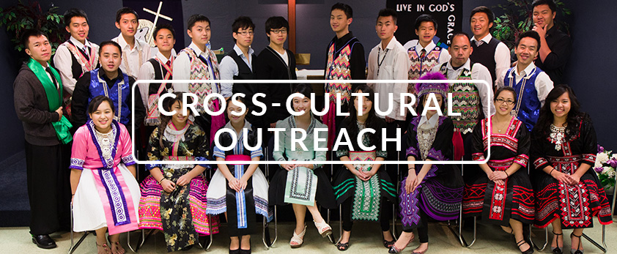

Slide 25
Notes:
Encourage people to check out the website: Learn more and stay up-to-date on progress at wels.net/100in10.

Slide 26
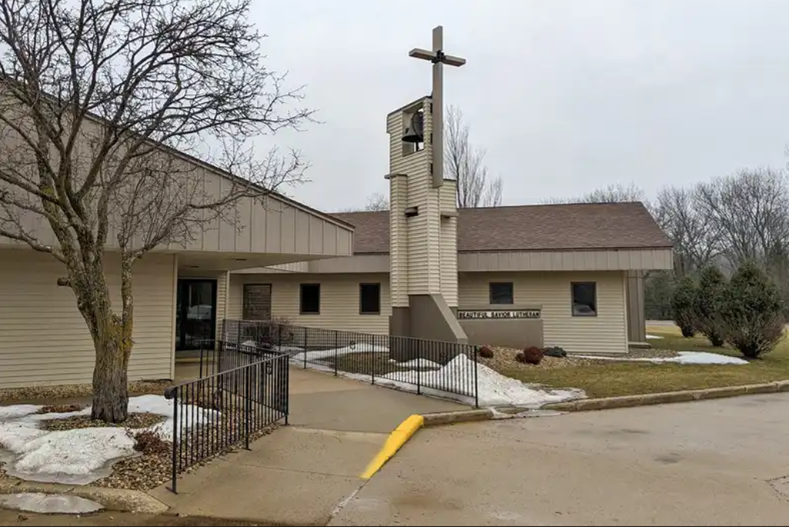
Beautiful Savior, Austin, MN
What’s Next? What do you want to do?

Slide 27

Beautiful Savior, Austin, MN
What’s Next? What do you want to do?
Neighborhood Church
Identity
“The Surprising Return of
the Neighborhood Church”
By Sam Rainer

Slide 28
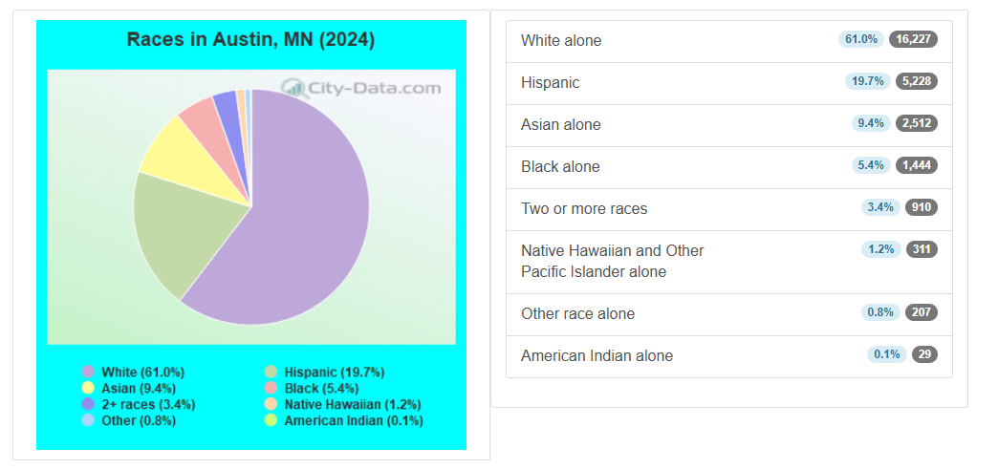
Beautiful Savior, Austin, MN
What’s Next? What do you want to do?
Hispanic Outreach

Slide 29
Beautiful Savior, Austin, MN
What’s Next? What do you want to do?
Hispanic Outreach
Are you able to talk to Hispanics in your community or at your jobs?
Do you already have connections with Hispanic people in your community?

Slide 30
Beautiful Savior, Austin, MN
What’s Next? What do you want to do?
Hispanic Outreach
BHM Enhancement Requirements:
Mission Minded
Committed to Evangelism
Ministry Plan with Benchmarks
Commitment to Monthly reporting of ministry efforts and financials

Slide 31
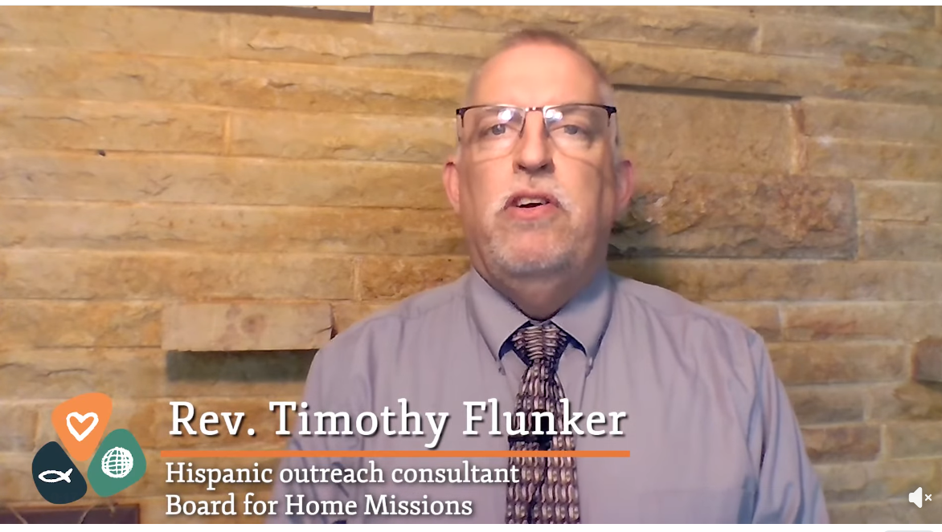
Beautiful Savior, Austin, MN
What’s Next? What do you want to do?
BHM Hispanic Outreach Counselor
flunker.tim@gmail.com
920-217-2704

