Slide 1
Rev. Steve Schmeling
WELS Christian Giving Counselor

Slide 2

WELS Ministry of Christian Giving mission
We encourage members to excel in the grace of giving through Christ and assist them in making planned gifts to support the gospel ministry of their congregations, synod, and WELS-affiliated ministries.
Notes:
MCG assists the COP with their responsibility to fund the Lord’s work through our synod. This funding is provided through Congregation Mission Offerings as well as direct gifts to WELS from individuals, groups, and foundations. Those offerings are prompted by Christ’s saving love for us and his Spirit’s gift of generosity.

Slide 3

Devotional thought
“You know the grace of our Lord Jesus Christ, that though he was rich, yet for your sake he became poor, so that you through his poverty might become rich” (2 Corinthians 8:9).
“You will be enriched in every way so that you can be generous on every occasion, and through us your generosity will result in thanksgiving to God” (2 Corinthians 9:11).
Notes:
The “Christ through us” long-range strategic plan assumes that God’s people in WELS will continue to excel in the grace of giving through Christ – who became poor that we might be rich with every spiritual blessing and all that we need in life – so that we who have been enriched in our Savior can be generous on every occasion, which results in thanksgiving to God. Generosity doesn’t occur naturally. It is a gift of God the Holy Spirit through the good news of Jesus in Word and sacraments.

Slide 4
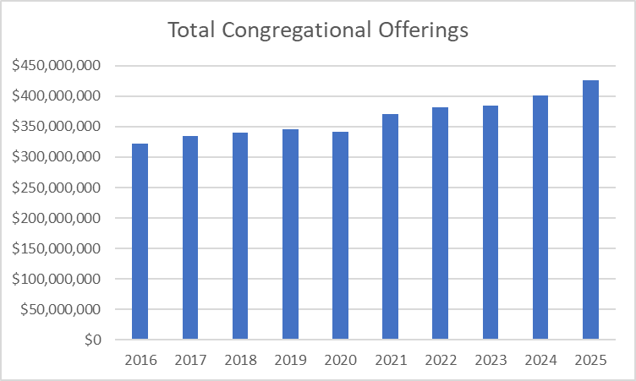
Blessings and opportunities
2025 total congregational offerings: $426.8 million
2024 statistics:
39% in worship
15% in Bible class
Notes:
A blessing is that total congregational offerings have trended up each year – except during 2020 – despite declining membership.

Slide 5
Blessings and opportunities
Congregation Mission Offerings for 2025 were a record $24.05 million.
Congregations have pledged $24.1 million in CMO for 2026.
Through April, offerings total $7.37 million, which is up $54,000 (0.7 percent) from the CMO that we received during the first four months of 2025 and $191,000 (2.7 percent) higher than projected receipts.
When setting CMO, aim for ten percent of offerings. If at or above this goal, encourage your congregation to maintain its generous support or consider increasing it as you’re able with God’s blessing.
Notes:
Congregation Mission Offerings have been strong. Last year was the sixth consecutive calendar year in which our congregations offered a record total of CMO, the fourth consecutive calendar year in which CMO surpassed $23 million, and the first calendar year in which CMO surpassed $24 million. We’re truly grateful to our heavenly Father for the wonderful thank offerings his congregations give him for the work of our church body. We’re also thankful for WELS members’ generous participation in the gospel ministry we conduct together.
Yet, due to inflation, the cost of ministry is starting to outpace gifts. When setting CMO, we encourage all our congregations to joyfully consider designating ten+ percent of general offerings for CMO. The reason? Because you know the grace of our Lord Jesus Christ! Also, it’s the foundational source of synod support for the areas of ministry that we’ve been hearing about this week.

Slide 6
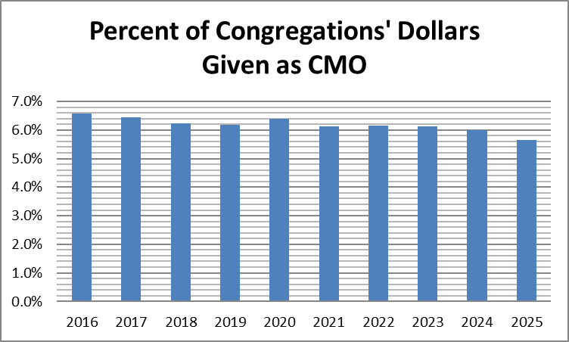
Blessings and opportunities
2.2% of personal income to offerings
5.7% of church offerings given as CMO
Notes:
Comparing offerings per communicant with our government’s latest figure for per capita income, the average percentage of income given is 2.2% (ahead of American Christians who gave 1.7%). The percentage of offerings that WELS congregations pass along for synod ministry compared to all offerings reported by our churches is slowly trending downward.
2.2% income figure—based on WELS 2025 Statistical Report and the U.S. Dept. of Commerce Bureau of Economic Analysis (divided 2025 synod per communicant giving figure of $1,655 by 2025 U.S. per capita income of $76,393).
1.7% giving by American Christians from Empty Tomb for 2022 (latest year measured).
5.7% CMO figure—based on data from WELS 2025 Statistical Report.

Slide 7
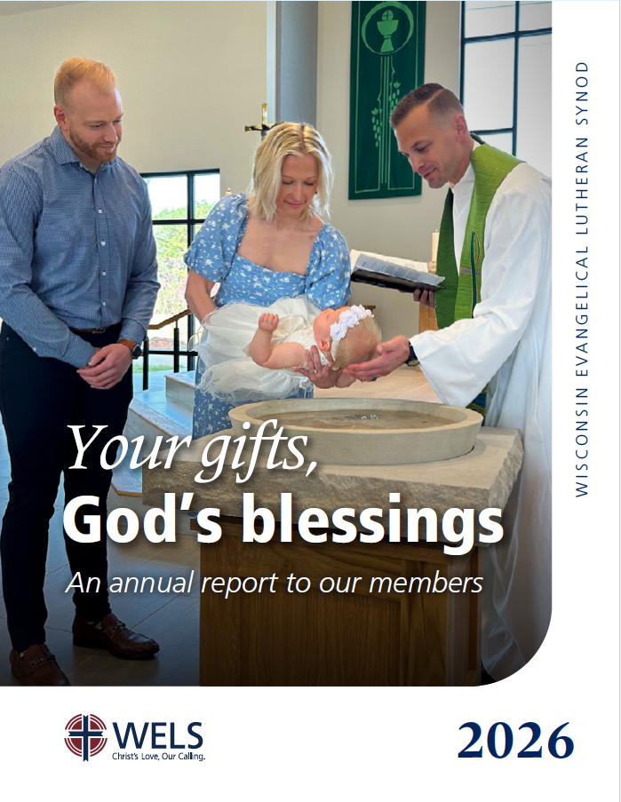
Congregation Mission Offerings
WELS Connection
Together e-newsletter
Forward in Christ
Annual Report (includes PowerPoint)
Annual CMO setting materials
Stewardship Toolbox resources (at mcg.welsrc.net)
Notes:
Please note these resources that are designed to keep you and others informed about how CMO and unrestricted IMO are being used to proclaim the firm foundation of God’s Word around the world.
Stewardship Toolbox: Every other month, church leaders can find two months’ worth of Stewardship Toolbox resources at MCG’s resource collection online, mcg.welsrc.net. “Mission prayers” allow the congregation or individuals to learn about and pray for different areas of our synod ministry. “Stewardship by the Lectionary” includes short stewardship devotions based on weekly readings from the lectionary – a good way to encourage members each week with how they can fully put their trust in our gracious God.

Slide 8

Blessings and opportunities
WELS 175th Anniversary
Offering total: $476,924
We praise God for this response and thank you for your participation that supports future goals in North American ministry, international ministry, and worker training!
Notes:
North American ministry includes Home Missions and Congregational Services, international ministry includes World Missions, and worker training includes Ministerial Education.

Slide 9
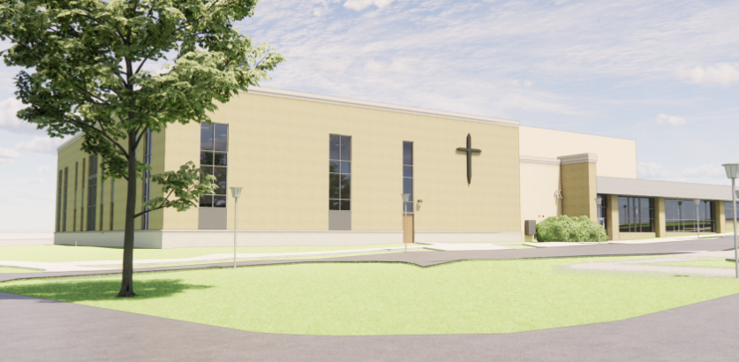
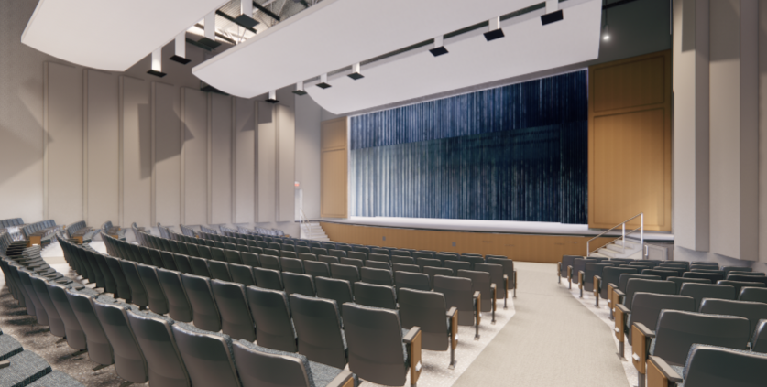
Blessings and opportunities
“Magnify” capital campaign for a new music center at Luther Preparatory School
Notes:
Luther Preparatory School is working toward building a new music center with sloped seating, designated band and choir spaces, right-sized classrooms, piano studios, and practice rooms. God has blessed our work with LPS on the “Magnify” campaign with $9 million in gifts, commitments, and events’ revenue/discretionary funds toward the $16 million goal.

Slide 10
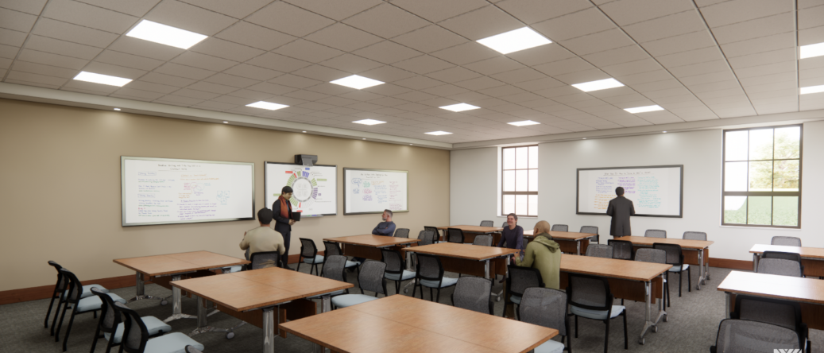
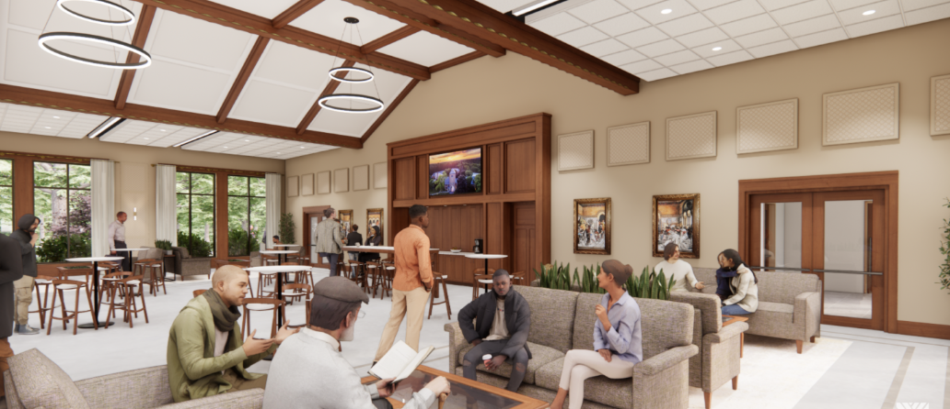
Blessings and opportunities
Wisconsin Lutheran Seminary broke ground on its “Compelled” initiative for new education center, faculty offices, and gathering hall.
Notes:
Our Savior has also blessed our work with Wisconsin Lutheran Seminary (WLS) on their “Compelled” campaign to encourage offerings for the school’s education wing, remodeled faculty offices, and auditorium gathering space. By God’s grace, we’ve received $8.2 million in gifts and commitments. In addition, WLS has $3 million in discretionary funds that may be used toward the $15 million project. These funds allowed the seminary to break ground on the project on May 20th.

Slide 11
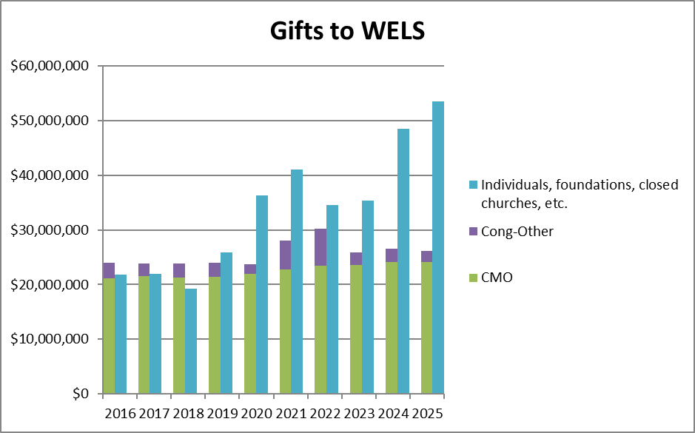
Individual offerings
2024 statistics:
39% in worship
15% in Bible class
Notes:
This chart shows offerings received from individuals, foundations, the sales of closed churches, etc., compared to congregational offerings per WELS Statistical Reports. What amazing evidence of joyful generosity, particularly in the past few years.
Individual gifts have helped us fund our work since CMO, while steady, hasn’t kept up with inflation.

Slide 12

Individual Offerings
WELS Christian giving counselors
Christ-centered, free, confidential
Assist with major gifts of assets according to donors’ interests and abilities (e.g., IRA qualified charitable distributions)
Nurture donors to consider supporting Christ’s work now and through their wills as the Lord has blessed them
Notes:
In fiscal year 2024-25, WELS Christian giving counselors (13.8 full-time equivalents)
-conducted 1,249 meaningful visits and 4,976 meaningful contacts with donors.
-nurtured $14.8 million in immediate gifts and $44.5 million in deferred expectancies from assigned donors.
-helped donors arrange 160 major gift opportunities (current and deferred) totaling $40.9 million.
To God be the glory!
Learn more about IRA QCDs at wels.net/qcd.

Slide 13
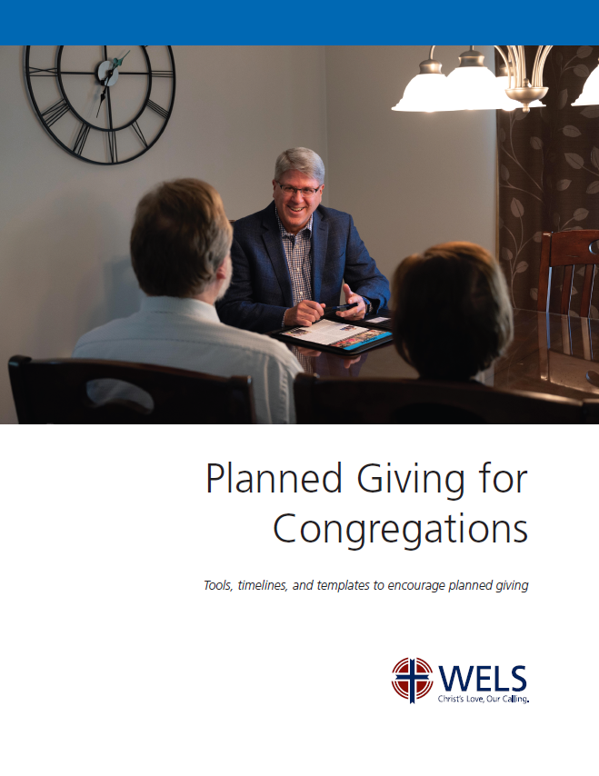
Resources
Planned Giving for Congregations
Encourage planned giving in your church using synod resources and your local giving counselor
wels.net/congregationalplannedgiving
Notes:
As part of what is known as the “Great Wealth Transfer,” an estimated $124 trillion in U.S. assets will shift from the Silent Generation and Baby Boomers to younger generations (Gen X, Millennials, and Gen Z) and charities over the next couple of decades, peaking toward 2045. Per James Langley in the February Planned Giving Today newsletter, “Organizations will never see a larger [portion] of philanthropic dollars or a generation as loyal to non-profit organizations. Further, when Baby Boomers pass on, there will be nothing like them to follow, not in terms of assets or inclinations.” As WELS membership declines and generous older members are taken to heaven, congregational and synodical ministry will have to be reduced unless we help members plan now to support ministry after they’re gone. To help congregations easily and regularly encourage planned giving, MCG offers a booklet called Planned Giving for Congregations. Our Christian giving counselors can introduce congregations to the resources and assist them. Learn more at wels.net/congregationalplannedgiving. [INTRODUCE VIDEO]

Slide 14
Thank you!
WELS Ministry of Christian Giving
mcg@wels.net
800-827-5482
Notes:
Thank you for your time today and your partnership in Christ’s kingdom. The grace of the Lord Jesus be with you!

