Slide 1

Consider Ministry
Creating a Culture of Encouragement
Minnesota District Convention
Tuesday, June 9, 2026

Slide 2
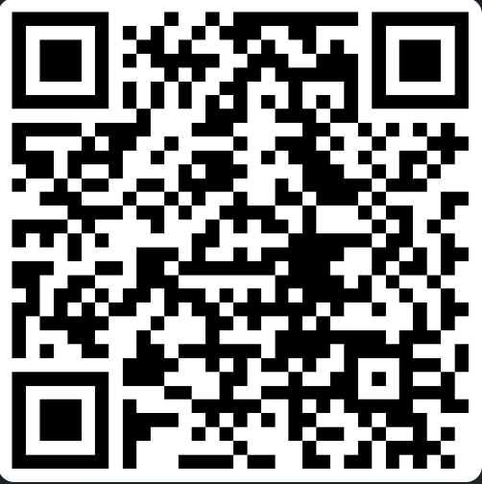
Consider Ministry
Who can you encourage?
Notes:
This QR code links to a form where I want you to enter the first name only of one person that you can encourage for ministry. I am not building a list. I promise I will not contact them (unless you ask me to). I simply want to pray that God gives someone in this room the opportunity to encourage them. Maybe it is a student, maybe your child or your grandchild, maybe it is someone from your congregation. Maybe a neighbor. Keep this person in mind as you listen today.

Slide 3
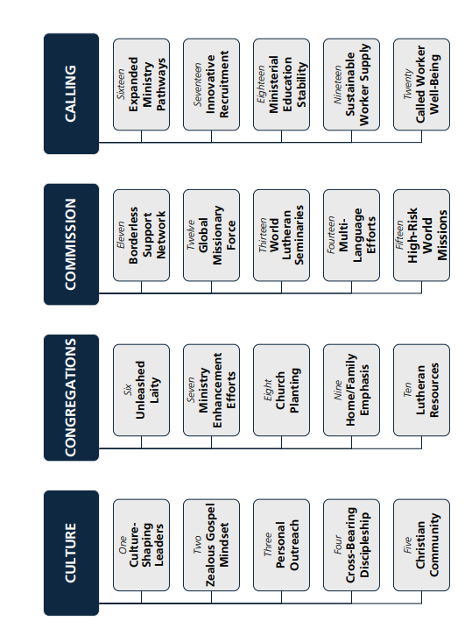

Ministry Recruitment Counselors?
Notes:
This QR code links to a form where I want you to enter the first name only of one person that you can encourage for ministry. I am not building a list. I promise I will not contact them (unless you ask me to). I simply want to pray that God gives someone in this room the opportunity to encourage them. Maybe it is a student, maybe your child or your grandchild, maybe it is someone from your congregation. Maybe a neighbor. Keep this person in mind as you listen today.

Slide 4
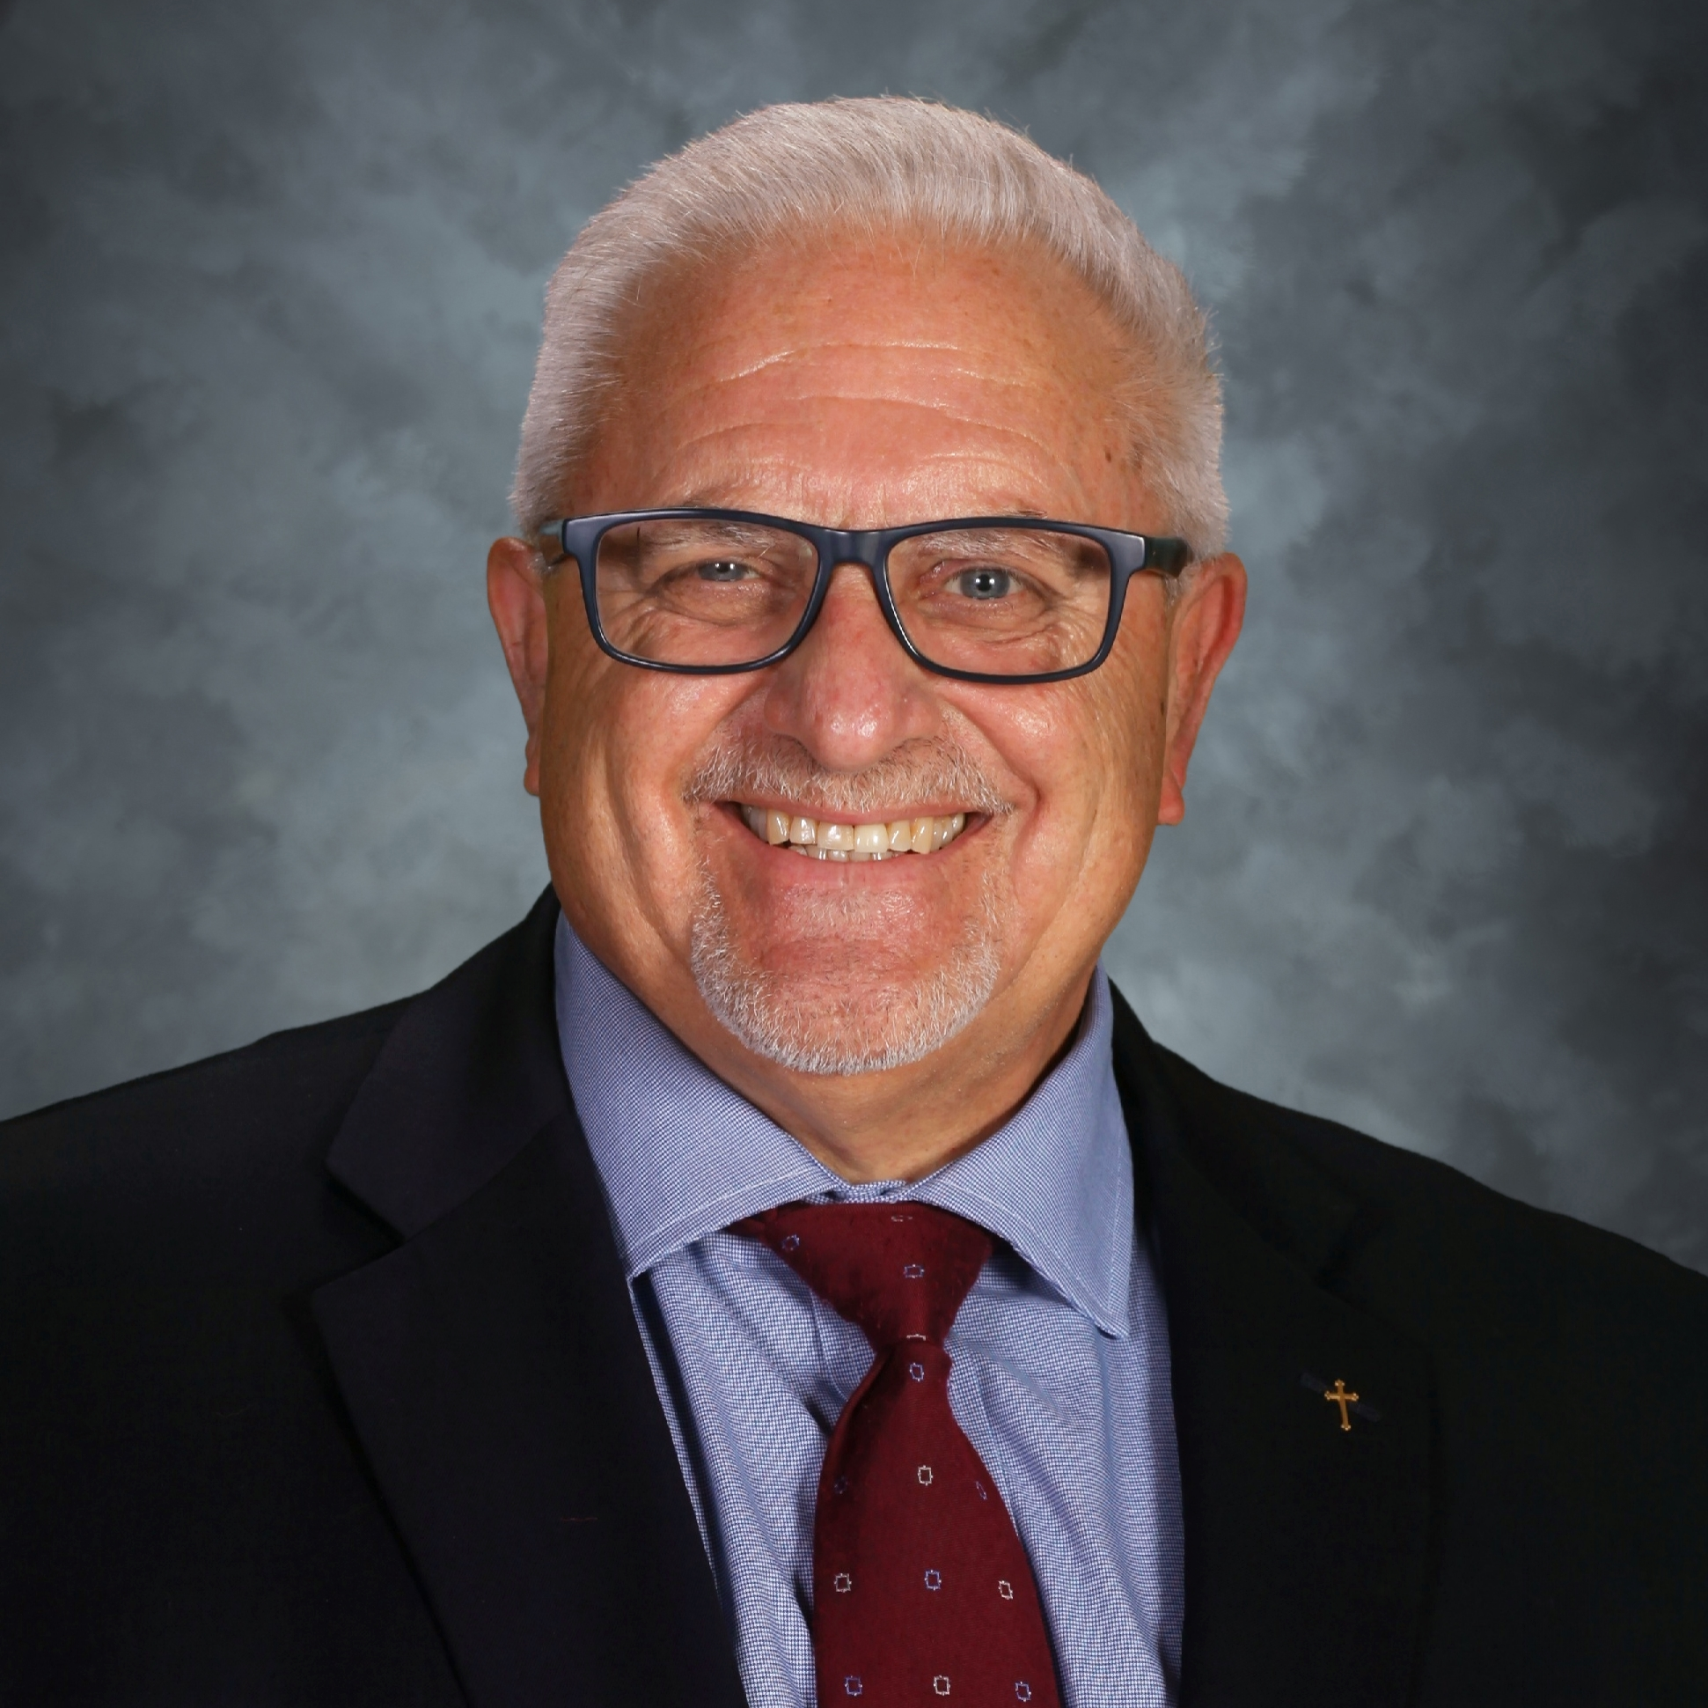
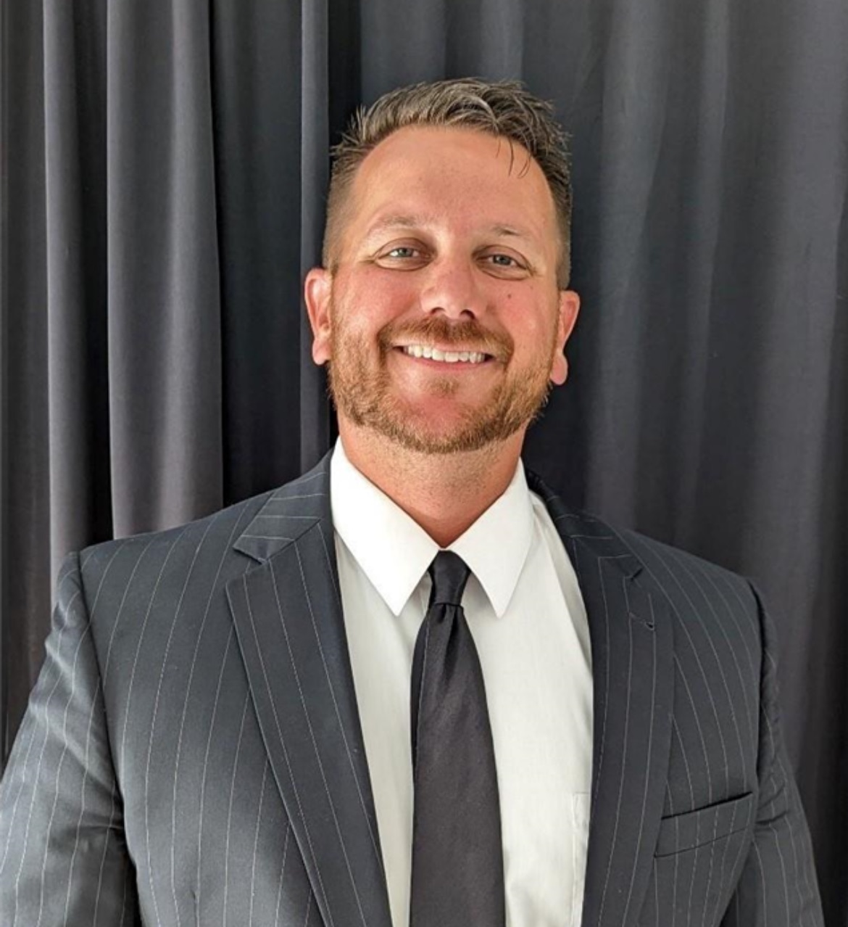
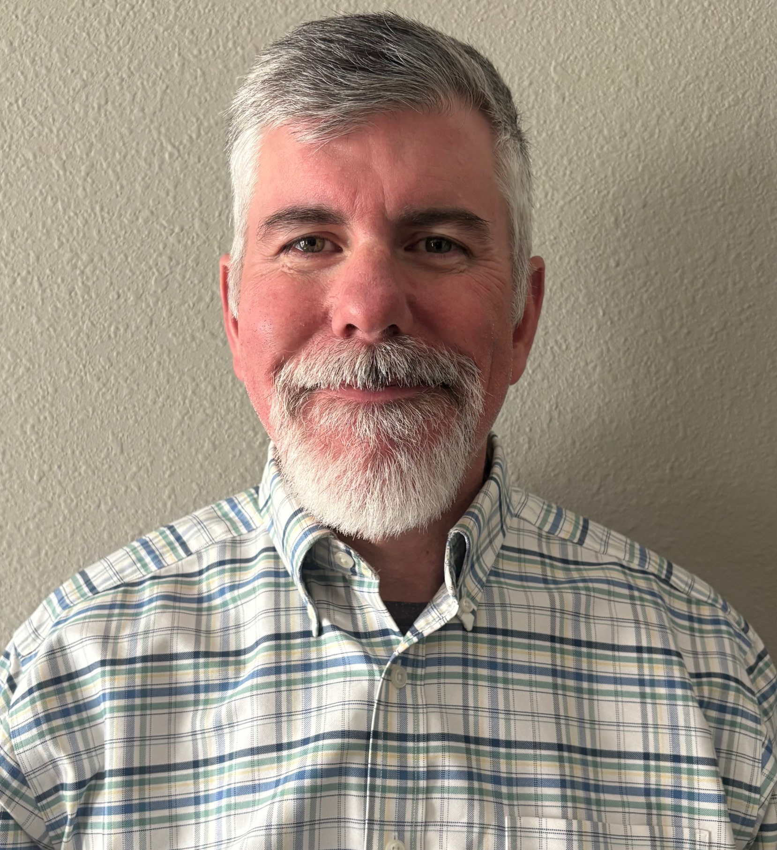

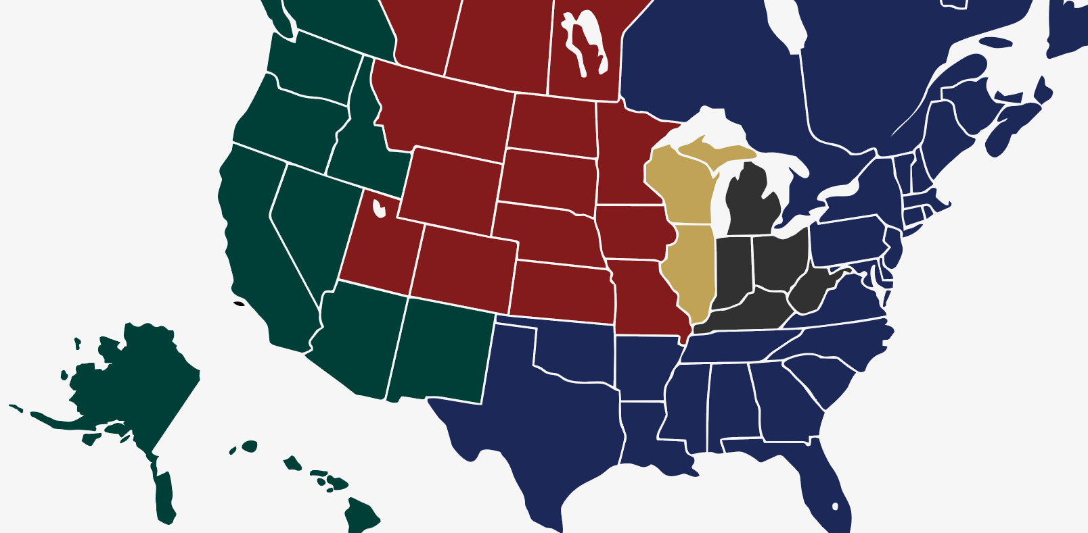
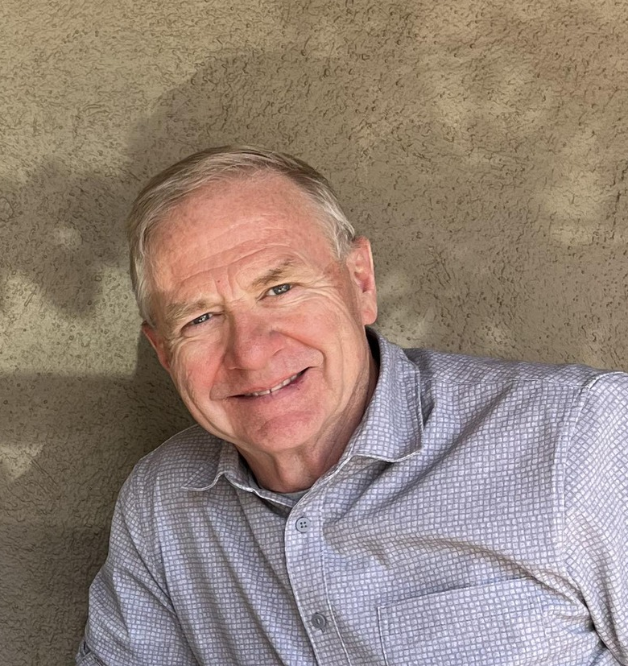
Ministry Recruitment Counselors
Notes:
The synod is supporting this effort through 5 ministry recruitment counselors over the next 4 years across the country. But 5 counselors is not enough to build a culture of encouragement, that happens congregation by congregation, person, by person. So I ask you today, what can You do to help your congregation build a culture of encouragement?

Slide 5

Create a Culture of Encouragement
Help others see how God could use their gifts in ministry…
Notes:
What would it look like if your congregation intentionally created a culture toward ministry recruitment? Maybe it would be meeting with kids at starbucks to talk about the bible, maybe it would be financially supporting students to do a visit to a school or church to shadow a teacher or a pastor, maybe it is simply writing an encourging letter. Ministry recruitment is creating a culture where people notice gifts, encourage faith, and help others see themselves possibly serving the Lord in full time ministry.

Slide 6
Why a Culture of Encouragement?
Not to…
But to…
Connect precious souls – via the MOG – with Jesus!
Notes:
I could show dozens of graphs, numbers and pictures about the shortage of called workers in our area. Many of us here have experienced a vacancy firsthand. Ministry recruitment does not exist to fill a position, we need ministry recruitment to show people Jesus. Here out west , we regularly meet people who don’t know Jesus. Behind every vacancy are people that need to hear they are forgiven, children that need to hear that they have a Savior that loves them. This is why a culture of encouragement matters so much.

Slide 7
A Culture of Encouragement
Some stories
Notes:
Let me share just a couple stories of what others are doing in hopes for you can see yourself and think of what you can do to create a culture. Carson and Josh did not grow up WELS, but Carson attended one of our LES. In HS he started to have some questions about the Bible and reached out to a local pastor from an area WELS church, they started meeting weekly for a bible study at Starbucks, Carson invited his friend Josh. The discussion continued to get more in depth. The pastor noticed their gifts, he encouraged, they encouraged each other. This fall they will both be freshmen in the Pastor track at MLC. The pastor didn’t do this because he had to, but because he wanted to encourage them. That is the kind of culture we want.

Slide 8
A Culture of Encouragement
A taste of ministry
Notes:
Let me go on. There are 2 girls. One from CA, on from AZ, both are attending public high schools in their area. Through encouragement from their parents or grandparents they have both expressed a desire to consider the teaching ministry. They would like to do a “job shadow” in a congregation unlike their own to see what it would be like. A congregation heard of this desire and responded by sponsoring each of these girls with financial reimbursement, so they can get a “taste of ministry”. Not because they had to.
But because they wanted to encourage others to consider ministry. That is the culture we want

Slide 9
A Culture of Encouragement
One more
Notes:
Or what about Colleen? She is a member of a congregation that wants to help. She asked how she could help. She startetd writing letters of encouragement to students at MLC and the Seminary whom she had never meant, so that she could encourgage them and couldn’t wait to tsee how the Lord would use them. 62 students got letters from colleen this past 6 months. Not because she had to, but because she wanted to encourage others. That is the culture we want to create.

Slide 10
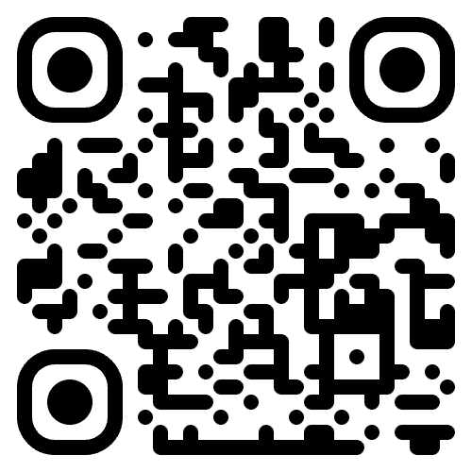
considerministry.net
Notes:
To help support this culture of encouragement, we’ve created a new ministry recruitment website. It is a work in progress, but we are off to a good On it we have started to create resources for parents, pastors, teachers, congregations, links to other helpful sites, spritiual growth resources because helping someone consider ministry is not just one conversation. At the beginning many of you entered a name into the form. If you haven’t yet, I encourage you to do it now. I will add the person and you to my personal prayer list. That God gives you the opportunity in the coming days and months to encourage that person to consider ministry. God may use your encouragement to raise up a future pastor, teacher or staff minister.

