Slide 1


Mission partners in 48 countries
Prospective mission fields in 25 new countries
51 missionaries (and counting!)
500+ national pastors
400+ students in theological training
WELS WORLD MISSIONS
Notes:
8.2 billion people inhabit this earth. 384 million of those reside in the United States and Canada.
We have before us the largest mission field the world has ever seen.
WELS World Missions conducts and encourages gospel outreach in 48 countries and is exploring outreach opportunities in 25 prospective new mission fields. World Missions brings the light of God’s Word to the world through evangelism efforts, church planting, training national workers for ministry, and providing religious materials in foreign languages. 51 world missionaries partner with over 500 national pastors to conduct outreach and train more than 400 students for service in Christ’s kingdom.

Slide 2
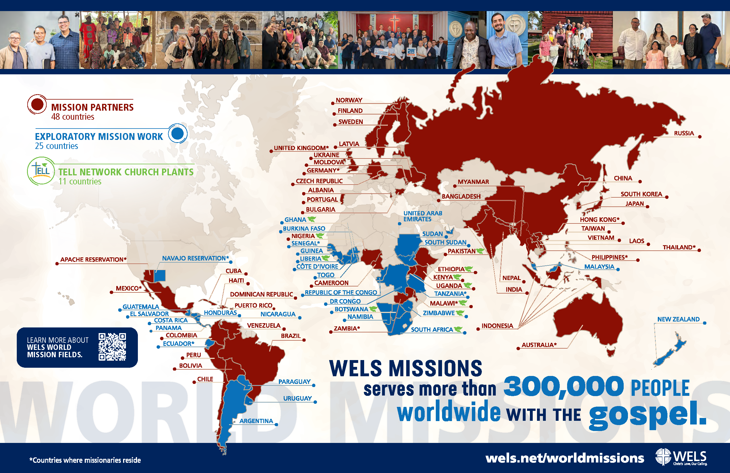
Notes:
World Mission supports mission work through five regional teams (Africa, Asia-Oceania, Europe, Latin America, Native American reservations) and Multi-Language Productions.

Slide 3

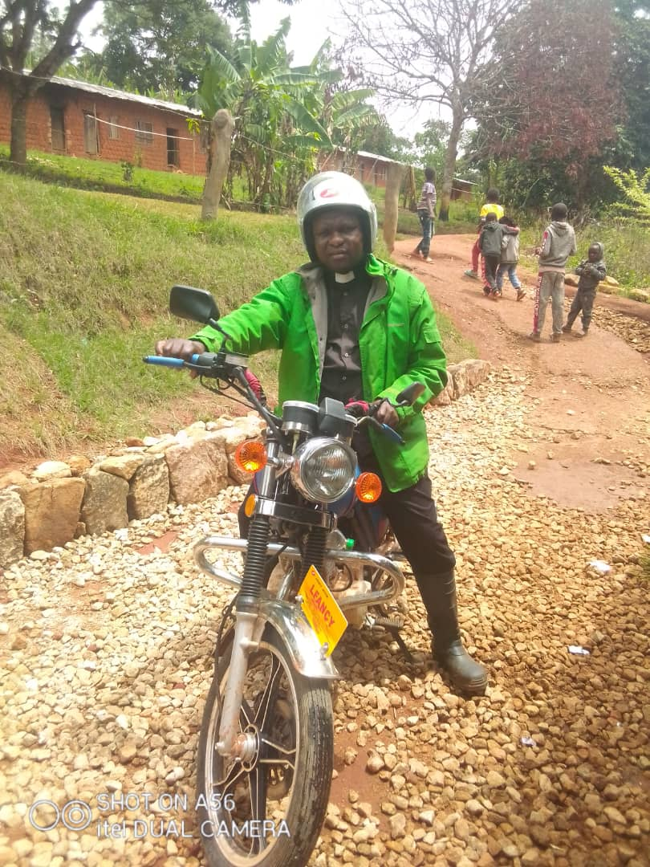
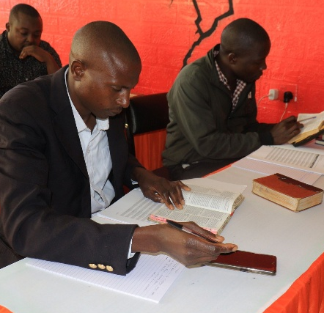
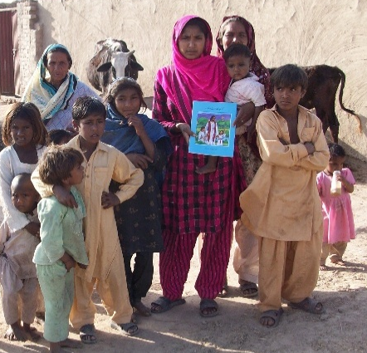
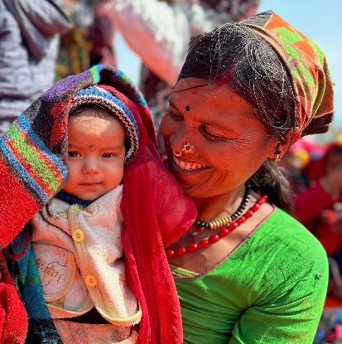
WELS Long-Range Plan: Bringing Christ to the Nations
Forge a borderless support network
Equip a global missionary force
Establish Confessional Lutheran seminaries
Expand multi-language mission efforts
Pioneer missions in high-risk and unreached areas
Notes:
The “Christ through us” Long-Range Strategic Plan was adopted at the 2025 Synod Convention. This issues-based strategic plan names four strategic priorities—Culture, Congregations, Commission, and Calling. Each priority offers a rationale for its urgency, followed by goals—tangible steps showing how, by God’s grace, we will meet these trials. Priorities frame the struggles; goals forge the path.
The “Commission” priority affirms the synod’s commitment to global gospel outreach through WELS World Missions. As the church responds to the spiritual needs of billions who have yet to hear the gospel, this priority calls for bold, Spirit-led action to expand confessional Lutheran witness across continents. The following five goals guide this effort:
Forge a borderless support network: We aim to build a global, cross-border network of generosity and collaboration by partnering with confessional Lutheran church bodies worldwide, equipping pastors and congregations to thrive in gospel ministry beyond traditional U.S.-based support.
Equip a global missionary force: We seek to train indigenous leaders from partner churches around the world to serve as missionaries in their own regions and beyond, shifting from a model of dependence to one of global partnership that strengthens outreach both abroad and in North America.
Establish Confessional Lutheran seminaries: We plan to plant seminaries in strategic global locations to train pastors and leaders with theological depth and Lutheran fidelity, ensuring a strong, sustainable gospel witness rooted in Scripture and the Lutheran Confessions.
Expand multi-language mission efforts: We aim to strengthen global gospel outreach by translating and distributing confessional Lutheran materials in native languages through print, digital media, and theological publications, ensuring doctrinal clarity and deep-rooted faith across diverse mission fields.
Pioneer missions in high-risk and unreached areas: We seek to bring the gospel to the most spiritually isolated regions by developing tailored strategies—such as underground networks, business-as-mission models, and digital outreach—and training workers to serve faithfully in places where Christ’s message is least known.

Slide 4
WELS and the world
WELS
Rest of the world
Goal:
322,000 members
300,000+ members
1,000,000
members
1,200 pastors
500+
pastors
Notes:
As part of the “Commission” priority in WELS’ Long-Range Strategic Plan, the synod envisions a bold expansion of its global gospel outreach—one that culminates in a vibrant fellowship of one million believers inside and outside North America by 2035. From the 150,000 believers in Vietnam to the anticipated declarations of fellowship with various church in Africa and thousands more across Latin America, this isn’t just a numeric milestone—it’s a growing family of faith. The strategic plan supports this vision through their five interwoven goals.

Slide 5
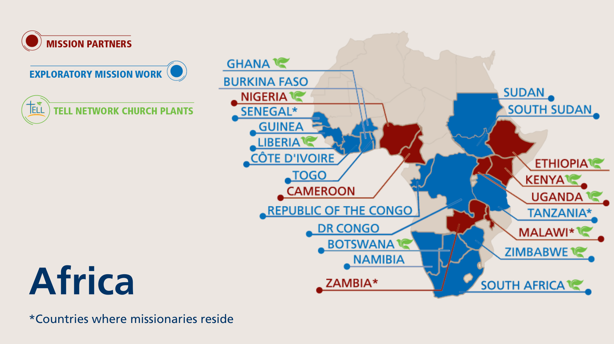
Notes:
The WELS One Africa Team currently works with established church bodies in Cameroon, Ethiopia, Kenya, Malawi, Nigeria, Uganda, and Zambia, partnering in outreach and assisting with theological education programs. The team is also exploring outreach opportunities and following up on promising contacts identified through Multi-Language Production’s TELL program in 15 countries. Nine missionaries serve on the One Africa Team, one of whom works exclusively with the TELL program.
Fast facts
Mission partners in 7 countries
Exploratory mission work in 15 countries (+Senegal by the Board for World Missions)
9 missionaries
TELL church planters in 10 countries

Slide 6
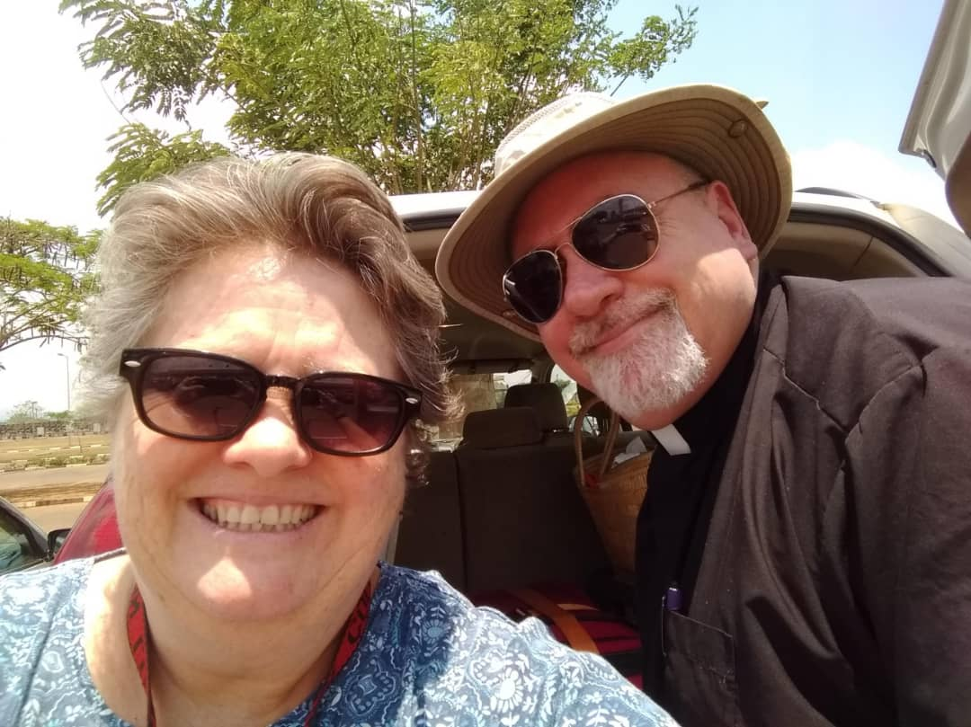
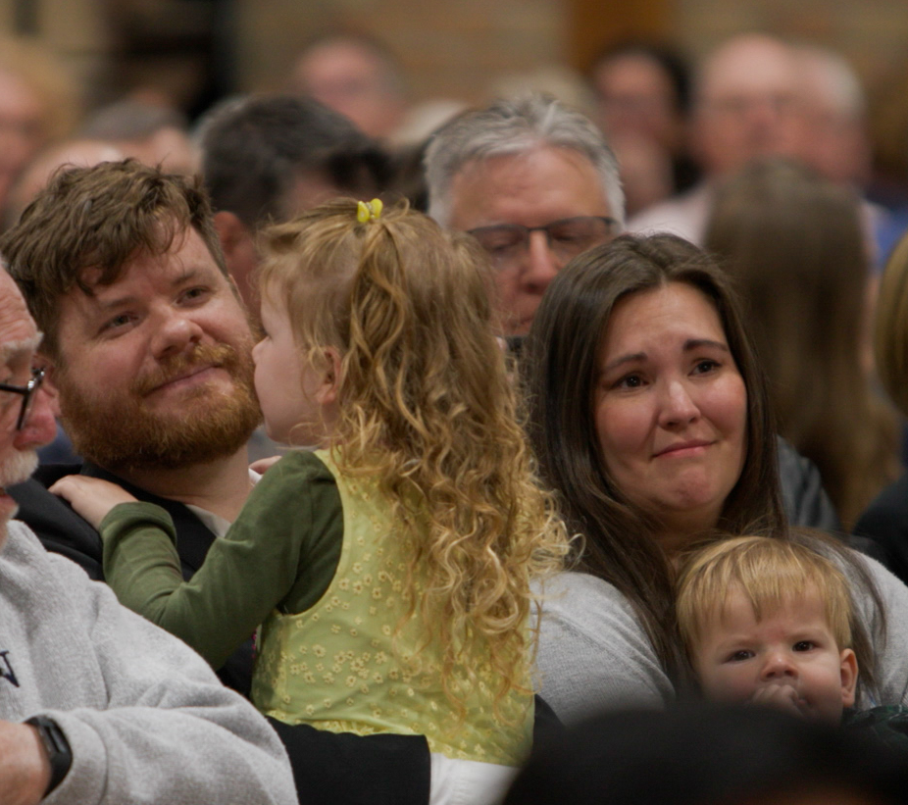
Two missionaries heading to Senegal in September
Notes:
In 2023, the Board for World Missions approved a plan to send two missionaries to Senegal to learn the culture and language of the Muslim Wolof tribe in preparation for sharing the gospel and gathering a congregation. The Wolof people make up a large portion of the population and have had very limited exposure to Christianity, making this a new opportunity for “raw” mission work starting from scratch. In February 2026, Director of World Missions Operations Stefan Felgenhauer traveled to Dakar to finalize language and cultural immersion plans that will serve as the first phase of ministry for new missionaries. The visit addressed key logistics such as housing, healthcare, and immigration and formalized partnerships with Africa Consultants International where missionaries will live with host families and receive intensive Wolof language training.
Missionary Dan Kroll, who previously served on the One Africa Team, accepted the call, and Missionary Stephen Gerling was assigned from Wisconsin Lutheran Seminary in May 2026 to serve alongside him in Senegal. Both families will relocate and begin their work in September 2026, pending no unexpected delays. Their first six months will be spent living in with a Muslim Wolof family in Dakar, learning the language and culture, and building relationships that will lay the foundation for future gospel outreach. It is the prayer that this work will not only bring the gospel to the Wolof people but also serve as a resource and encouragement for future outreach in Muslim communities around the world.
Learn more: wels.net/Africa

Slide 7
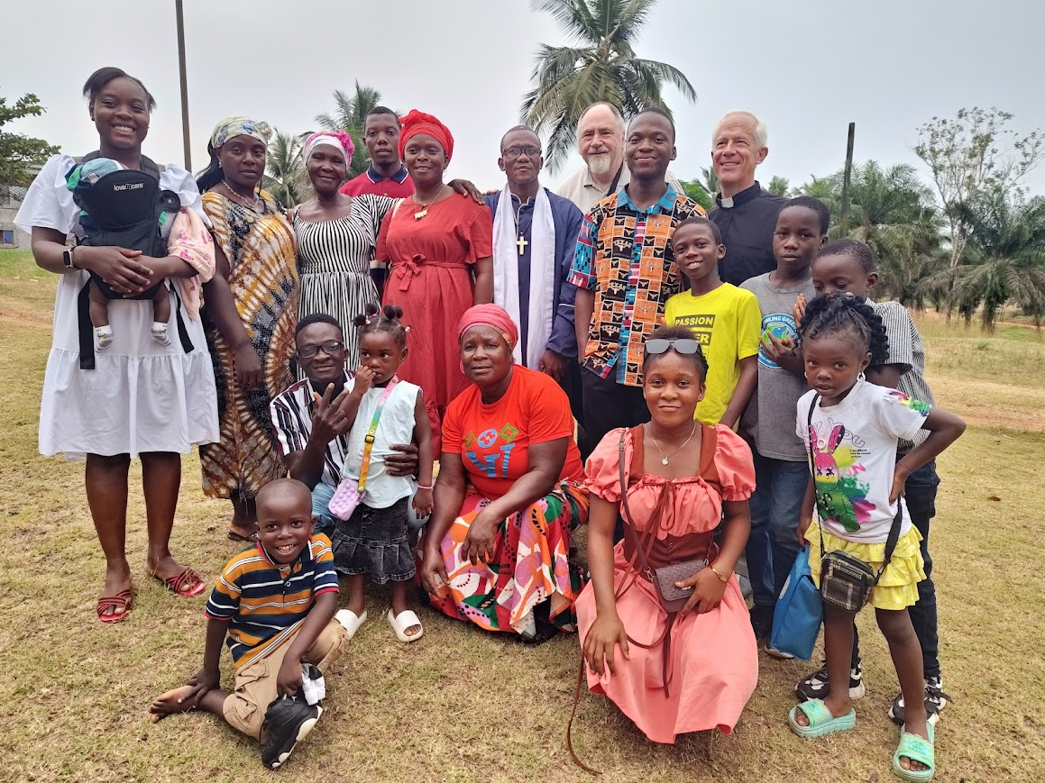

The One Africa Team is exploring partnerships and outreach with more than 15 different groups
Notes:
The One Africa Team is expanding its outreach and exploring potential partnerships with more than 15 different groups in several countries. Here are some examples:
Liberia (pictured): Lamb of God Lutheran Church and its leader, Pastor Toye Barnard, broke away from a Pentecostal group in 2022 and were introduced to the One Africa Team. They are in stage two of the four-stage process the One Africa Team uses to guide discussions with potential ministry partners. They have purchased a piece of land where they plan to build a church as well as a school.
Cameroon: Holy Trinity Lutheran Synod consists of St. John's congregation in Fondonera, as well as its various daughter churches and preaching stations throughout the region. They are served by Pastor Julius Nkwetta. One Africa Team missionaries meet with Pastor Nkwetta and his leadership in the city of Douala, Cameroon, for doctrinal workshops. Holy Trinity would like to begin a ministry to university students in the regional hub of Dschang.
Ethiopia
Opiew Okugn connected with the One Africa Team in 2018. He formed the Gambella Evangelical Lutheran Church after studying in Multi-Language Production’s TELL program. They currently worship in a temporary building on a member's property. They are in stage three of the four-stage process the One Africa Team uses to guide discussions with potential ministry partners.
Because of civil war in South Sudan, many members of the Nuer tribe live in refugee camps throughout Africa. Refugees in the U.S. have connected the One Africa Team with contacts in Gambella, Ethiopia. One Nuer man has graduated from Maor Theological Seminary of the Lutheran Church of Ethiopia in Bishoftu and is serving the Nuer community in Gambella.
Sudan: They are in contact with the Lutheran Church of Sudan (LCS), an Arabic-speaking group with approximately 16,000 members, though visa and passport issues have delayed in-person meetings.
Tanzania: The Africa Mission Evangelism Church (AMEC) split from a larger group of Tanzanian Lutherans in the mid-1990s. The One Africa Team has visited this group two to three times a year since 2021. AMEC is in five provinces of Tanzania and has 81 congregations, which are served by their 65 pastors. They serve about 13,000 members.
Learn more at wels.net/africa.

Slide 8
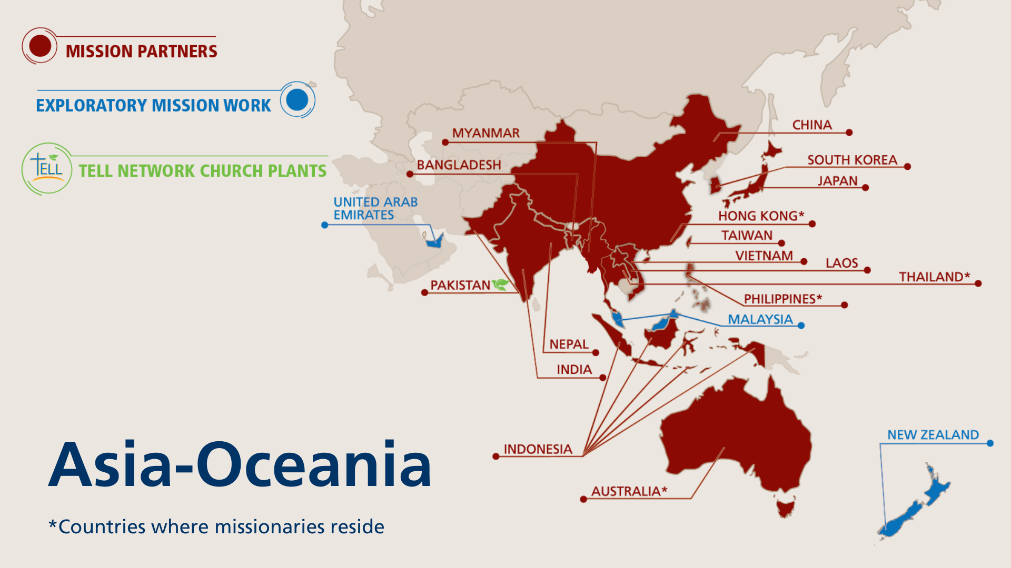
Notes:
The Asia-Oceania Team is made up of 19 missionaries serving 19 different countries throughout Asia and Oceania. The team—with members in Thailand, Hong Kong, the Philippines, and Australia—partners with God’s people to equip, encourage, and empower others to bring the good news of Jesus Christ to the billions still lost in darkness. The Asia-Oceania Team explores new mission opportunities, supports existing sister synods, and trains current and future leaders for service in their churches through Asia Lutheran Seminary.
Fast facts
Mission partners in 16 countries
Exploratory mission work in 3 additional countries
19 missionaries

Slide 9
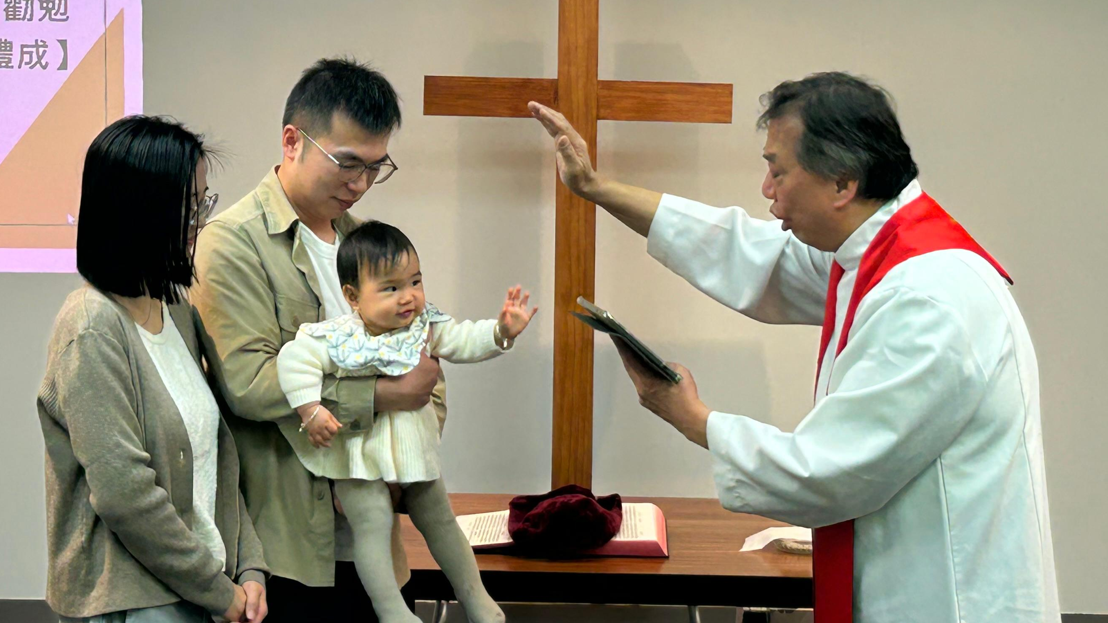
8,275 people were baptized across
Asia-Oceania in 2025
Notes:
8,275 people baptized in Asia-Oceania in 2025
110,000+ people gathered weekly around God’s Word in 2025 throughout Asia-Oceania
Pictured: Rev. Titus Tse, retired chairman of SALEM in Hong Kong, baptized a child in October 2025 at the new Chinese mission in New Zealand. A second adult man was also baptized at the service.

Slide 10
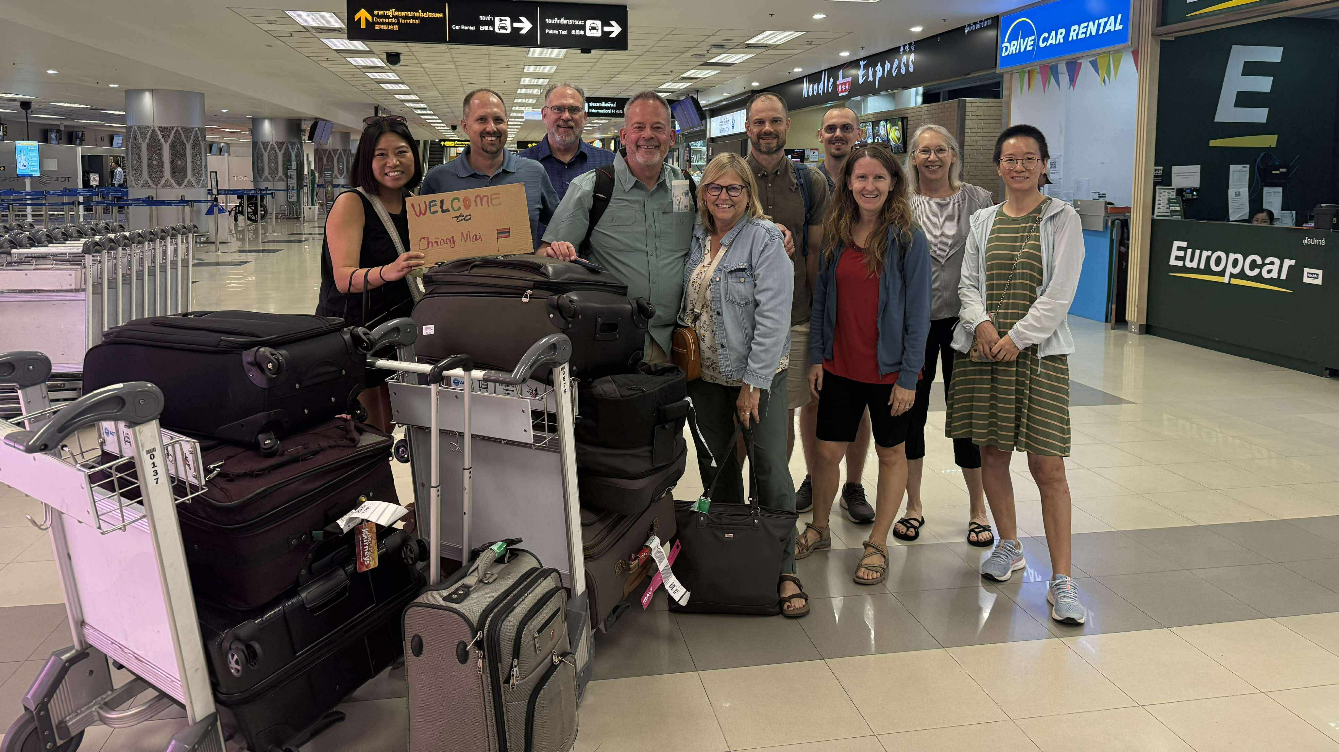
New Asia-Oceania team leader and missionary: Mr. Jim Brandt
Notes:
Mr. James Brandt accepted the call to serve the Asia-Oceania Team as the team leader and arrived in Chiang Mai, in August 2025. In this role, Brandt guides Asia-Oceania Team efforts by leading vision, strategy, and operational planning; coordinating team functions and the efforts of field liaisons; supporting missionaries and their continued development; coordinating mission advancement with the Mission Advancement and Promotions team; and strengthening relationships with national partners and WELS organizations in both the U.S. and Asia-Oceania.

Slide 11
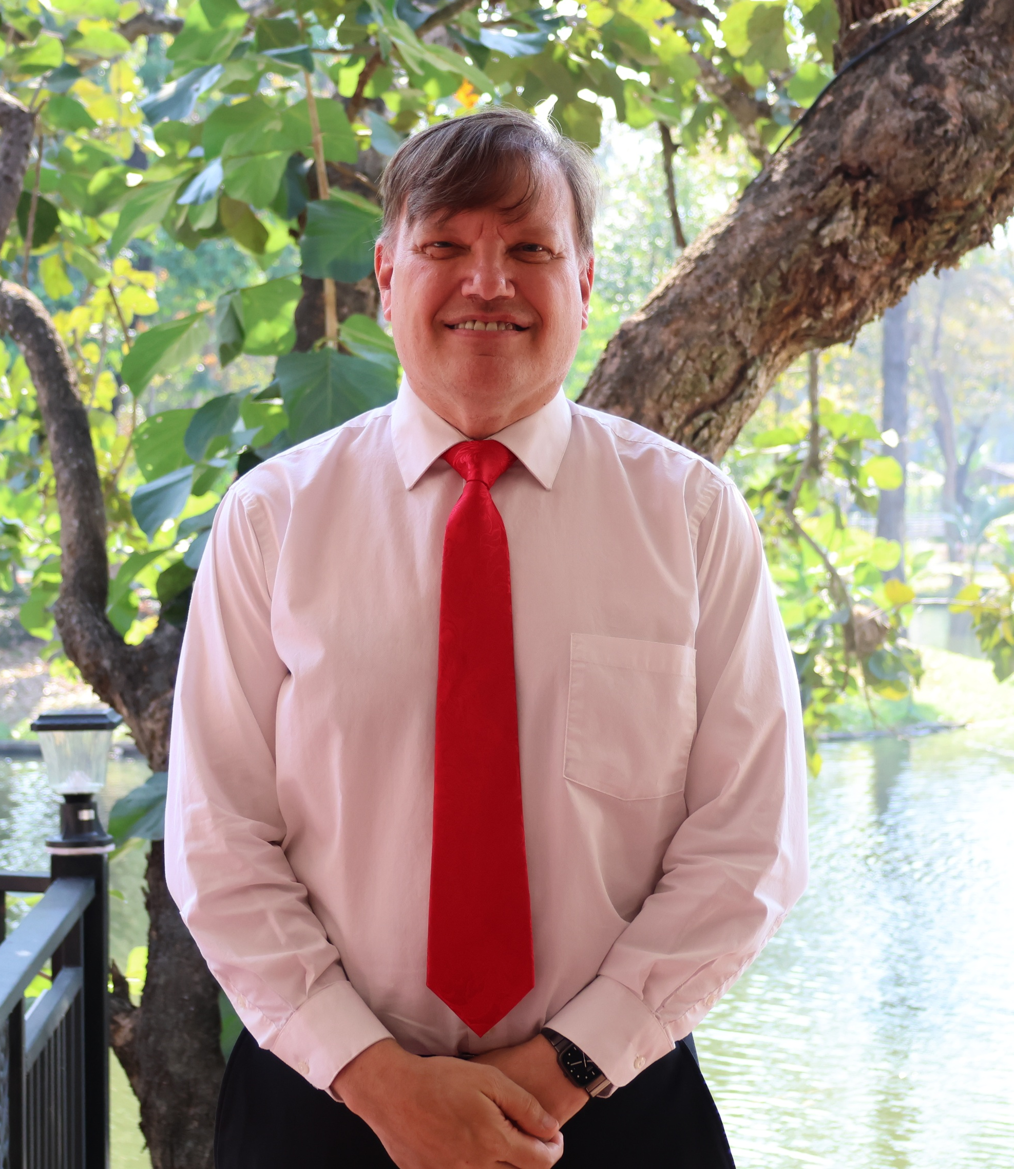

New missionary focused on Hindi outreach
Missionary John Hildebrant
Notes:
New Missionary John Hildebrant is preparing for mission work within the Asia-Oceania Team. He is living in India for one year while studying the Hindi language at a school in Mussoorie. Through this immersion, he will gain insight into South Asian values and communication styles, preparing him to teach, build relationships, and share God’s Word effectively with Hindi people groups across Asia and Oceania. Next, Hildebrant will relocate to Chiang Mai, Thailand, where many missionaries on the team reside. From there, the team will determine how Hildebrant’s gifts can best be used within its purview.
Pastor Hildebrant previously served in India for many years. He has worked in the Hindi language before and will be able to use that experience to engage in new work quickly.
Read more: https://wels.net/climb-the-hill-again/

Slide 12
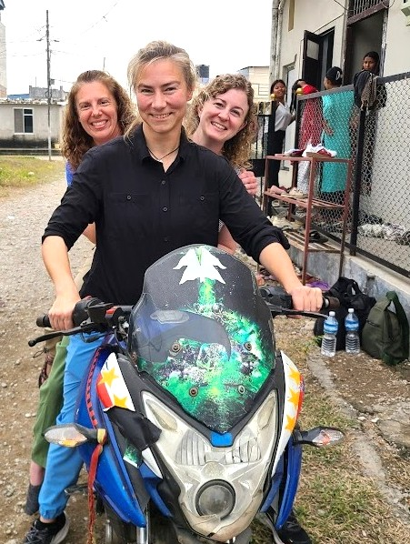
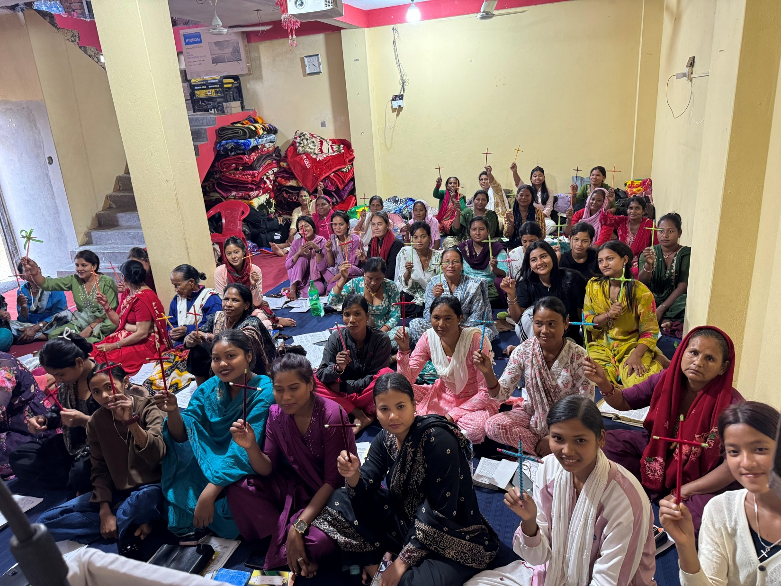
New women’s ministry coordinator in
Asia-Oceania
Notes:
Women’s ministry efforts continue to expand within the Asia‑Oceania Team. Cindy Lendt (pictured left, front) accepted the call to serve as Women’s Ministry Coordinator for the Asia-Oceania Team starting July 2026. Women have unique challenges in many areas of Asia, and this position is focused on increasing their access to the gospel. Lendt will develop and oversee a comprehensive framework for women’s ministry across Asia-Oceania mission fields and coordinate local teams to amplify existing efforts and implement new initiatives.
Prior to accepting this call, Lendt volunteered to participate in a women’s workshop held in Nepal (pictured), offering a helpful example of the types of outreach and training she will now help coordinate more broadly. The workshop, organized in partnership with national church leaders, equipped local Christian women for relationship‑based, woman‑to‑woman gospel conversations grounded in God’s Word.

Slide 13
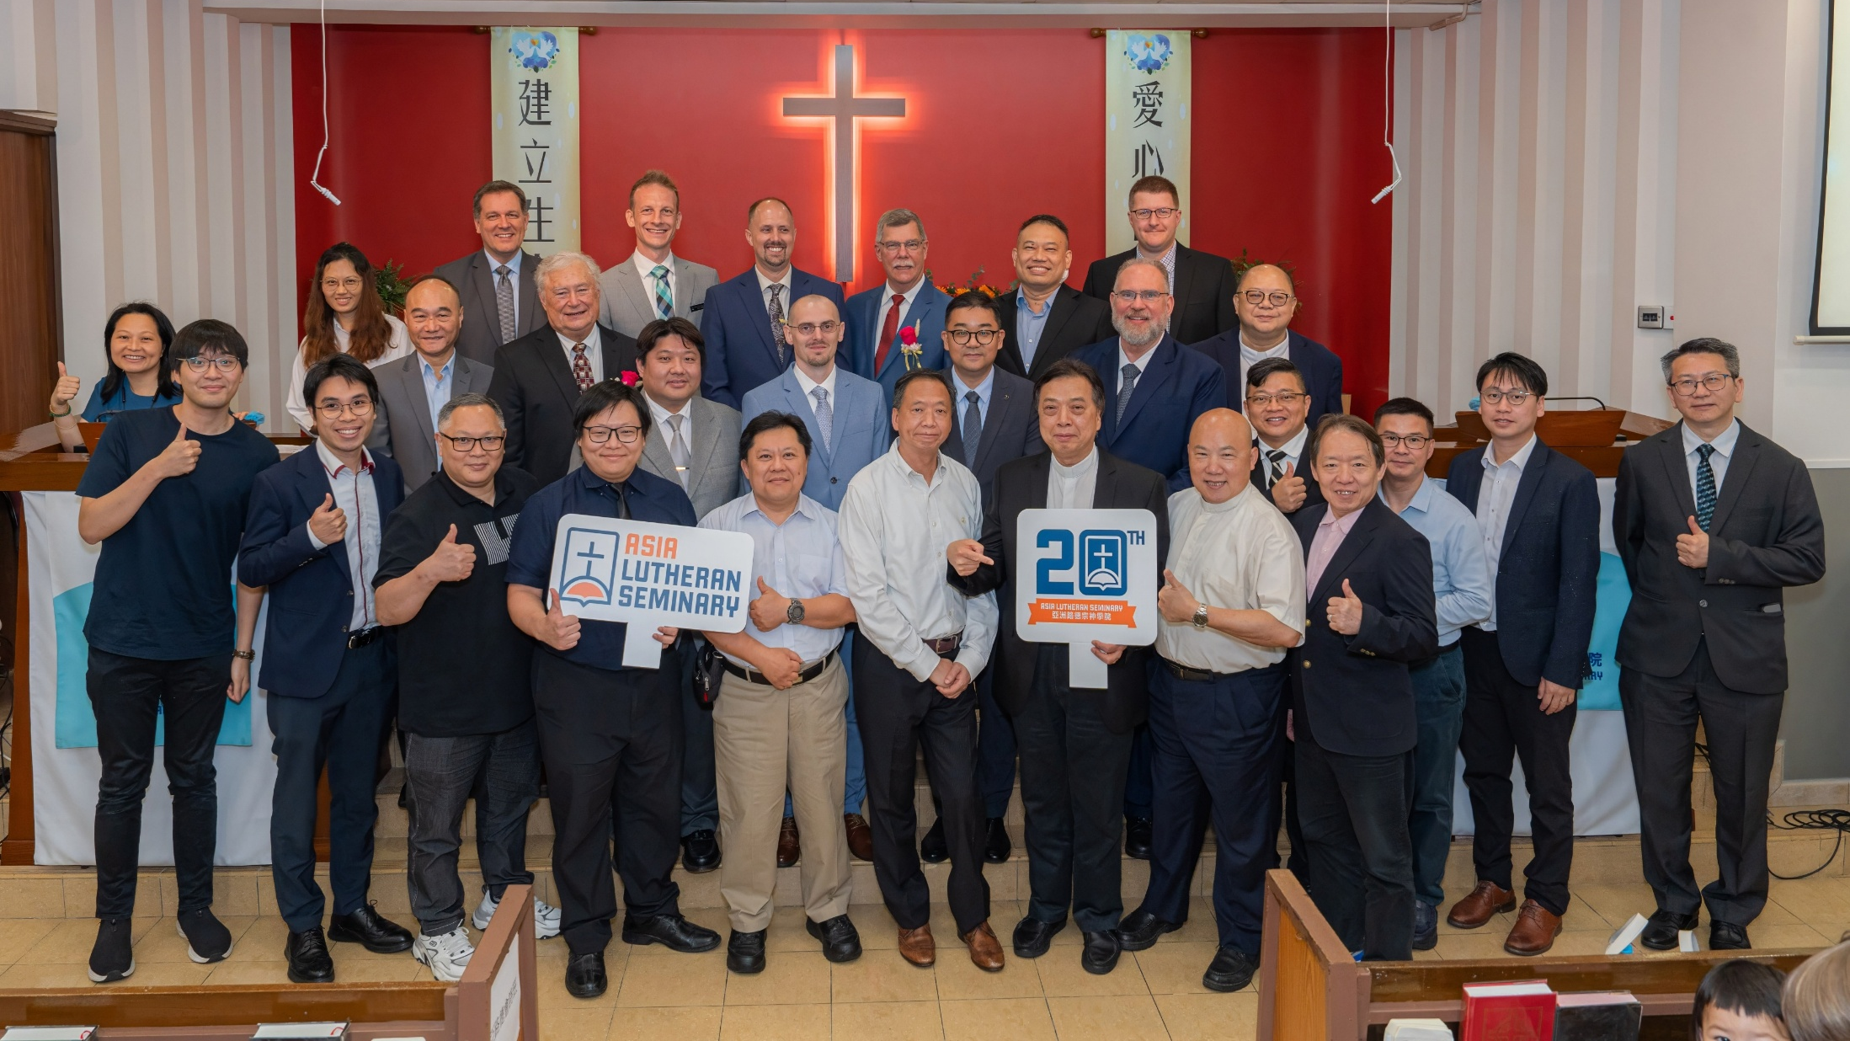
Asia Lutheran Seminary celebrates 20 years
Notes:
On June 1, 2025, Asia Lutheran Seminary (ALS) celebrated its 20th anniversary with a special worship service and banquet in Hong Kong. From its beginnings as a seminary for Hong Kong and East Asia, ALS has grown into a truly regional seminary with hubs in both Hong Kong and Chiang Mai, Thailand. ALS now supports theological education efforts in more than 18 countries and reaches students across four continents.
Watch the special 20th anniversary video: https://wels.net/together-video-june-17-2025/
Read more: https://wels.net/asia-lutheran-seminary-celebrates-20-years-of-gospel-ministry/

Slide 14
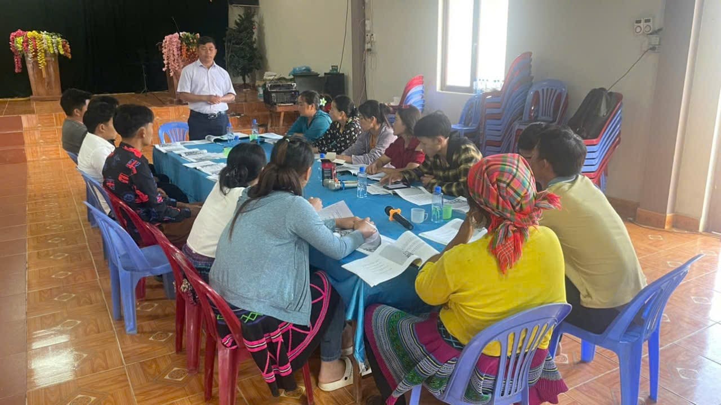
God’s plan flourishes in Vietnam
despite earthly setbacks
Notes:
Fourteen years ago, Hmong church leaders in Vietnam invited WELS to train their pastors in the gospel. Seven years ago, the Vietnamese government approved the construction of a theological education center in Hanoi. We knew that the Lord had opened a door for outreach, but we also knew that the door could close at any time. WELS World Missions worked quickly to take advantage of the time the Lord provided. And God’s work moved forward in ways we could have never predicted. We were able to build the building, but government regulations have kept us from using it for now. A former partner church began demanding practices contrary to Scripture. WELS’ partner church stood firm, losing government recognition in the process and delaying occupancy. Despite these challenges, ministry thrives. Over 160,000 Hmong believers now call themselves Lutheran, 55 pastors have been trained, and 120 more are in seminary-level studies. Without the building, training continues in rented spaces and online. Though red tape persists, we see God’s hand at work, growing the church beyond expectations. The delay has provided more time to strengthen faith and train leaders. We remain confident. We thought we needed that building. God knew we needed him—and him alone.
Read more: https://wels.net/gods-plan-flourishes-in-vietnam/
Stay up to date on progress at wels.net/asiaoceania.

Slide 15
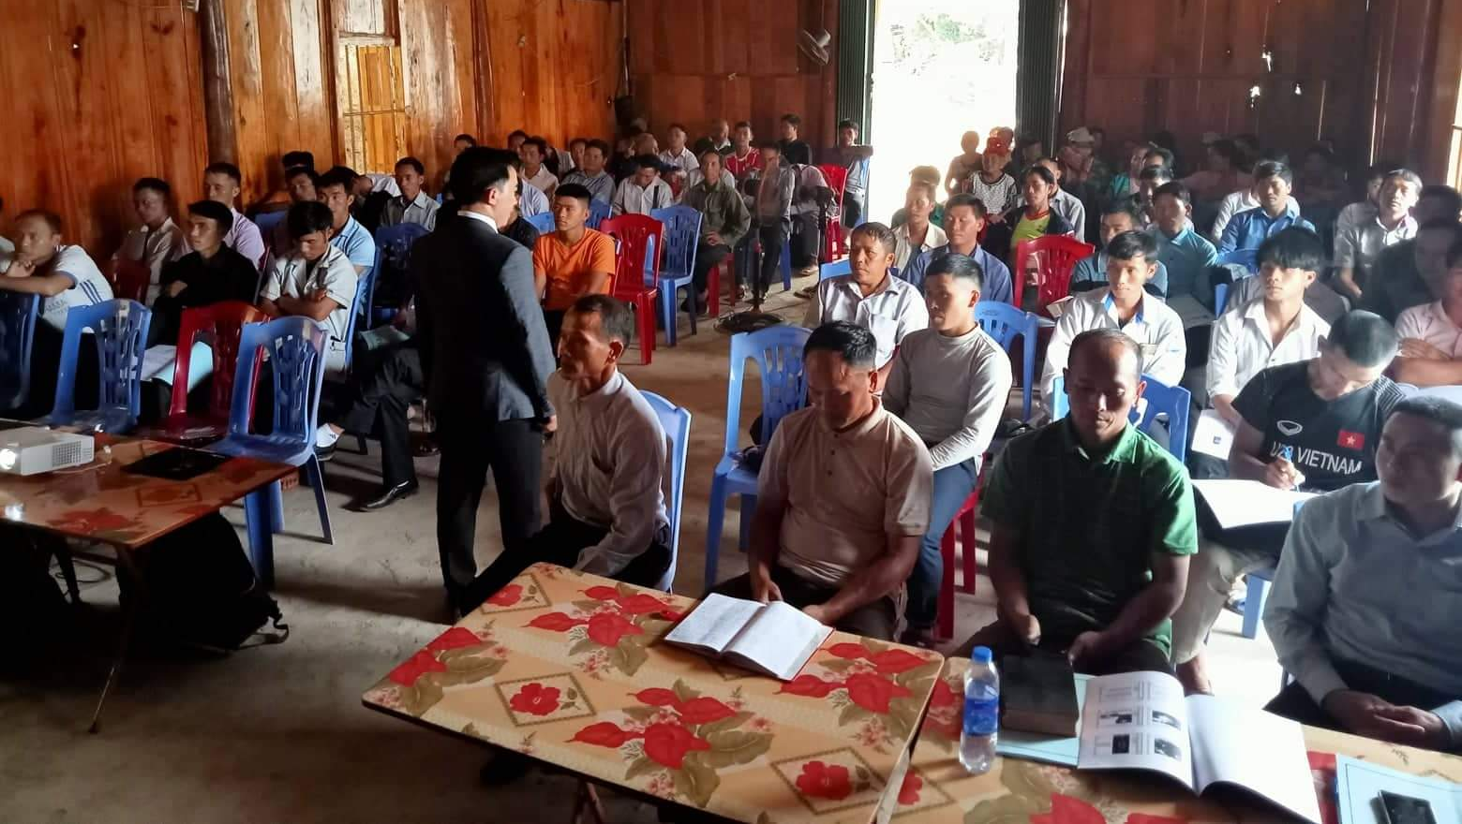
Rural training in Vietnam continues
Notes:
In addition to the seminary training being provided, a new rural training program developed by WELS missionaries Bounkeo Lor and Joel Nitz is training 700 rural church leaders in the basic truths of the Bible, with 700 more church leaders targeted for future training. Twelve of the new HFC graduates were commissioned to serve as instructors in the program
Online courses led by full-time professors Bounkeo Lor and Joel Nitz (pictured) continue to be taught to rural church leaders of the Hmong Fellowship Church (HFC) while residency visas for Lor and Nitz and HFC government registration are still pending.
Learn more at wels.net/vietnamhmongoutreach.

Slide 16
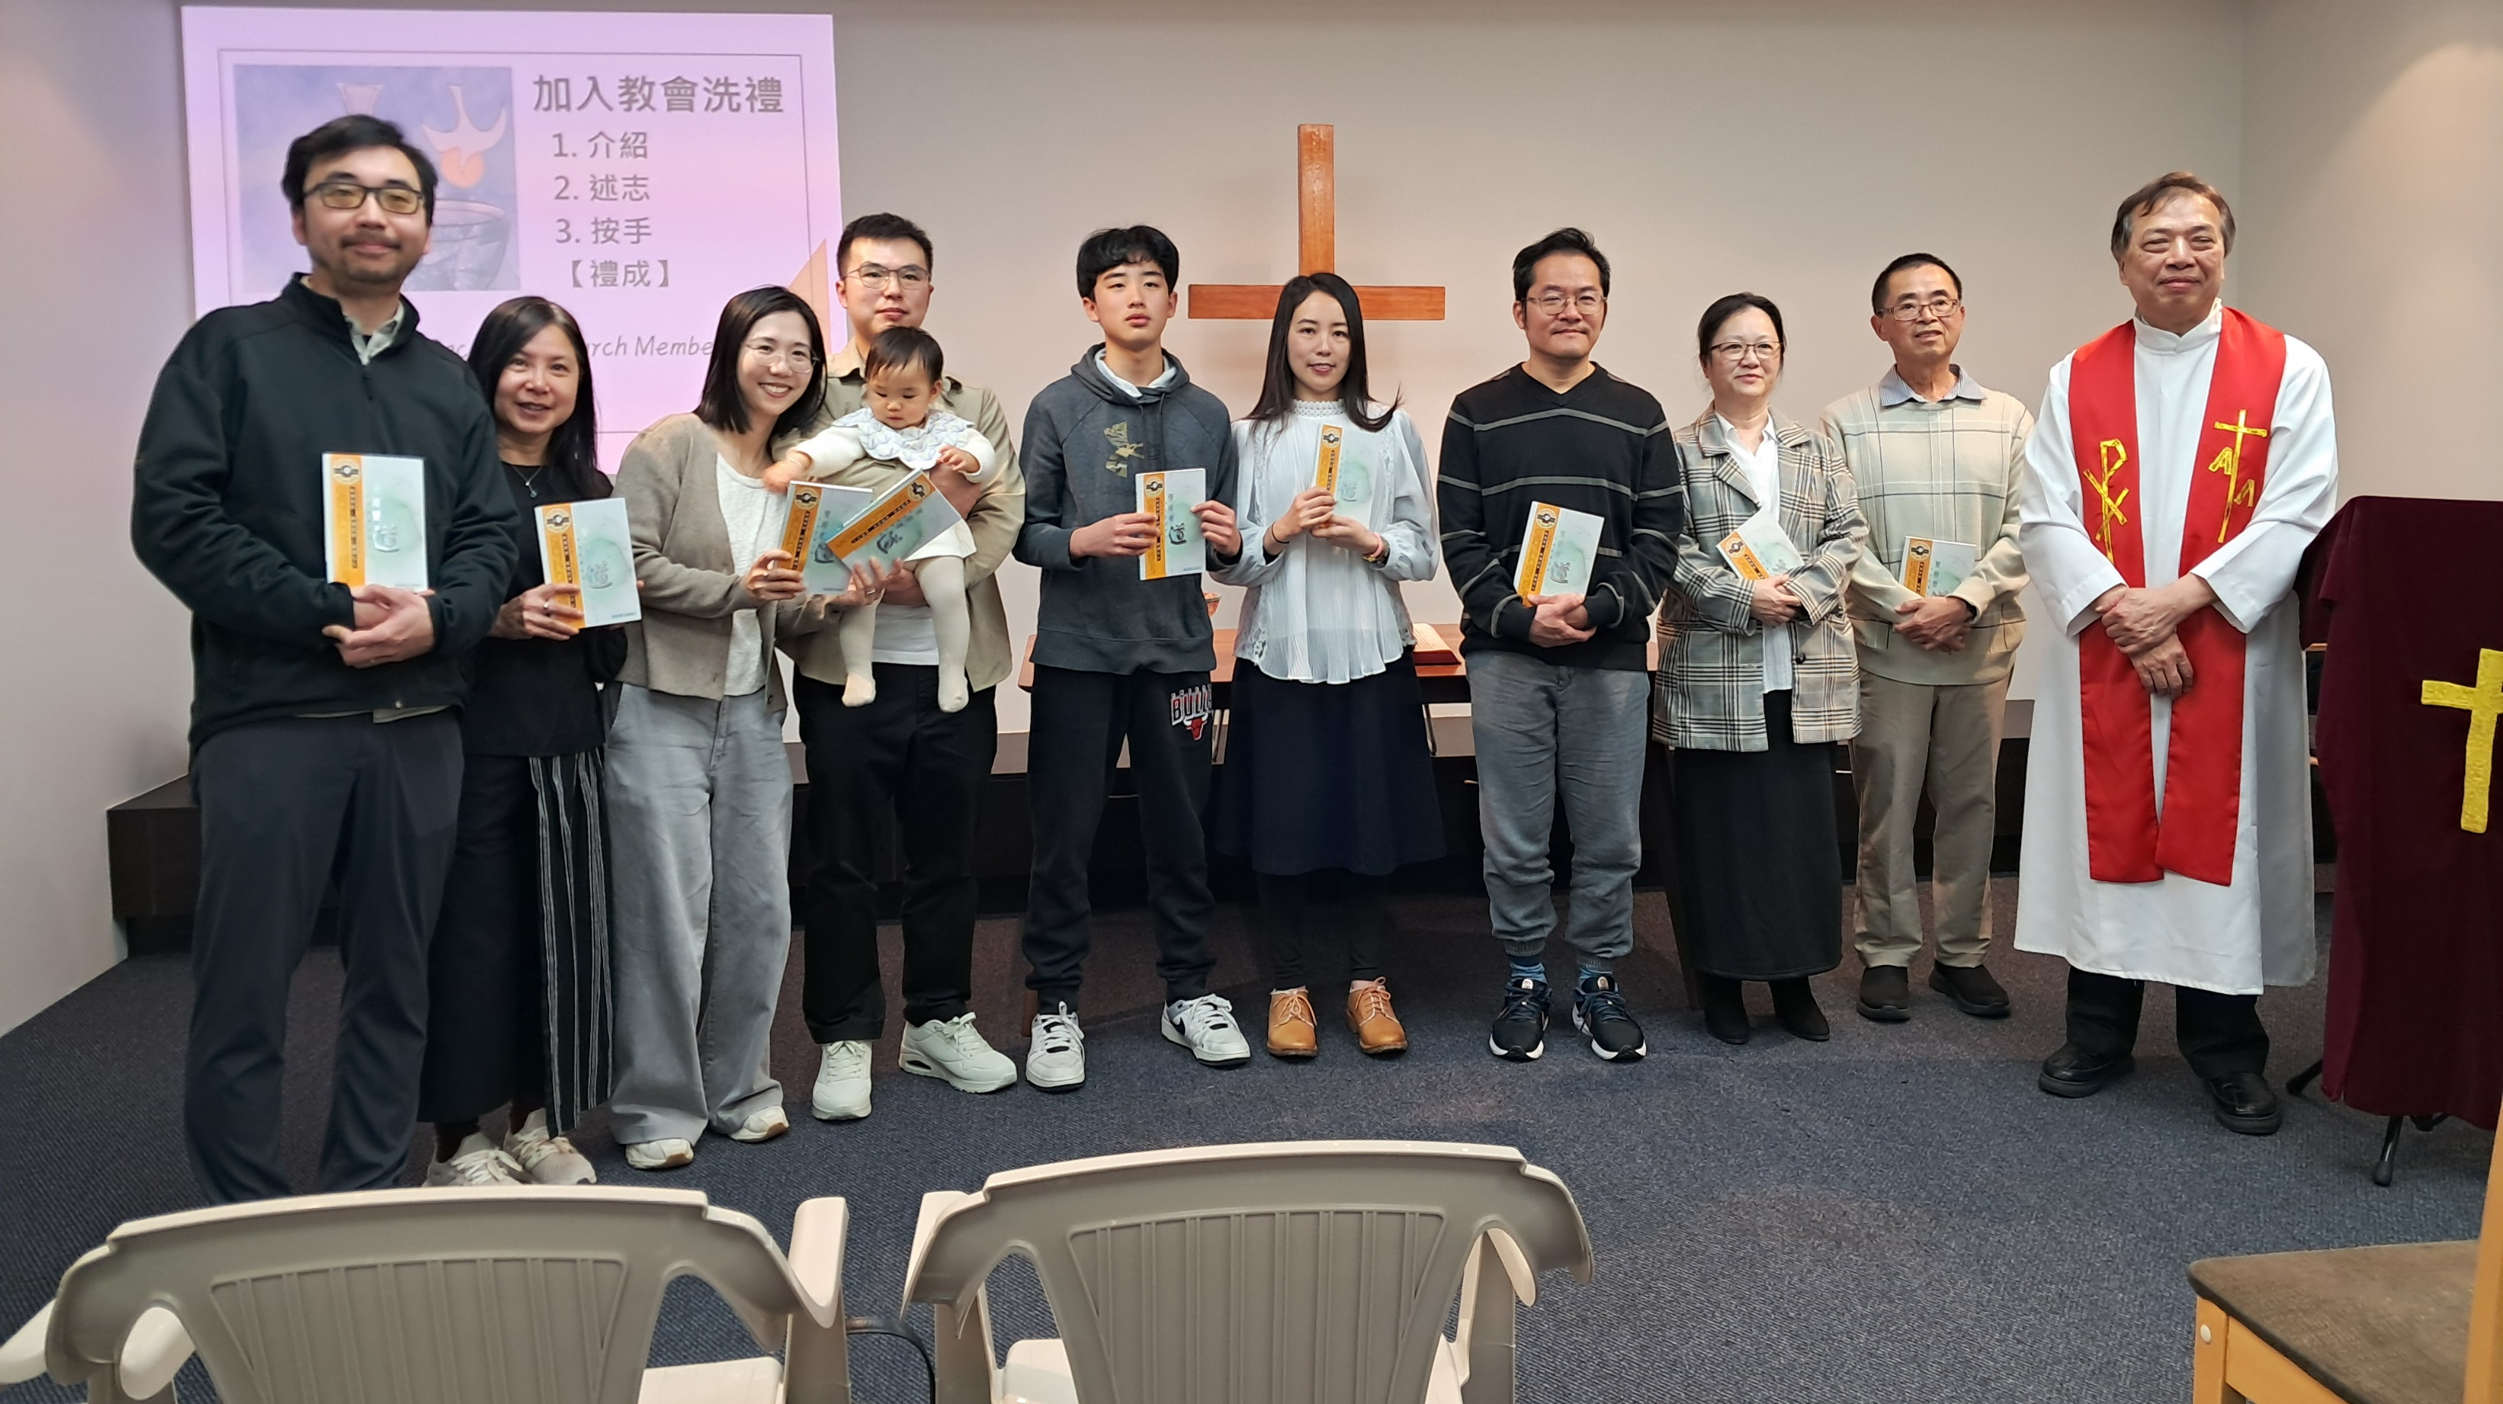
New mission work in New Zealand through SALEM
Notes:
Years ago, a few South Asian Lutheran Evangelical Mission (SALEM) members who immigrated from Hong Kong to New Zealand began meeting online with SALEM leadership for Bible Study and fellowship. This group, located in Auckland, has grown to over 20 members. In January 2023, they began a monthly worship gathering facilitated by local leaders. Rev. Titus Tse (pictured right), retired chairman of SALEM in Hong Kong, moved to New Zealand in mid-2025 to help lead this group. Pictured: Eleven people were welcomed into membership as founding members of SALEM New Zealand Lutheran Church, and two individuals (a child and adult) were all baptized during a service held in October 2025.
WELS is excited to continue assisting our sister church SALEM as they foster this new mission in New Zealand.

Slide 17
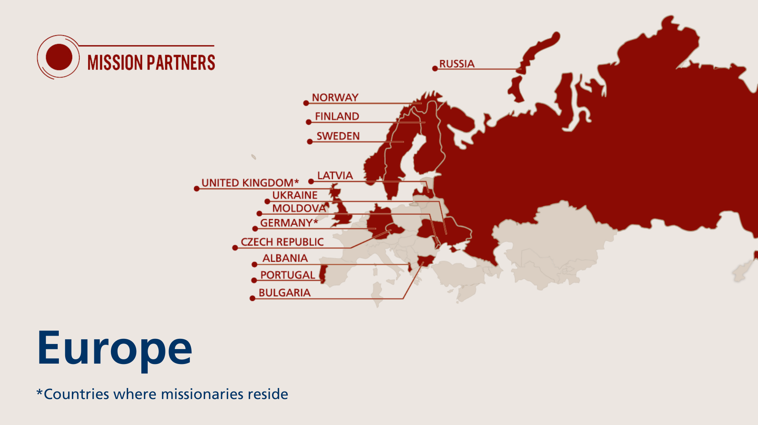
Notes:
The Europe mission team partners to share Christ’s grace across the continent, supporting gospel outreach and assisting with theological education and ministry training in 12 different countries. This work is carried out through collaborative ministry efforts with sister churches, grounded in a shared confession of faith. Three WELS missionaries reside in Europe.
Fast facts
Mission partners in 13 countries
3 missionaries

Slide 18
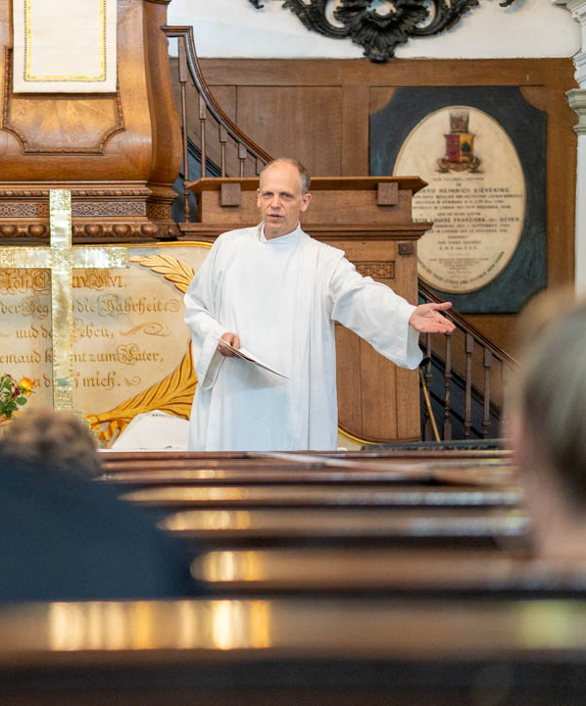
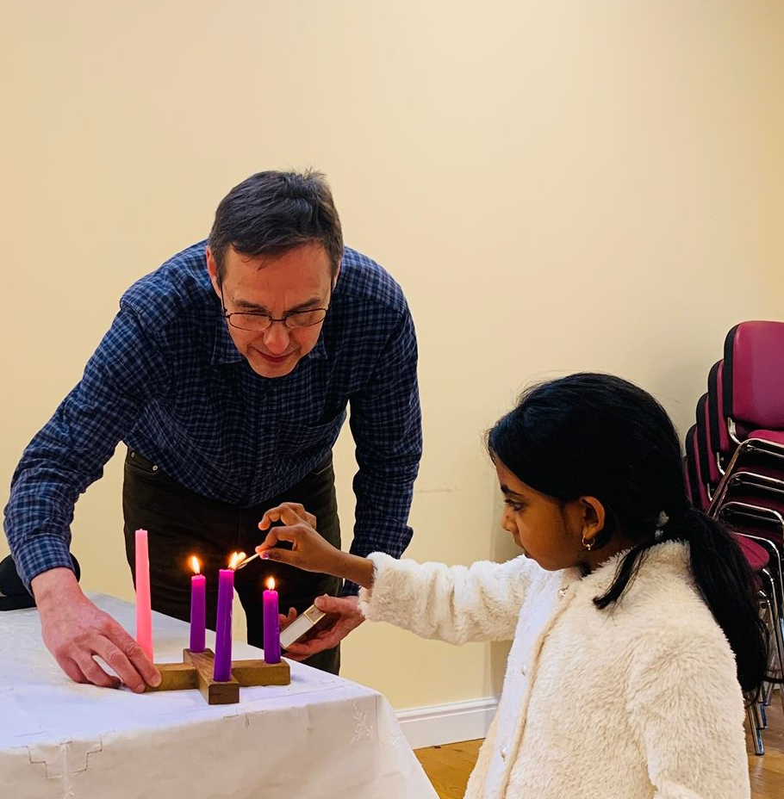
Mission work in London underway
Notes:
Mission work in the United Kingdom is centered in London, where Missionary Mike Hartman is leading outreach in one of the most diverse cities in the world. Through weekly worship, Bible study, and outreach such as hosting Bible-based book clubs in local pubs, Hartman is building relationships and connecting people from many backgrounds to God’s Word.
This growing ministry is expanding beyond London through new contacts and small-group gatherings across the country. One example is Lawrence McCatty (pictured right), who returned to the U.K. as a WELS Lutheran before missionaries were established and became part of the core group supporting this work. Today, he leads the group in Wolverhampton while training through the Pastoral Studies Institute.
Read more about Lawrence McCatty at https://wels.net/from-a-uk-baptist-to-a-confessional-lutheran-pastor/.

Slide 19
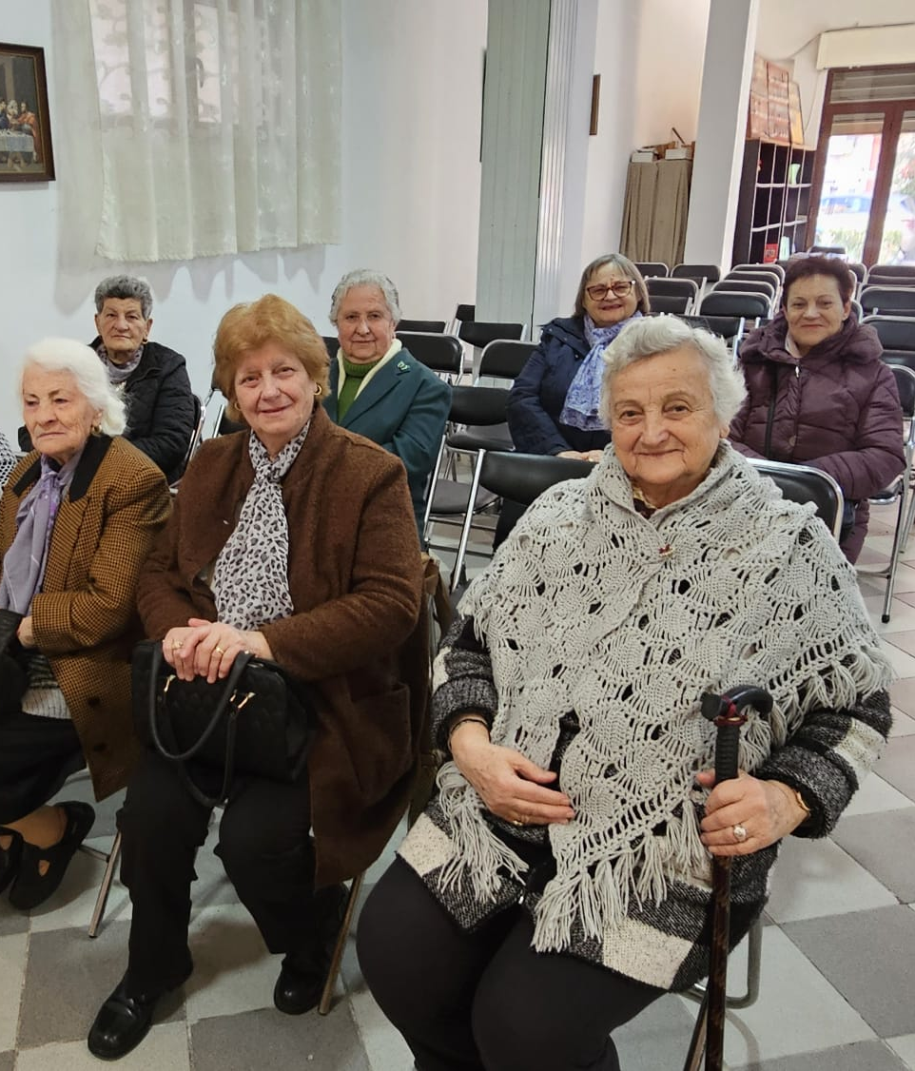
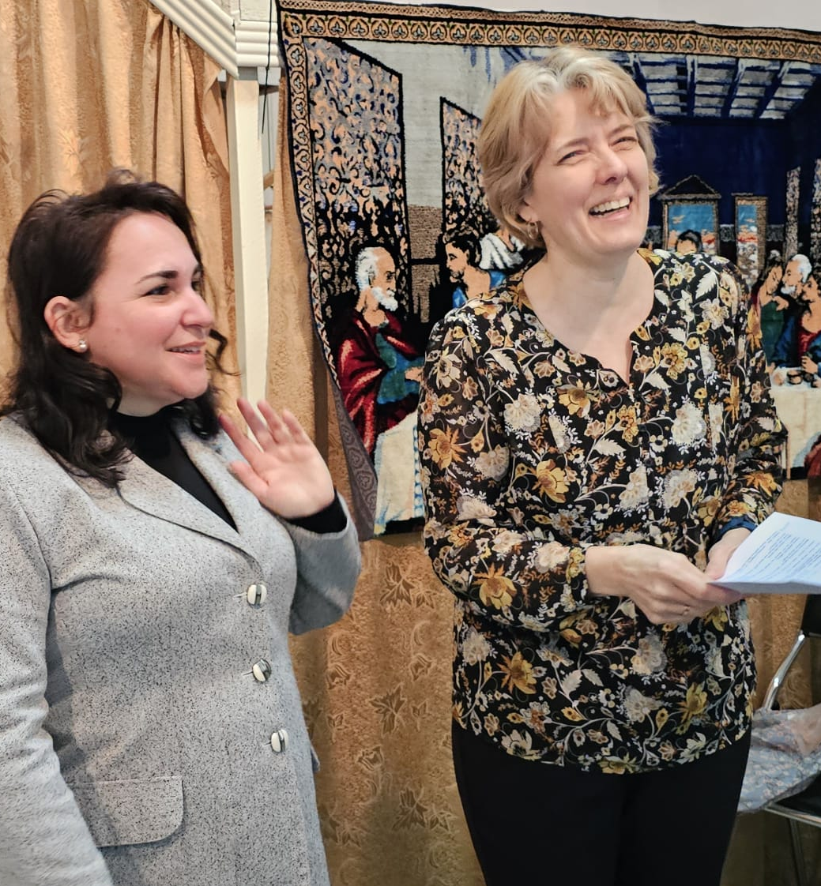
Jennifer Wolfgramm leads women’s ministry efforts across Europe
Notes:
Jennifer Wolfgramm, wife of Missionary Luke Wolfgramm, was recently called by the Europe Team to serve women in Europe. Jennifer travels with Missionary Wolfgramm, building relationships and learning about opportunities for women’s ministry in our sister churches on individual, congregational, and inter-European levels. As her role grows, she looks forward to engaging in more mentoring, teaching, praying with, and encouraging women across Europe.
Pictured: Jennifer Wolfgramm leads a new ministry opportunity for women in Albania. On Wednesday, February 25th, ten women gathered in Durrës for a dedicated women’s Bible study. The study created space for meaningful conversation and connection, and it was a positive experience for everyone involved. Jennifer looks forward to continuing these women’s Bible studies and strengthening faith-filled friendships whenever possible in her new role as Women’s Ministry Coordinator
While she led the women’s study, her husband, Missionary Luke Wolfgramm, partnered with Pastor Nikolla Bishka to prepare a Lenten Bible study series, with 31 people attending the first session led by Missionary Wolfgramm.

Slide 20
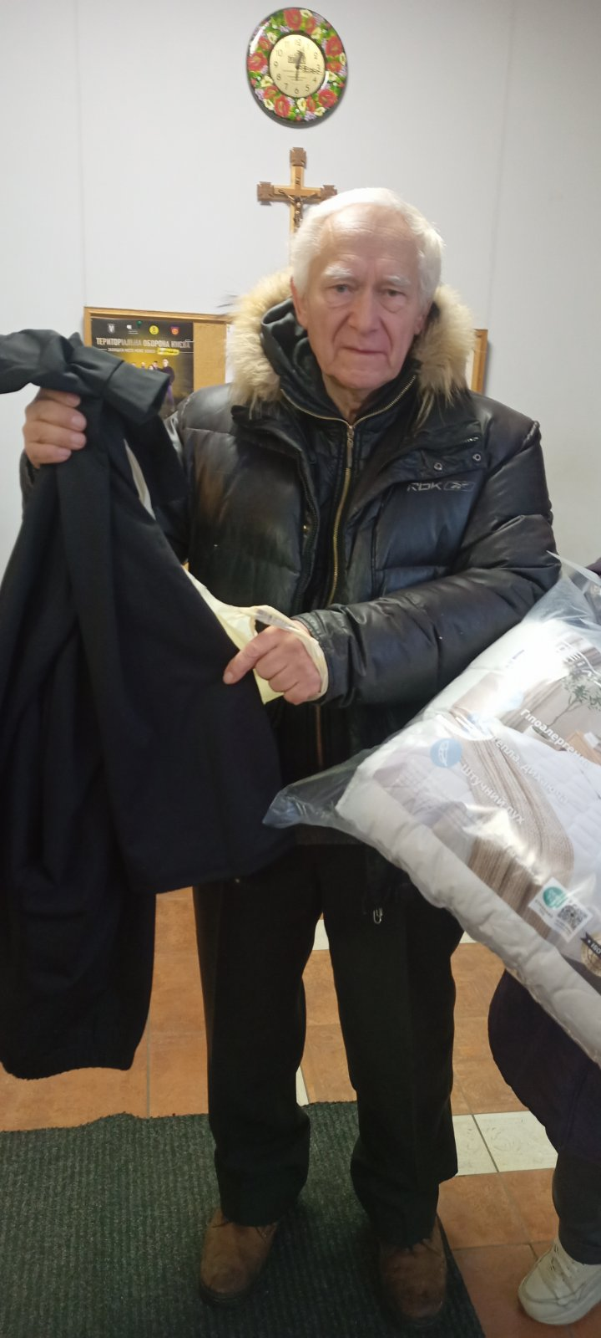
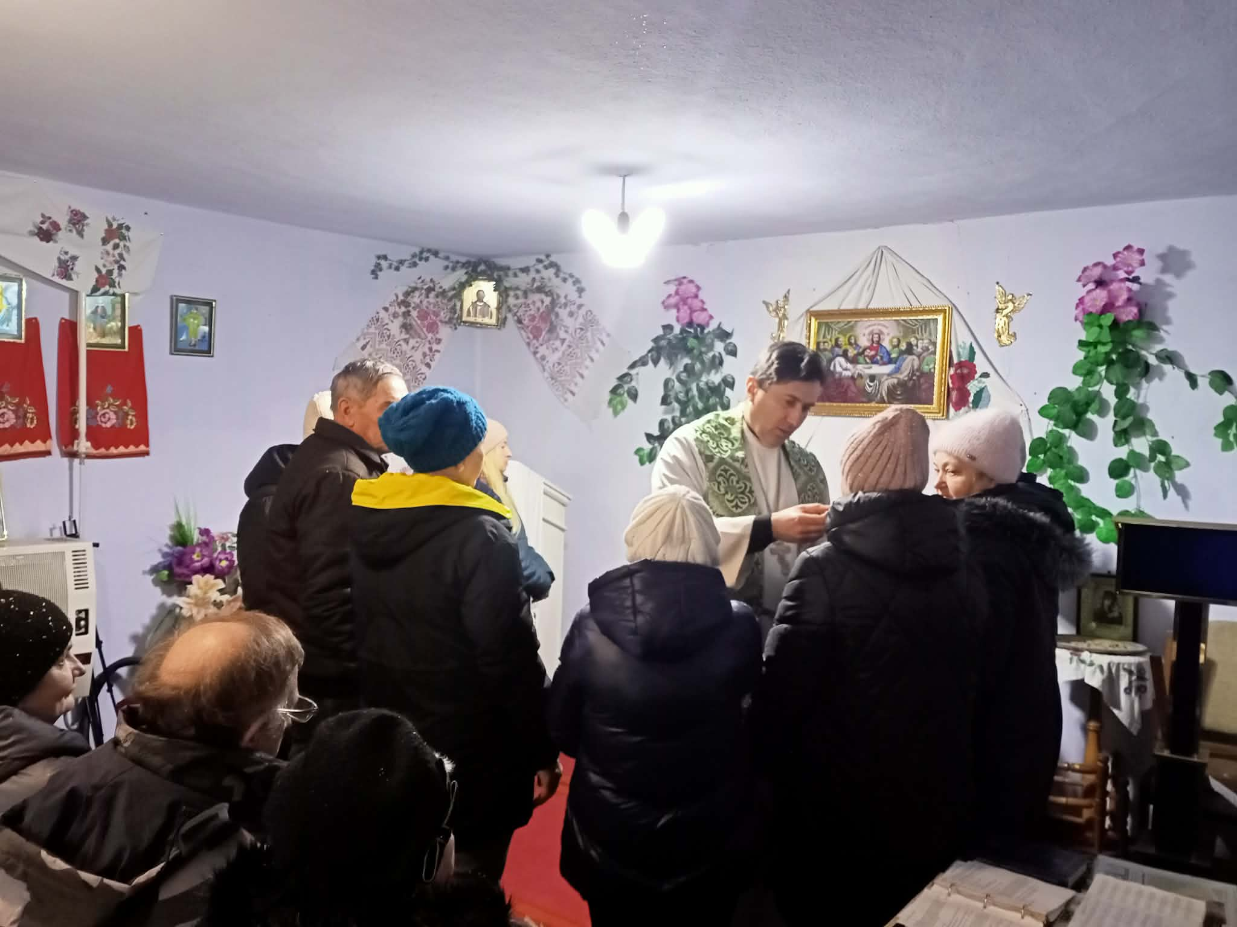
God’s work in Ukraine continues
Notes:
Even amid continuing war and widespread hardship, God’s work through the Ukrainian Lutheran Church (ULC) continues as congregations remain active in worship, mercy, and outreach. With support from WELS prayers and offerings, the ULC has been able to provide essential aid such as food, fuel, medicine, clothing, and heating supplies to congregation members and neighbors affected by displacement, winter conditions, and infrastructure damage. Rather than keeping this aid only for themselves, ULC members have shared generously within their communities, creating new opportunities for Christian witness. Through these works of love, many non‑Christians have come into contact with the gospel, leading new people to worship, instruction, and confirmation, even as pastors continue preaching, caring for the needy, and encouraging God’s people in the midst of ongoing instability.

Slide 21
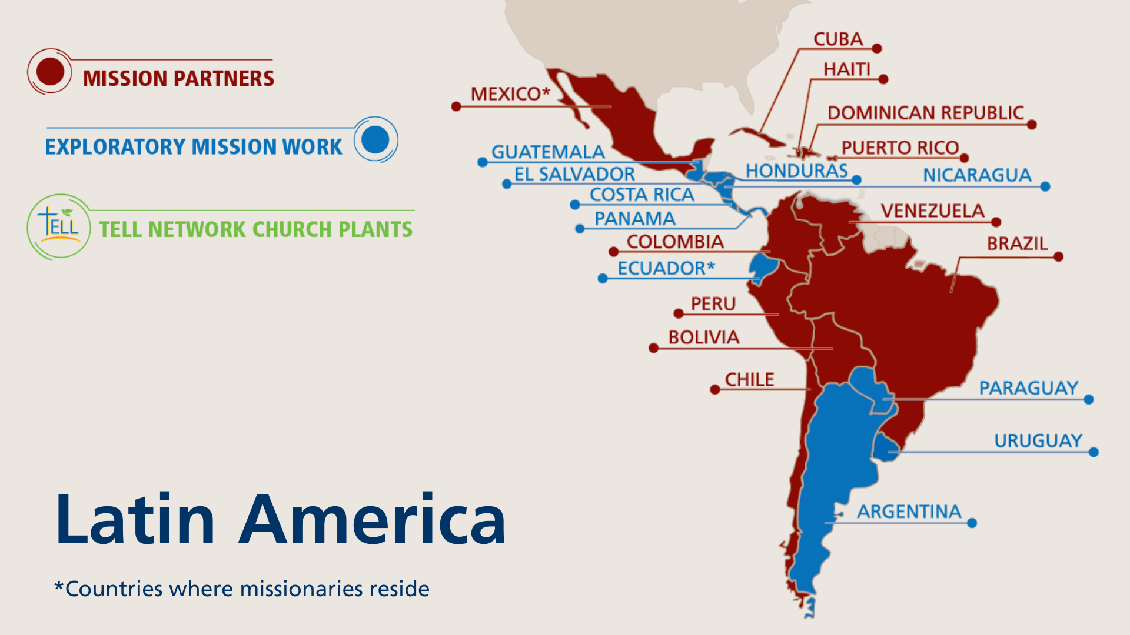
Notes:
The primary focus of the One Latin America Team is Academia Cristo. Academia Cristo is a multi-faceted effort which seeks to 1) make disciples in Latin America by sharing the message of God’s grace with as many people as possible, 2) identify and train potential church planters, and 3) encourage those church planters to make disciples who plant even more churches. The One Latin America Team uses social media to promote Academia Cristo throughout Latin America.

Slide 22
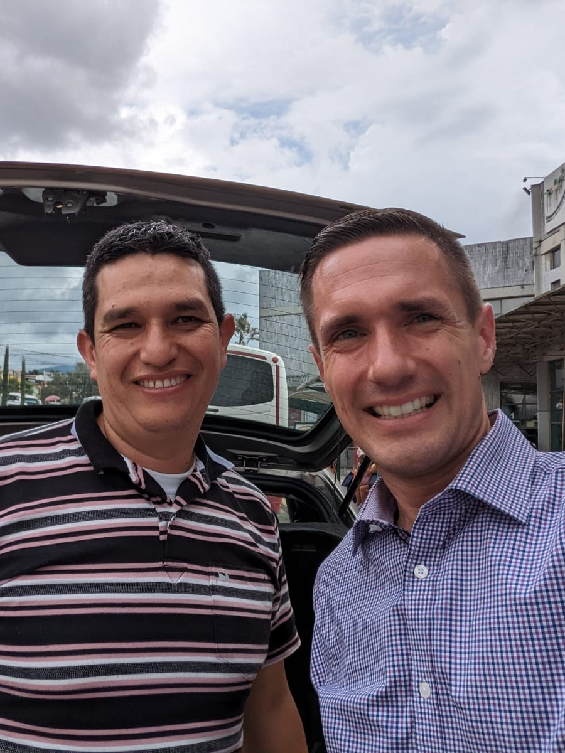
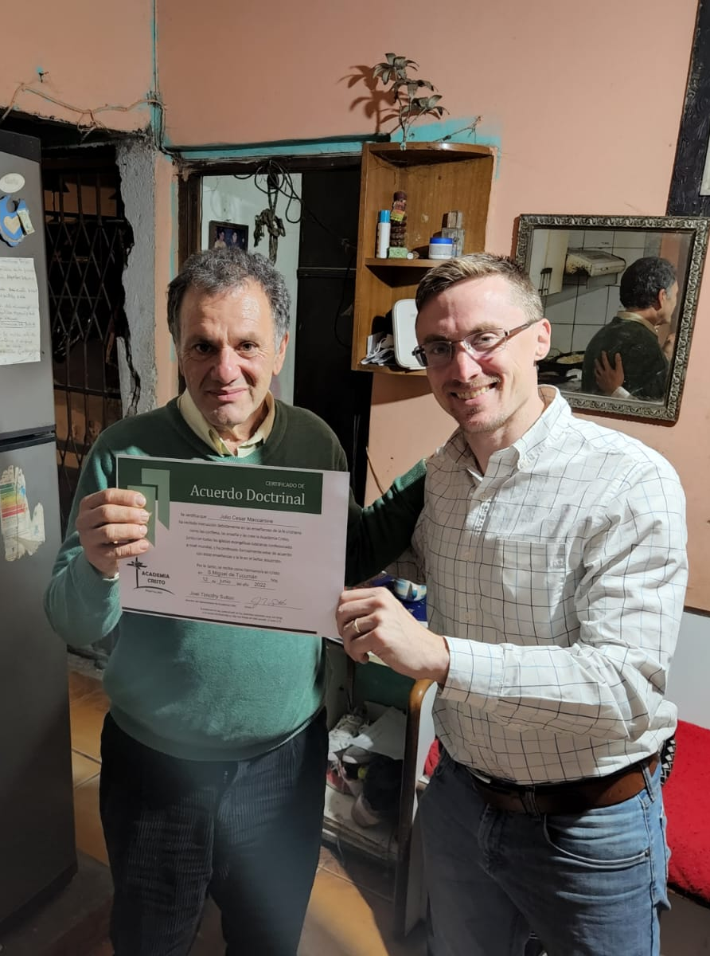
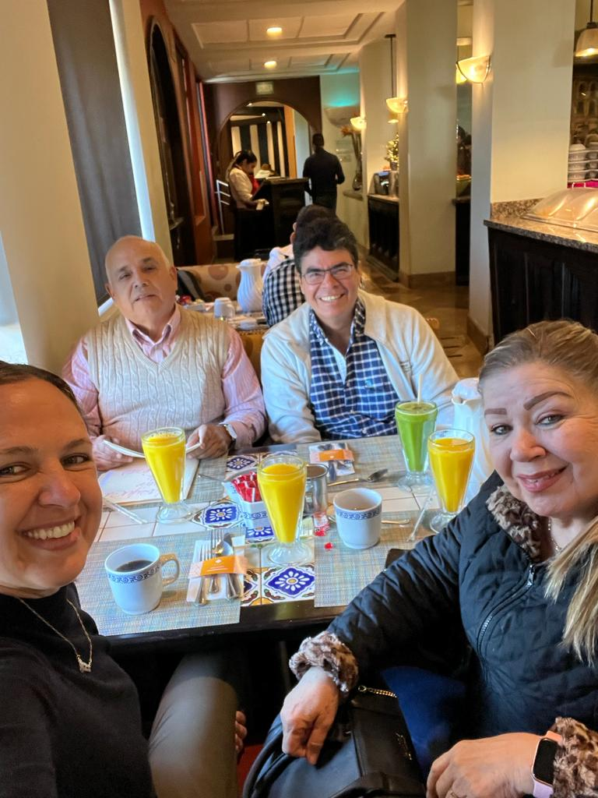
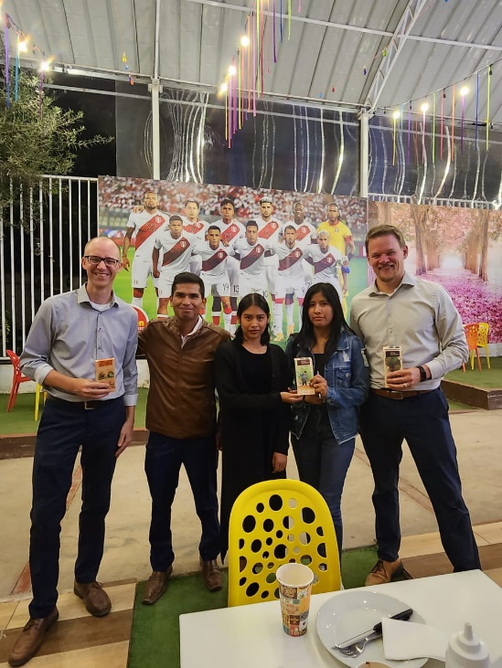
1,830+ students
Have completed at least one live Academia Cristo class online
Notes:
Pictured: Confirmands of Academia Cristo outreach efforts from across Latin America
Amazing blessings through Academia Cristo:
An average of 50+ students complete the Self-Study Level of courses each week
1,830+ students have completed one Discipleship Level live course
179+ students have completed the Discipleship Level (13 live courses)
57 Academia Cristo students are actively leading church plants (Grupos Sembrador)

Slide 23
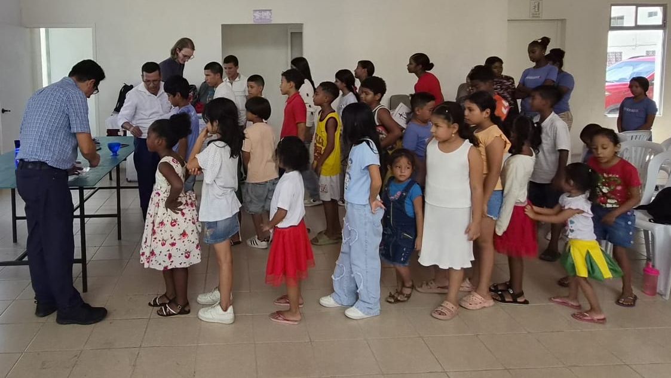
42 Baptisms in Guayaquil, Ecuador
Notes:
The One Latin America Team continues to see strong, measurable momentum across the region, with 57 active church plants (Grupos Sembrador) currently being led by trained local leaders across Latin America.
Ecuador provides a clear example of this fruit. Missionary Nixon Vivar and Vicar Jonas Landwehr traveled to Guayaquil, Ecuador, in May 2026 to see firsthand the ministry of Academia Cristo at work through Silvia and Daniel’s church plant.
Each Saturday, Silvia and Daniel gather with their church plant at a community center to share God’s Word. Through these regular gatherings, many people—including children and young adults—have been led to learn more about God’s promises in baptism. On May 9, 2026, 42 children and young people were baptized (pictured). Vicar Landwehr had the special opportunity to perform his first baptisms, baptizing 13 children, while Missionary Vivar baptized 18 individuals and Daniel baptized 11.

Slide 24
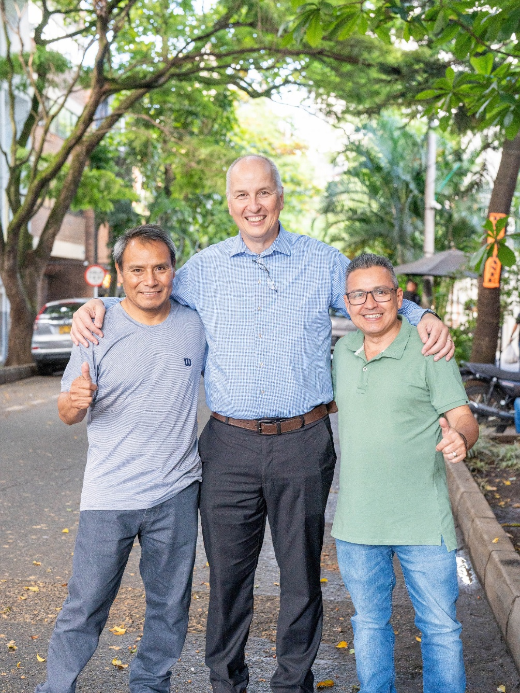
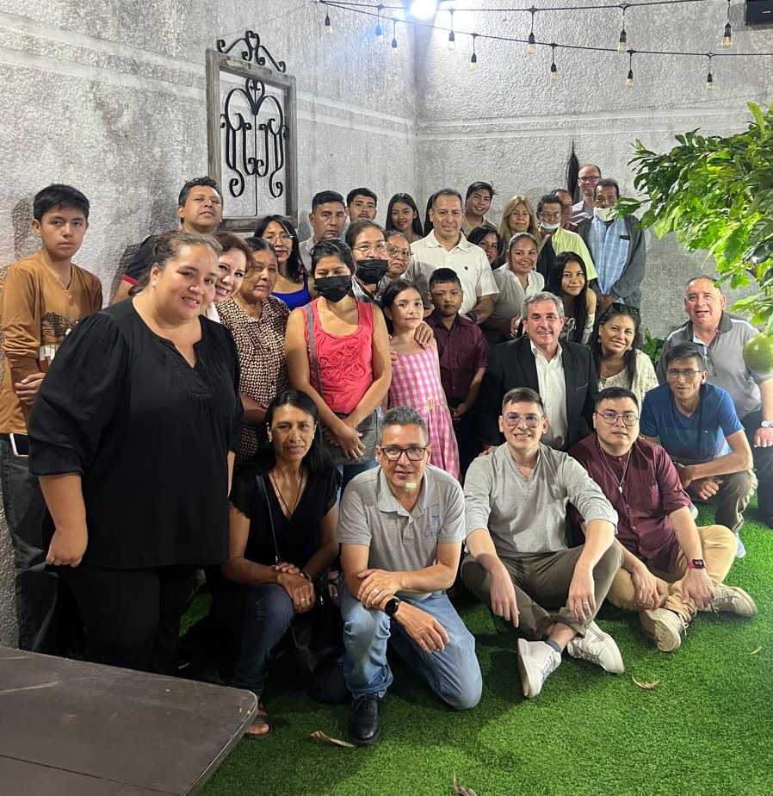
Iglesia Cristo WELS Internacional welcomes new church plants into fellowship
Notes:
Iglesia Cristo WELS Internacional, WELS’ sister church, was formed in 2021 through the partnership of WELS sister churches across five countries throughout Latin America. This international synod is also where Academia Cristo church plants are welcomed into fellowship after completing a two-year confessional process to become full-fledged churches.
A maxillofacial surgeon in Cochabamba, Bolivia, named Eduardo Milanesi became an Academia Cristo student in 2020. In February 2023, Eduardo completed the studies prepared for church planting groups and his group was received by Iglesia Cristo WELS Internacional as a congregation, the first Academia Cristo church plant to do so. He has now launched a second group in Santa Cruz (pictured right), recently gathering over 30 eager listeners to God’s Word.
The church group in Tenancingo, Mexico, led by Juan Reyes (pictured far left) was formed after Reyes learned God’s Word and how to share it through Academia Cristo. He began by sharing the gospel with his family in 2021, and the group has since grown to a congregation of about 45 members. In October 2025, the congregation was welcomed into fellowship with Iglesia Cristo WELS Internacional, becoming the second church plant formed through Academia Cristo outreach to join the synod. Read more about Juan Reyes: https://forwardinchrist.net/juan-reyes/

Slide 25

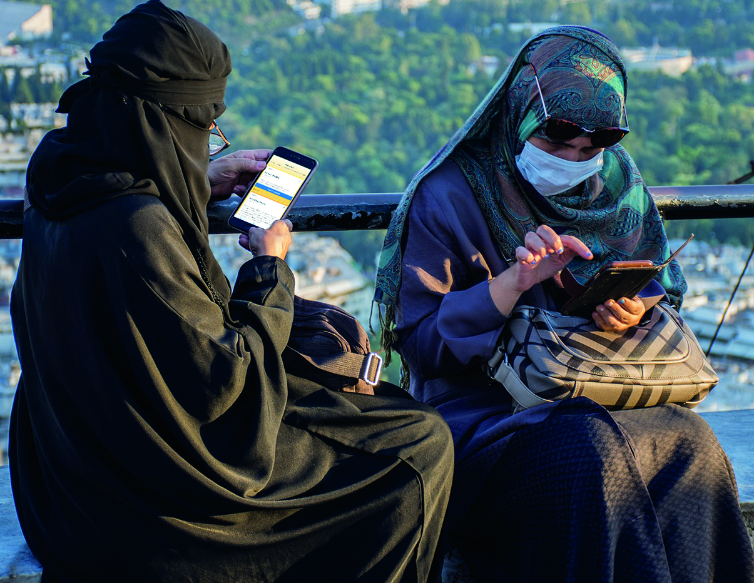

TELL Network:
Think. Evaluate. Learn. Lead.
Notes:
Multi-Language Productions (MLP) has created nearly three million video, audio, and print resources for use in global outreach. Materials have been translated into 56 languages to date—all to share the gospel message with people around the world.
Multi-Language Productions (MLP) operates the TELL Network, an online training and church multiplication program. TELL Network provides Bible study curriculum focused on leadership training for students across the globe, preparing them to gather groups, lead Bible studies, and plant churches. The training method is customized across four programs offered in English, Mandarin, Spanish, and Tagalog.
Fast Facts:
TELL is training students from 58 countries around the world; of these, many do not otherwise have a WELS presence.
There are TELL students in 30 countries across Africa.
More than 130 TELL Network students have been recognized for completing eight or more courses.
There are 38 advanced TELL students leading groups and starting churches.

Slide 26
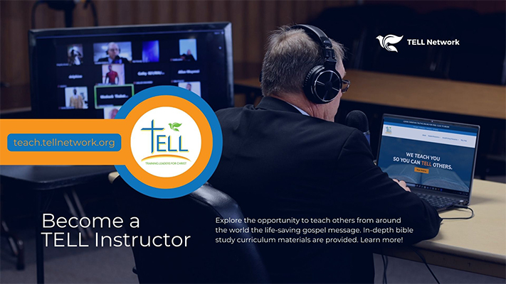
Notes:
TELL English student enrollment is growing fast with more than 500 active students, and they need teachers!
As part of the TELL Faculty, non-missionary TELL instructors are given an honorarium. If you are a mission-minded pastor, have some tech sense and aware of cross-cultural relationships, TELL is in desperate need of your skills to meet the needs of our ever-expanding student body. Most TELL courses average three hours per week for six weeks. The TELL registrar and staff handle most of the administration. Between teaching LIVE Classes, TELL Instructors message their students using WhatsApp. After classes are complete, the instructor collects and grades students’ final projects.
If you are interested in teaching for TELL, contact TELL Network at ask@tellnetwork.org for more details or visit teach.tellnetwork.org.

Slide 27
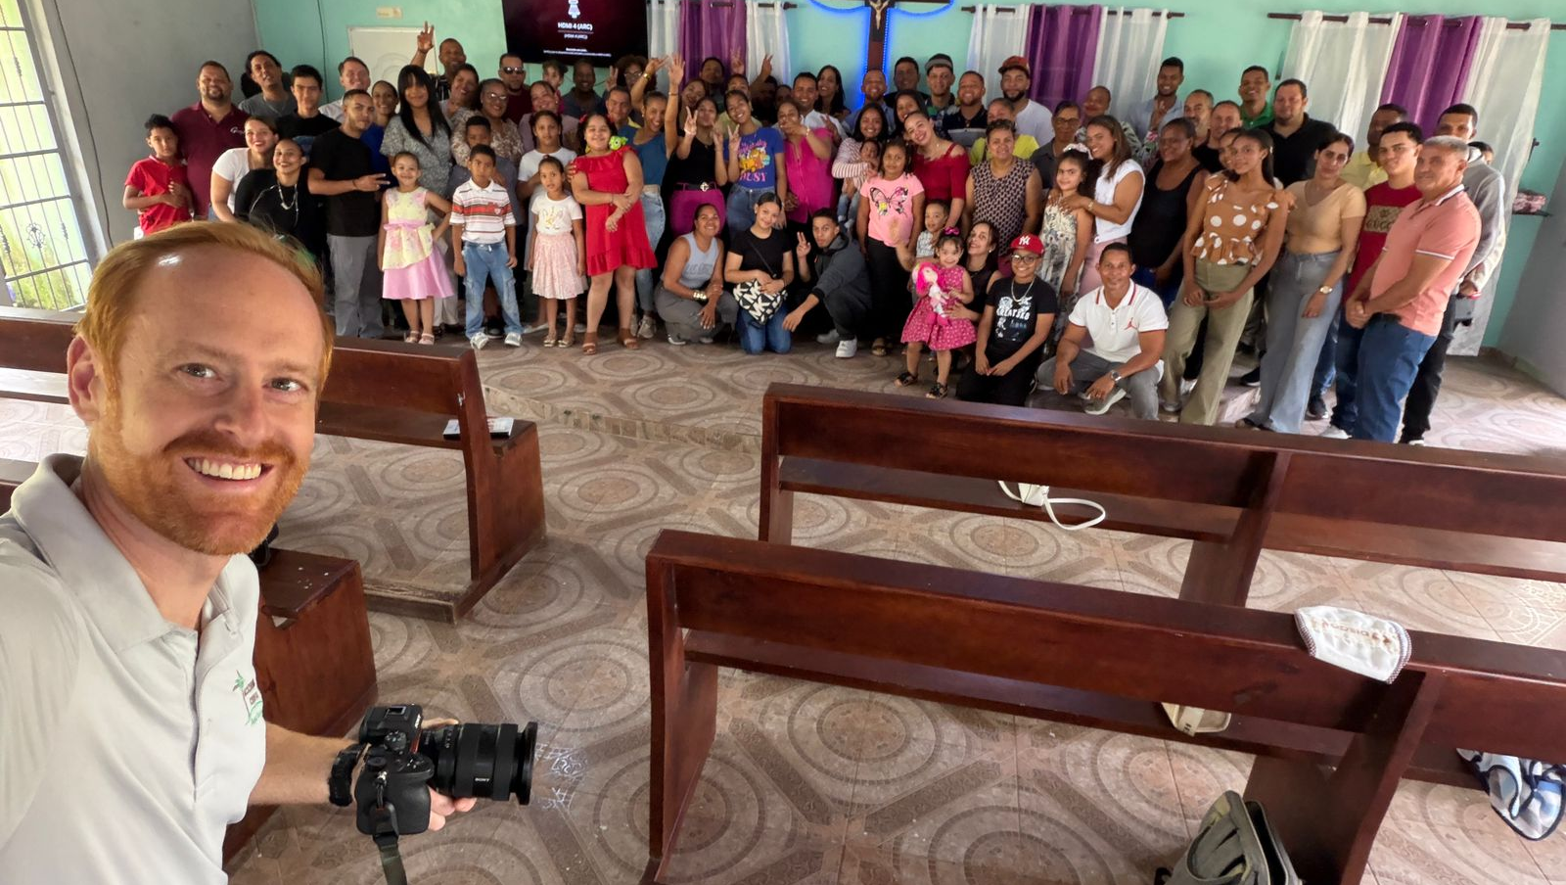
Missionary Jon Gross – Innovation consultant
Helping teams use technology to spread the gospel
Notes:
Mr. Jonathan Gross serves as Innovation Consultant for WELS World Missions. He works with world mission teams and national church leaders to develop systems and sustainable strategies that expand gospel ministry around the world. His work includes guiding technology and training initiatives, building tools for collaboration across cultures and languages, and helping local leaders use digital resources to reach more people with the gospel.
One project he is currently working on is the Lutheran Leader’s Companion, a secure, multilingual platform that connects confessional Lutheran leaders across the globe. This platform enables verified leaders to teach, learn, and collaborate across languages using AI supported translation guided by theological glossary safeguards to preserve confessional accuracy.
Pictured: Missionary Jon Gross on a trip to WELS’ sister church in Dominican Republic in May 2026.

Slide 28
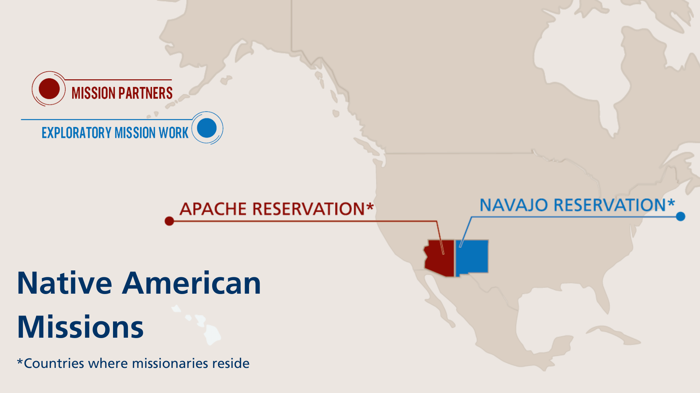
Notes:
The Apache mission in Arizona celebrated 125 years of God’s blessings in 2018 as the first world mission of WELS. Today, WELS’ Native American mission serves nine churches and two elementary schools, and it provides theological education through the Apache Christian Training School (ACTS) on the White Mountain and San Carlos Apache reservations in Arizona. New Native American outreach is also occurring in the Four Corners area of Arizona, New Mexico, Utah, and Colorado through the Native Christians Network.
Fast facts
Baptized members: 2700+
Congregations/preaching stations: 9
K-8 schools: 2
Missionaries: 6 (1 Apache)
Teachers: 17 (5 Apache)
Apache Christian Training School students: 60

Slide 29
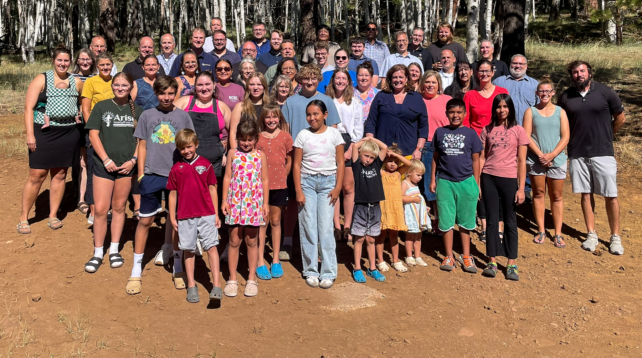
Native Christians Network stands ready to reach out with the gospel to the 574 Native American Reservations throughout the U.S.
Notes:
Pictured: Members of the Native Christian Team met for their annual meeting/retreat in July 2025. Attendees included the missionaries, national pastors and lay leaders, teachers at the two schools on the Apache reservations in Arizona, and their families. WELS World Missions representatives were also in attendance.

Slide 30
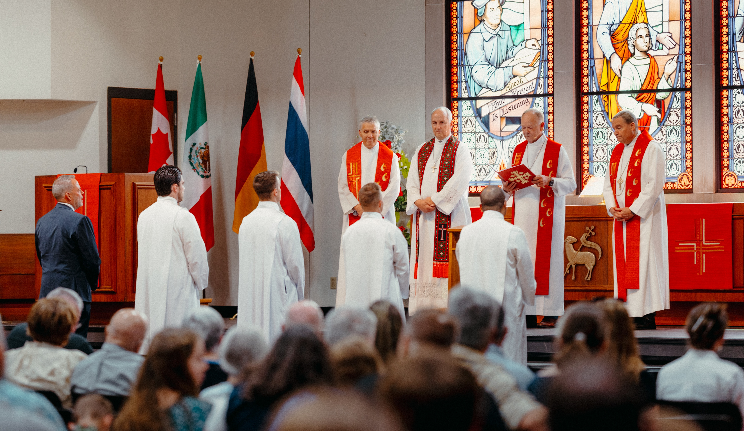

Join us at Taste of Missions for the commissioning of
six new world missionaries
Notes:
Taste of Missions
Saturday, June 13, 2026 | Wisconsin Lutheran Seminary, Mequon, Wis.
Register today for Taste of Missions, a celebration of gospel outreach and the commissioning of new home and world missionaries. Enjoy a special commissioning worship service, ethnic cuisine from mission fields, fellowship with fellow attendees, and firsthand accounts from missionaries about their work.
Six world missionaries/teachers are confirmed to be commissioned at Taste of Missions:
Rev. Dr. Francisco Cossio La Rosa – Missionary, One Latin America Team
Ms. Louisa Felgenhauer – Peridot-Our Savior’s Lutheran School, San Carlos Apache Reservation, Ariz.
Rev. Stephen Gerling - Missionary, Senegal
Rev. Dan Kroll – Missionary, Senegal
Ms. Cindy Lendt – Women’s ministry coordinator, Asia-Oceania Team
Dr. Chris Pluger – Missionary, One Africa Team
If you can’t attend in person, tune into the livestream and join us virtually!
Learn more and register at tasteofmissions.com.

Slide 31

Notes:
Pray. Ask God for more opportunities to reach those who don’t know Jesus Christ as their Savior from sin.
Share. Tell others about the work WELS is doing in the United States and around the world.
Discover. Subscribe to Missions emails at wels.net/subscribe and follow us on Facebook and Instagram @WELSMissions. Request a speaker for your next Mission Festival at wels.net/speaker-request.
GIVE – Visit wels.net/missionsgift or mail checks with your preferred mission designation (e.g. Home or World Missions) in the memo field to:
WELS, Attn. Gift Processing
N16W23377 Stone Ridge Drive
Waukesha, WI 53188

Slide 32
“My name will be great among the nations, from where the sun rises to where it sets. In every place incense and pure offerings will be brought to me, because my name will be great among the nations,” says the Lord Almighty.”
Malachi 1:11

