Slide 1

Engaging Women in Ministry
Presented by Pastor Dennis Klatt

Slide 2
Outline
Current WELS Landscape
Societal Landscape
Engaging Men and Women with the Word
Engaging Women’s Input
Engaging Women’s Gifts
Local Ministry Analysis
Local Ministry Adjustments
Q&A

Slide 3

The Current WELS Landscape
The number of women who leave the WELS is equal to that of men.
80% of WELS women ages 18-34 indicate they aren’t using their gifts in any manner to support local congregation ministry. (The same is true for men in WELS within this age group)
Surveys indicate many WELS Women feel there is ambiguity regarding roles in which they may serve without violating Scripture.

Slide 4
The Current WELS Landscape
WELS Women often feel their gifts and input are being under utilized for ministry in areas beyond traditional roles that don’t involve the exercise of authority over men.
WELS women are often left with the impression their service in the kingdom is valued less than the service of men.
Women frequently report longing for deeper relational connection, mentoring, and support structures within congregations.
Notes:
WELS Women’s Ministry Conference (2024) Exit Survey

Slide 5
The Current WELS Landscape
Some WELS women report that service opportunities are communicated in ways that emphasize what women may not do, rather than positively articulating what they may and are encouraged to do.
Many WELS women find deep fulfillment in women’s Bible studies, LWMS, and service roles which they are able to make wholly their own.
The majority of WELS Women want men to lead in a sacrificial Christ-like way.
Notes:
WELS Women’s Ministry Conference (2024) Exit Survey

Slide 6
The Current WELS Landscape
WELS women aren’t looking to supplant the divinely established male headship role. They are looking to be enabled and respected in their helper role.
Notes:
WELS Women’s Ministry Conference (2024) Exit Survey

Slide 7

Societal Landscape ~ Feminism
1st Wave 1800-1920
Key goals:
Women’s right to vote (suffrage)
Property rights
Access to education
Basic legal personhood for women
Characteristics:
Rooted in liberal democratic ideals
Focused heavily on changing laws
Led primarily by middle‑ and upper‑class white women

Slide 8
Societal Landscape ~ Feminism
2nd Wave 1960-1980
Key goals:
Workplace equality and anti‑discrimination
Reproductive rights (birth control, abortion access)
Ending gender‑based violence
Challenging traditional gender roles
Expanding women’s participation in all spheres of society (e.g. Breaking the glass ceiling)
Characteristics:
“The personal is political”
Included consciousness‑raising groups
More systemic critique of patriarchy (“It’s a man’s world”)

Slide 9
Societal Landscape ~ Feminism
3rd Wave 1990-2010
Key goals:
Inclusion of race, sexuality, class, ability, and cultural identity within feminism
Challenging gender norms and binaries
Reclaiming femininity and sexuality
Expanding the definition of “woman” and gender expression
Characteristics:
Strong focus on intersectionality (term by Kimberlé Crenshaw); advantaged/disadvantaged; oppressor/oppressed
Emphasis on individuality and personal empowerment
Critique of earlier waves for being too white, middle‑class, and cisgender

Slide 10
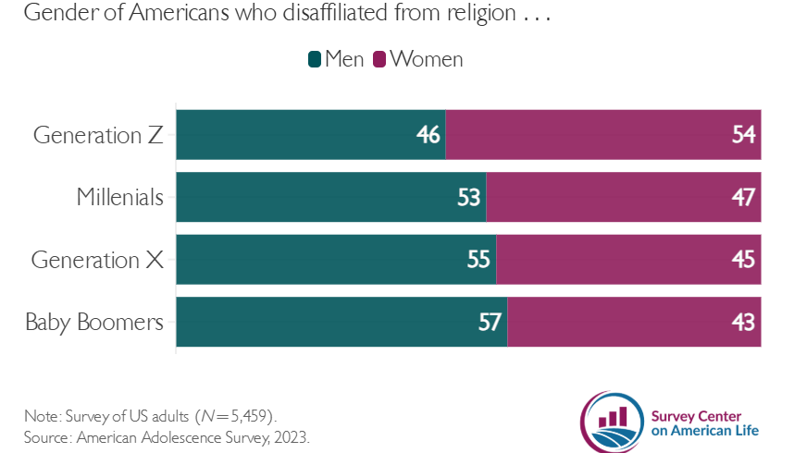

Slide 11
Blue and White Collar Cultural Influences
Blue Collar Culture
More likely to recognize and appreciate physical and psychological gender differences
Clear hierarchy is preferred
Work is viewed separately from identity
Action oriented
Shorter planning horizon
White Collar Culture
More likely to view gender roles as a construct
Authority tied to expertise
Career role is part of one’s identity
Process oriented
Longer planning horizon

Slide 12
10 Minute Breakout Discussion
What are the generational and cultural differences you perceive among the men and women in your local congregation?
How do those differences influence that demographic’s perception of as well as their interest and participation in congregation ministry?
How do you address these generational and cultural differences as a shepherd of souls? (e.g. What biblical truths need emphasis for each group?)

Slide 13
Engaging Men and Women with the Word
(A Matter of Stewardship)
Romans 12:4-6
Just as each of us has one body with many members, and not all members have the same function, so in Christ we who are many are one body, and each member belongs to one another.
We have different gifts according to the grace given us. If one’s gift is prophecy, let him use it in proportion to his faith.
Maximizing the gifts of women is a matter of faithful stewardship for both men and women.

Slide 14
Engaging Men and Women with the Word
(Embrace God’s Design Differences)
Men
Value accomplishments above relationships
Less dependent upon external validation ~ “Looks good to me.”
Less afraid to rock the boat (17% of men have harmony in their top five CliftonStrengths)
Women
Value relationships above accomplishments
Frequently seek external validation ~ “How do I look?”
More averse to rocking the boat (21% of women have harmony in their top five CliftonStrengths)

Slide 15
Engaging Men and Women with the Word
(Embrace God’s Design Differences)
Dominant Traits in Men
Decisiveness
Risk tolerance
Task clarity & focus
Dominant Traits in Women
Perspective taking
Collaboration skills
Long-term relationship focus
Detailed planning

Slide 16
Engaging Men and Women with the Word
(Divinely Establish Role Differences)
1 Timothy 2:11-14
A woman should learn in quietness and full submission. I do not permit a woman to teach or to assume authority over a man; she must be quiet. For Adam was formed first, then Eve. And Adam was not the one deceived; it was the woman who was deceived and became a sinner.
Faithfully teach the biblical headship principle along with the careful application of it. Distinguish clearly which ministry responsibilities and roles involve the exercise of authority over men and which do not.
Notes:
Reduce the number of oversight groups where possible. Invite women to serve

Slide 17
10 Minute Breakout Discussion
In your own ministry context identify which unbiblical attitudes if any need loving correction. (How will you address them.)
Identify the biblical truths and principles that need encouragement. (How will you address them-Bible class, sermon series, newsletter articles…)
Which design differences between men and women can you better utilize and celebrate in your ministry context?

Slide 18
Engaging Women’s Input
1 Peter 3:7
Husbands, in the same way be considerate as you live with your wives, and treat them with respect as the weaker partner and as heirs with you of the gracious gift of life, so that nothing will hinder your prayers.
Good decisions flow from well informed decision makers. Seek and encourage orderly and humble input from women regarding the ministry of the church. Woman often recognize needs and opportunities men overlook.

Slide 19
Engaging Women’s Input
Utilize open forums
Involve women in advisory roles to oversight groups
Involve women in the congregation’s long range planning process
Utilize surveys when appropriate to seek ideas and gauge the benefits or lack there of regarding current ministry in their lives

Slide 20
Engaging Women’s Gifts
Restructure the congregation’s governance to separate roles from oversight groups that are not by nature authoritative and allow women to use their gifts in keeping with the headship principle.
Younger adults are already over committed to activities. Therefore, they shy away from agreeing to long term ministry responsibilities. Provide short-term or one time volunteer opportunities.
Provide opportunities for older women to mentor younger women.
Utilize women on soul care teams to visit female inactive members.
Validate and celebrate the service of women to the body of Christ.

Slide 21
Engaging Women’s Gifts
Recruit women to visit the hospitalized female shut-ins.
Establish a “Mommy and Me” group.
Utilize adult and teenage women on usher teams.
Organize or publicize area women’s retreats.
Organize female bible study and prayer groups.
Female Led Advent by Candlelight Services
Women’s Ministry Webinars

Slide 22
Local Ministry Analysis
Check the boxes next to areas most in need of enhancement in your congregation
Improving the understanding and application of the biblical headship principle.
Gaining input from women.
Restructuring to better utilize women’s gifts.
Providing spiritual growth, mentoring and mutual encouragement opportunities for women.
Validating and celebrate women’s contribution to the mission of the Church.

Slide 23
Local Ministry Adjustments
Sketch out a prioritized plan to address the areas you highlighted in the previous slide
Issue_____________________________________________________________
Appropriate group to address the issue _______________________
Rationale for improvement _____________________________________
__________________________________________________________________
Desired outcome________________________________________________
Process to communicate the adjustment plan__________________
__________________________________________________________________

Slide 24
Local Ministry Adjustments
Sketch out a prioritized plan to address the areas you highlighted in the previous slide
Issue_____________________________________________________________
Appropriate group to address the issue _______________________
Rationale for improvement _____________________________________
__________________________________________________________________
Desired outcome________________________________________________
Process to communicate the adjustment plan__________________
__________________________________________________________________

Slide 25
Local Ministry Adjustments
Sketch out a prioritized plan to address the areas you highlighted in the previous slide
Issue_____________________________________________________________
Appropriate group to address the issue _______________________
Rationale for improvement _____________________________________
__________________________________________________________________
Desired outcome________________________________________________
Process to communicate the adjustment plan__________________
__________________________________________________________________

Slide 26
Q & A

Slide 27
Source Material
Young Women Are Leaving Church in Unprecedented Numbers - The Survey Center on American Life
Why Young Women Are Leaving the Church More Than Ever – RELEVANT
Women’s Ministry Webinars – WELS
The Quiet Exodus: Dawn Schulz & Rev. Paul Wendland
Jon Hein email summary of WELS 2025 Statistical Report data.

